Slide 1
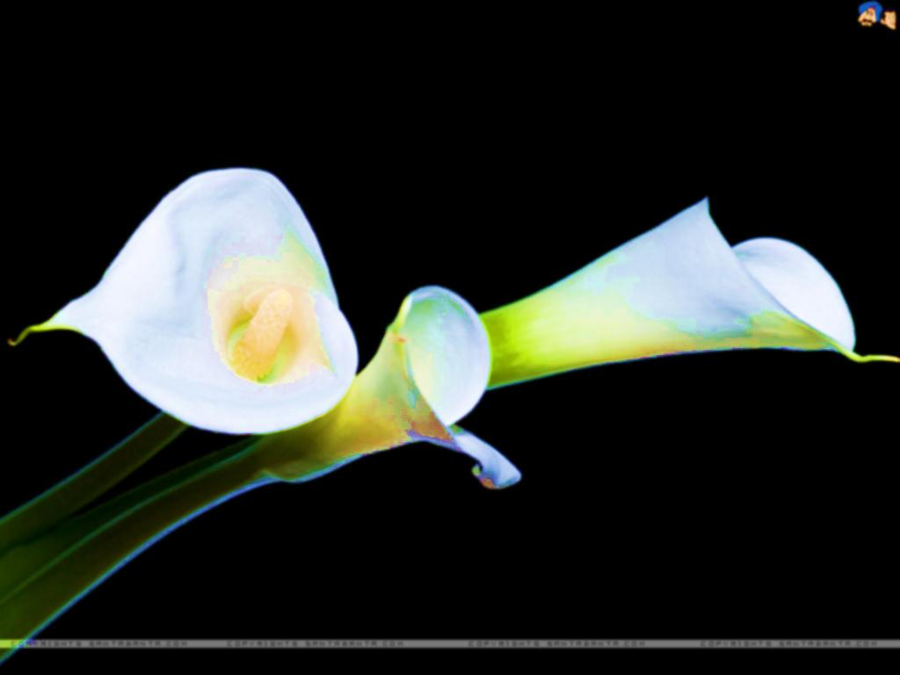
Welcome dear students.

Slide 2
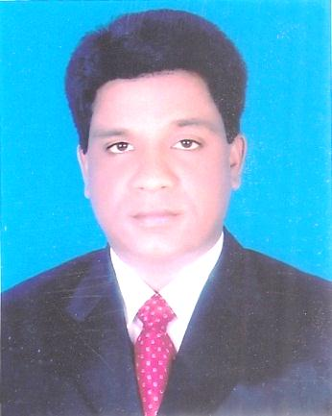
INTRODUCTION
MOHAMMAD AZHARUL ISLAM
Assistant Teacher (English)
Hugra Habib Kader High School
Tangail Sadar Tangail
CLASS: SEVEN
SUBJECT: ENGLISH FIRST PAPER

Slide 3
What do you see in the picture?
A Happy family
Notes:
Showing the picture teacher can ask the question to the whole class. SS can raise their hands. Teacher can ask 2/3 students randomly.

Slide 4
Today our topic
Paul and his family
UNIT: Eight
LESSON: 7

Slide 5
LEARNING OUTCOMES OF THE LESSON
By the end of the lesson the students will be able to
Ss will read and understand text.
Ss will make questions and answers about likes/dislikes.
Ss will Complete guided and semi-guided writing task.
Ss will Infer the meaning of some key words from the inference.

Slide 6
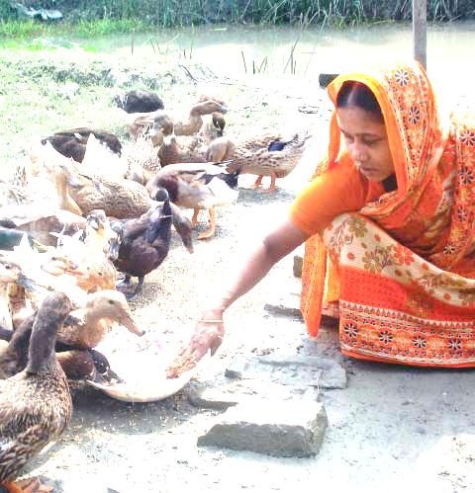
Feed
Vocabulary
Meaning
To give food to a person or an animal.
Mother feeds the ducks everyday .

Slide 7
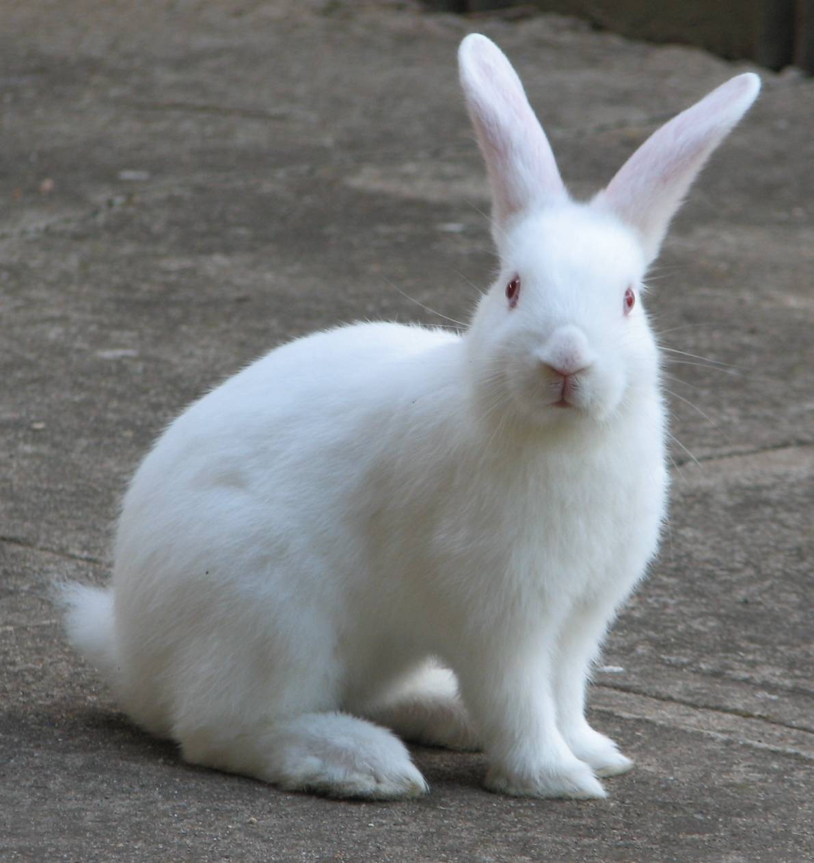
Rabbit
Vocabulary
a plant-eating mammal with long ears, long hind legs, and a short tail.
Meaning
The rabbit is sitting.

Slide 8
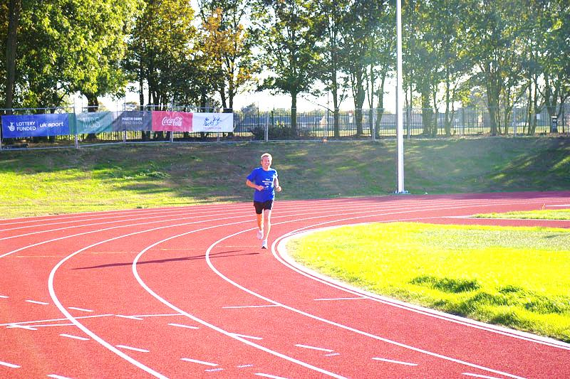
Run around
Vocabulary
Meaning
Run all sides.
Henry is running around the track .

Slide 9
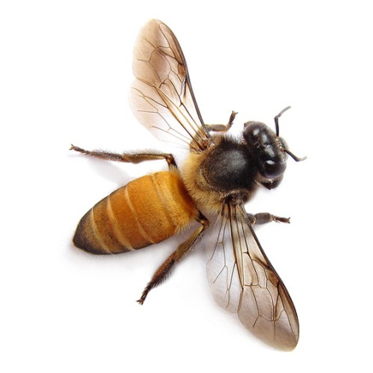
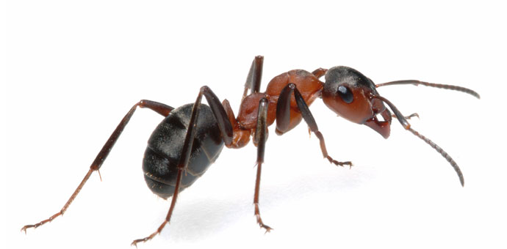
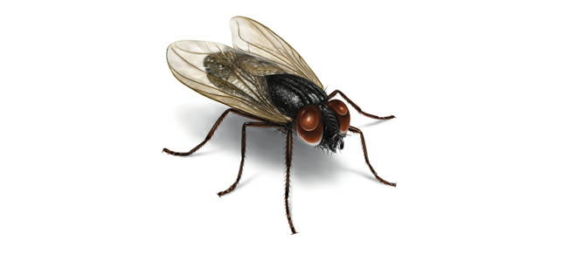
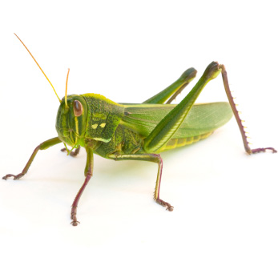
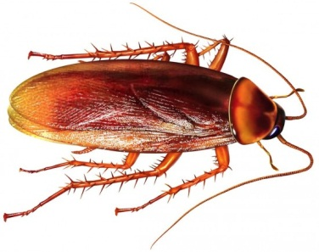
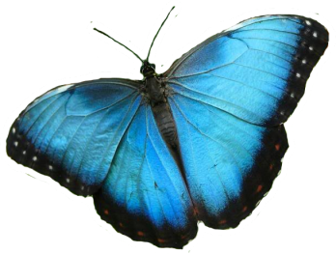
Insects
Vocabulary
A type of small creatures having six legs and a body divided into three parts. Insects usually also have wings.
Meaning
All these are called insects.

Slide 10
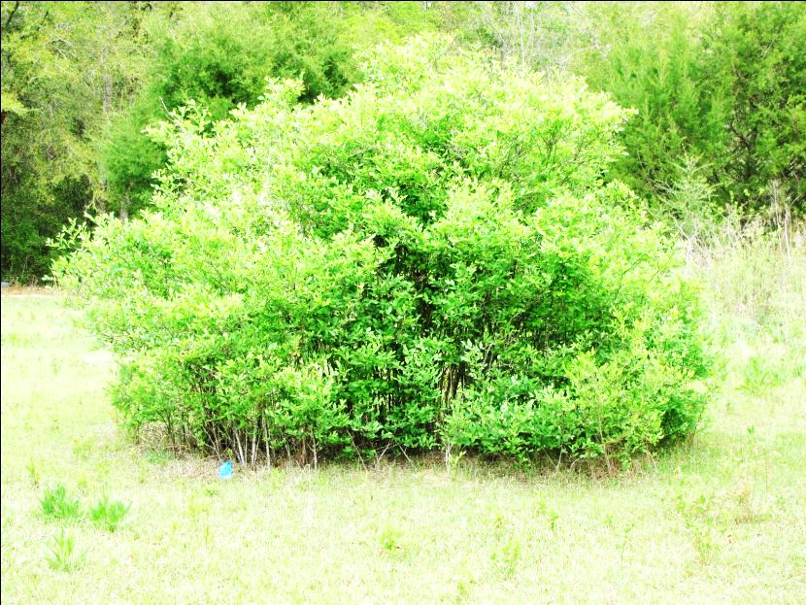
Bush
Vocabulary
Meaning
A plant that grows thickly with several stems coming up from the roots; a shrub
The children should not go to the bush.

Slide 11
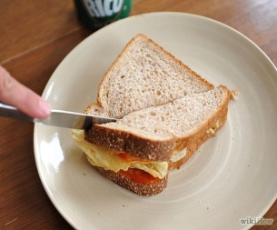
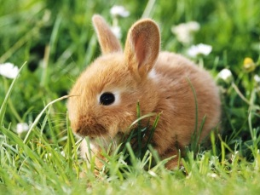
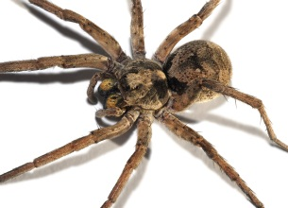
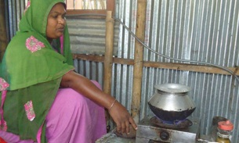
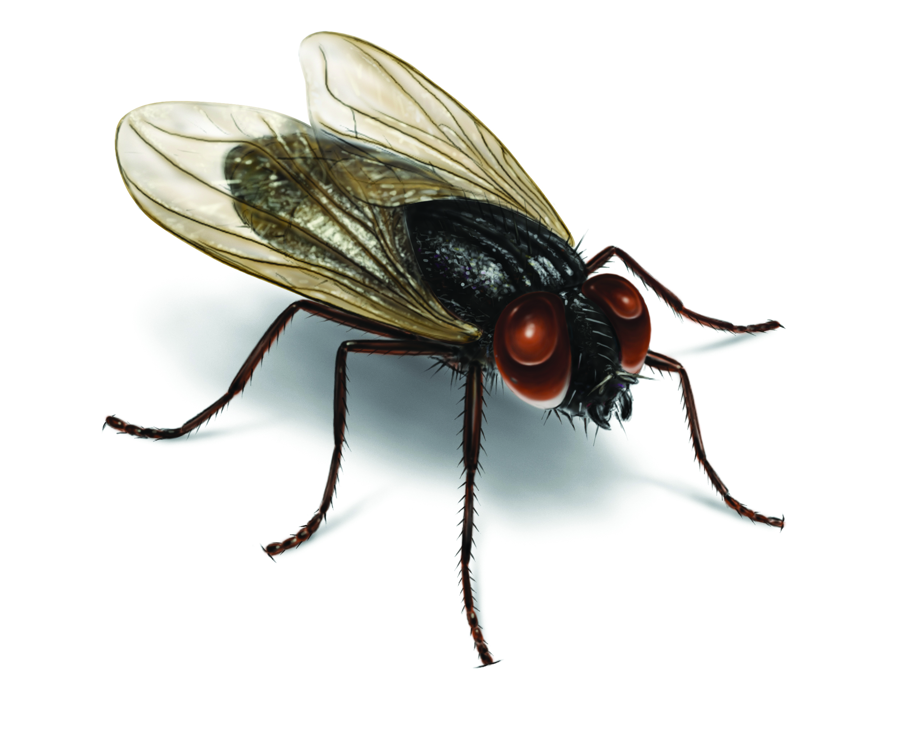
Go to the textbook , section A and read the text and fill the table below. Use the words likes/doesn’t like/loves/hates appropriately under each member of Paul’s family. One is done for you.
Thing/activity | Paul | Sister | Mother | Father
Making sandwiches |  |  | likes
Watching animals
Spiders
Cooking
Flies
loves
loves
hates
hates
doesn’t like

Slide 12
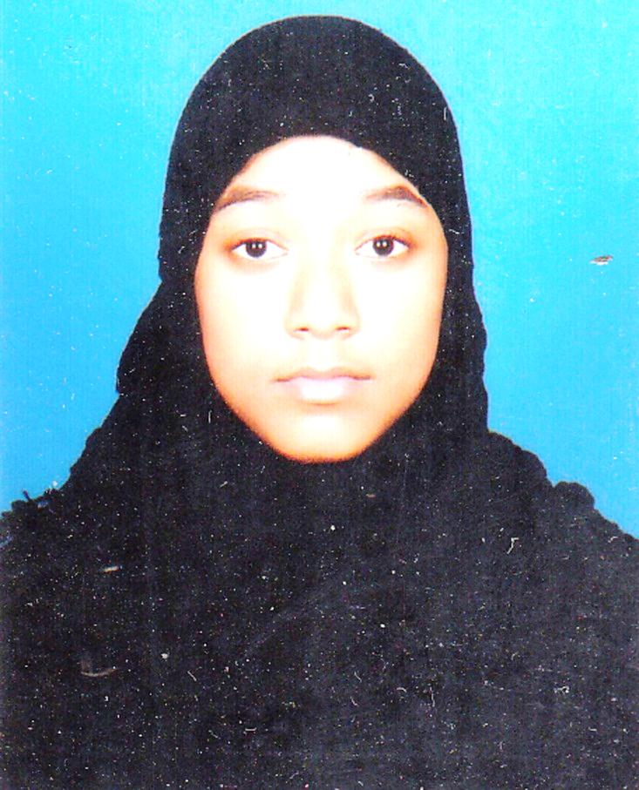
See the jumble words. Rearrange the words and make question from the box 1 and answer from the box 2.
1. she/ like /drawing/ does /picture/ a/?
2. likes / she /drawing/ yes, /a/ picture/.
Q: Does she like drawing a picture?
A: Yes, she likes drawing a picture.
Notes:
From the jumble words the SS will make question and answer. Then teacher can elicit answer from them. Here when teacher will elicit answer he/she can ask the SS to raise their hands. Eliciting answer from one student teacher can ask other students whether they agree or not. If answer is not correct teacher can give the chance to others. Then teacher can give them the feedback showing the answer. In the same way, slide no. 14-16 can be conducted.

Slide 13
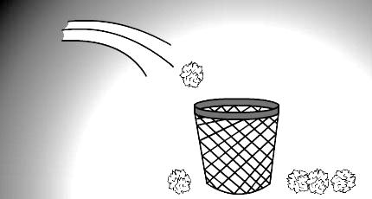
See the jumble words. Rearrange the words and make question from the box 3 and answer from the box 4.
3. you/ waste/ like /throwing/ do / here and there /?
4. don’t / I /like /throwing/ no, /waste/ here and there.
Q: Do you like throwing waste here and there?
A: No, I don’t like throwing waste here and there.

Slide 14
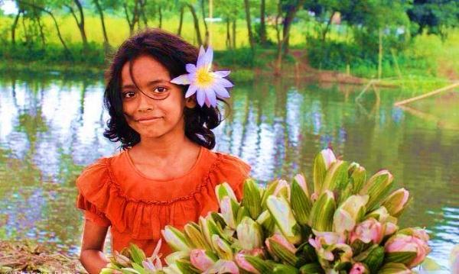
See the jumble words. Rearrange the words and make question from the box 5 and answer from the box 6.
5. she/ like /herself/decorating/ does /flower/ a/with/?
6. loves / she /decorating/ yes, /a/ flower/with/herself.
Q: Does she like decorating herself with a flower?
A: Yes, she loves decorating herself with a flower.

Slide 15
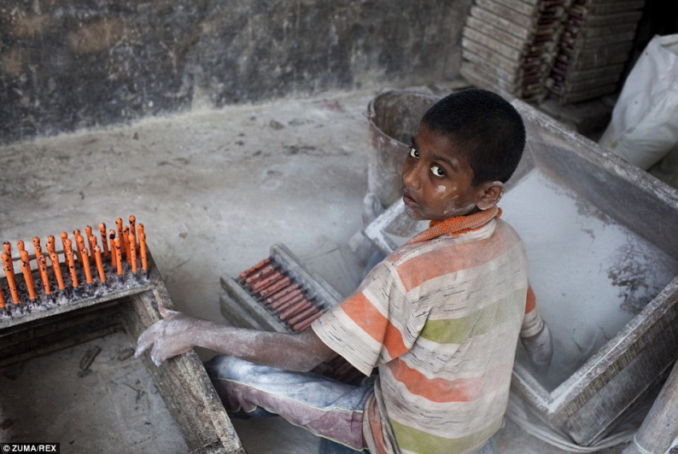
See the jumble words. Rearrange the words and make question from the box 7 and answer from the box 8.
7. he/ like /in/working/ does /factory/ a/?
8. hates / he /working/ no, /a/ factory/in/.
Q: Does he like working in a factory?
A: No, he hates working in a factory.

Slide 16
Use the clues to make questions and answers about likes/dislikes.
2. They go to school.
2. She draws picture.
Q: ( like ) …………………………?
A: ( Yes, like ) ……………………
A: (Yes, like) Yes, she likes drawing a picture.
Q: Do they like going to school?
A: Yes, they like going to school.

Slide 17
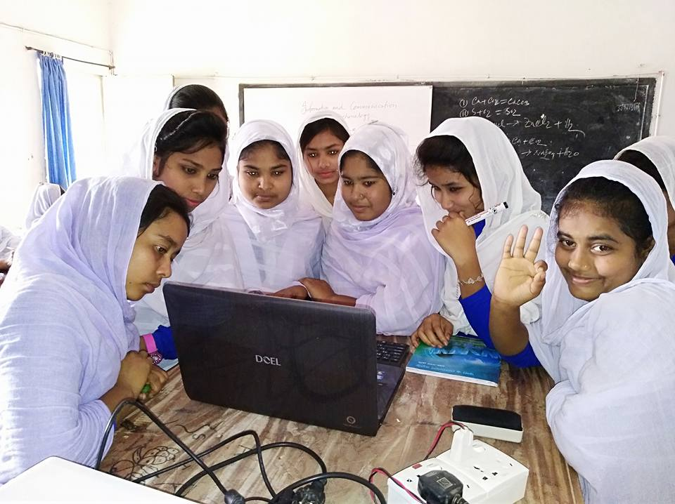
Use the clues to make questions and answers about likes/dislikes.
2. She studies in load-shedding.
Q: ( like ) ………………………………?
A: ( No, not like ) ……………………
Q: Does she like studying in load-shedding?
A: No, she does not like studying in load-shedding.

Slide 18
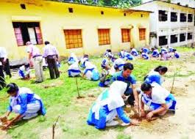
Use the clues to write questions and answers about likes/dislikes.
1. They make garden.
Q: ( like ) ………………………………?
A: ( Yes, love ) …………………………
Q: Do they like making garden?
A: Yes, they love making garden.

Slide 19
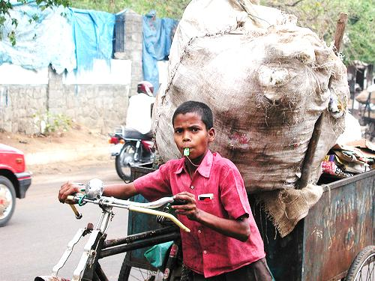
Use the clues to write questions and answers about likes/dislikes.
1. The boy pulls garbage.
Q: ( like ) ………………………………?
A: ( No, hate ) …………………………
Q: Does the boy like pulling garbage?
A: No, the boy hates pulling garbage.

Slide 20
Look at the structure of making question and answer.
Q: Does she like drawing a picture?
Q: Do you like throwing waste here and there?
1. Structure of Question:
Do/Does + Subject + like + verb + ing + others + ?
A: Yes, she likes drawing a picture.
A: No, I don’t like throwing waste here and there.
2. Structure of Answer:
Yes,/No, + Subject + like/likes/don’t like/doesn’t like/love/loves/hate/hates +verb + ing + others.

Slide 21
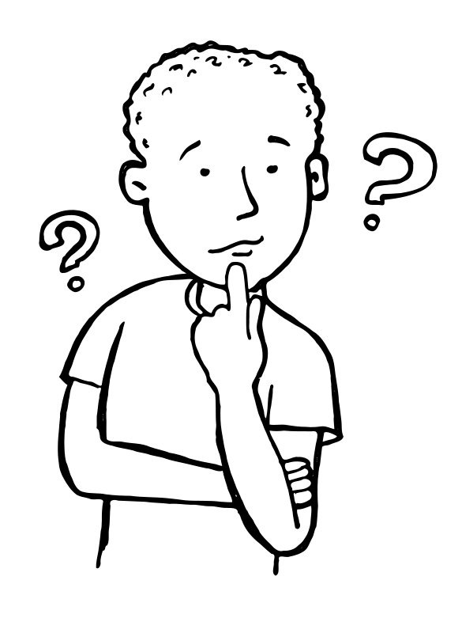
Home Work
Write about what you like and don’t like. (Not more than 10 lines)

Slide 22
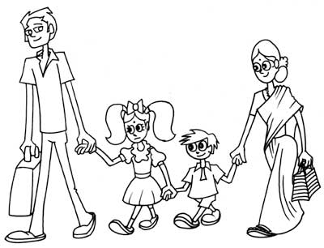
Love and respect your family. Take care of each member’s likes and dislikes.
These are all for today.

