Slide 1



Welcome
Welcome

Slide 2
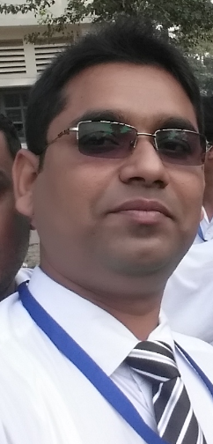

PRESENTED BY...
Md.Rabiul Islam
Assistant Teacher
144 N0 Deluty PurbaparaGovt. Primary School
Paikgacha, Khulna.
Cell No.01912374507
Email: raislam162@gmail.com

Slide 3

Let’s start our today’s class with this greetings song...!!!

Slide 4

LESSON’S INTRODUCTION
  Class: One
  Whole Lesson: Alphabet
  Unit-24; Lessons: 4-6/Part-c
  Time: 50 Minutes
  Date: 20-10-2019

Slide 5

Learning outcomes
  By the end of the lesson the students will be able to____________________________________________
  Listening______________
  1.1.1. become familiar with English sounds by listening to common English words
  Speaking______________
  1.1.2.say simple words and phrases
  Reading_______________
  1.2.1.recocnize and read the alphabet both small and capital.(non-cursive)
  Writing______________
  1.1.1.practise letter shapes

Slide 6
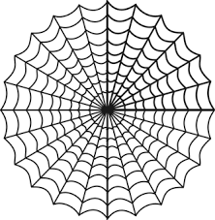

One Day One Word
N
e
t

Slide 7
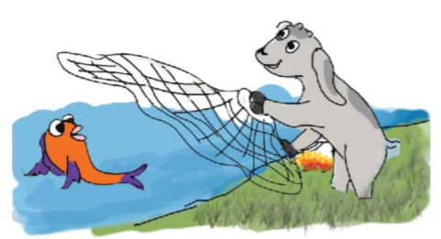

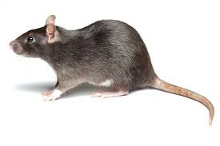

Let’s see the pictures

Slide 8


* Our today’s lesson*
Write the letters to make word

Slide 9
Let’s read……..
N
e
t
N
e
t
N
e
t

Slide 10
Let’s read……..
S
u
n
S
u
n
S
u
n

Slide 11
Let’s read……..
R
a
t
R
a
t
R
a
t

Slide 12
Let’s read……..
T
a
p
T
a
p
T
a
p

Slide 13

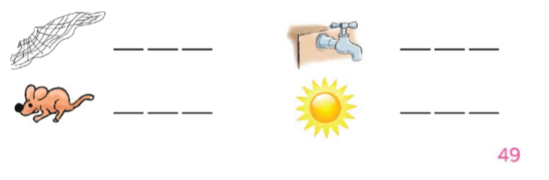
Open your English book.
Open at page 49

Slide 14
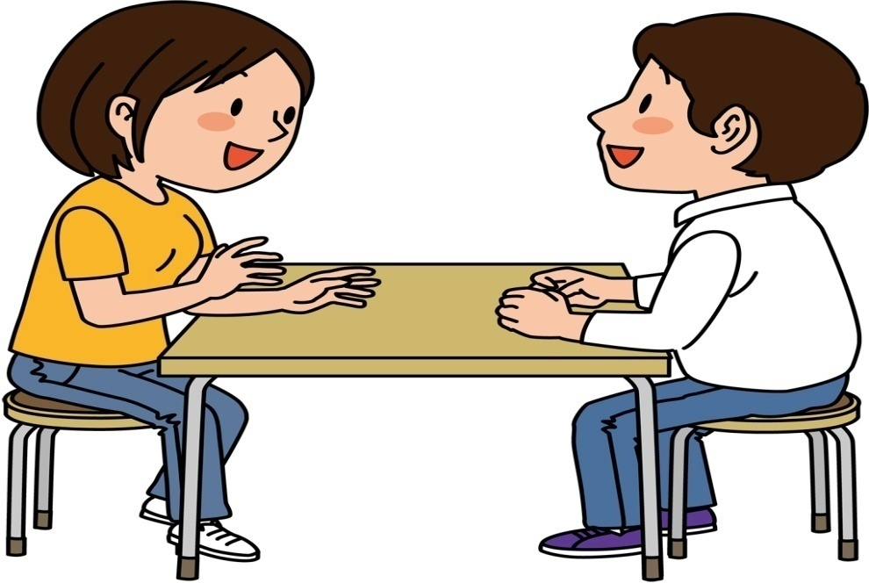
Pair work
Discuss about the words

Slide 15
TASK (WCW)
1. Make words with letters
N
e
t
R
a
t
S
u
n

Slide 16
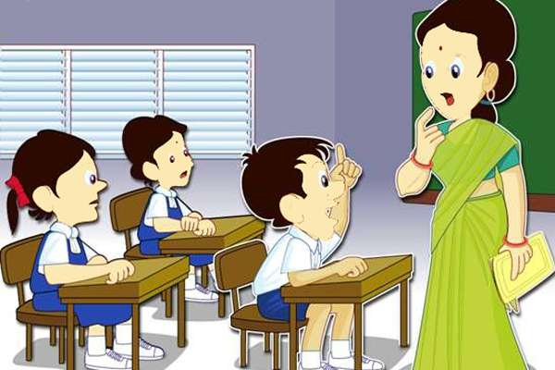
Task
(Assessment)
Whole Class Work

Slide 17


Home Task
Write 1 word with the each letter... N,R,S,T

Slide 18

NOW IT’S TIME TO GO AWAY….!!!

Slide 19


THANKS
SEE YOU AGAIN!!
Notes:
এখানে শিক্ষক – শিক্ষার্থীদের ধন্যবাদ জানিয়ে আজকে পাঠ শেষ করবেন।
MD.AHSAN HABIB
ASSISTANT TEACHTER
UTTAR LUXMIPUR GOVT. PRIMARY SCHOOL
MOBLE No– 01736-022295

