Slide 1
Good morning

Slide 2
Class:1
Subject:English
Duration:40 minutes

Slide 3
Jony Jony
Yes papa
Eating sugar
No papa
Telling lies
No papa
Open your mouth
Ha ha ha
Mental Preparation

Slide 4
Ackowledge
Where do you live?

Slide 5
Unit:19
Lesson:1-2
Page no:38
Declaration of lesson

Slide 6
At the end of the lesson,the students will be able to
Say where animals live.
Learning outcomes

Slide 7
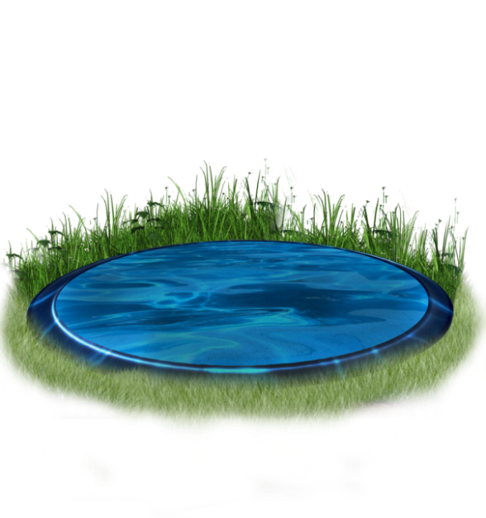
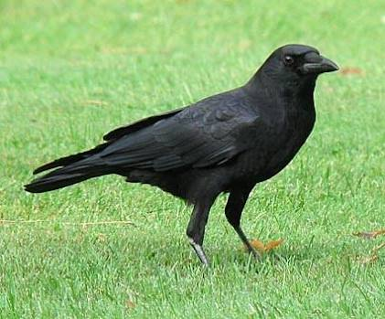


Look at the following picture and discuss with your partner about it.Try to say what it is.
What is it?
It is a Crow
What is it?
It is a Pond
What is it?
It is aTree
What is it?
It is a Plant

Slide 8
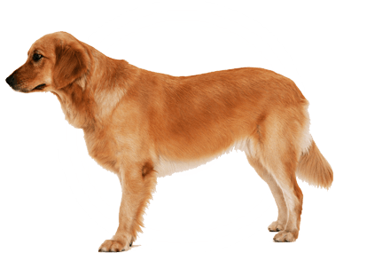
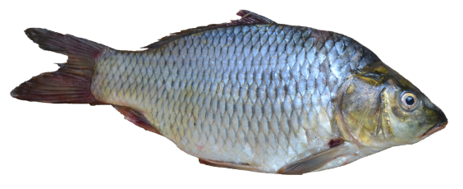

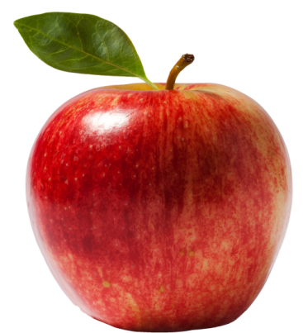
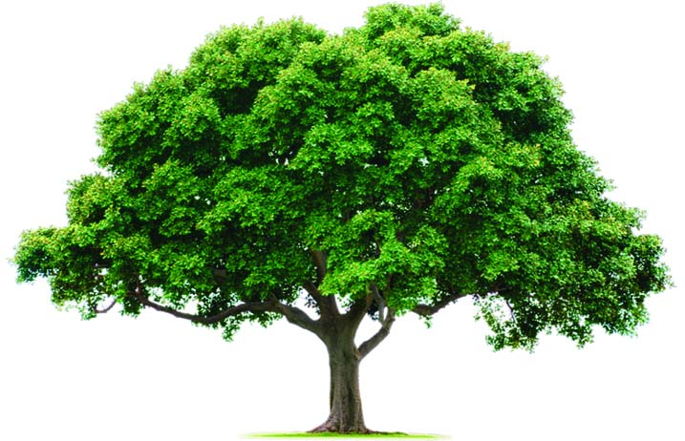
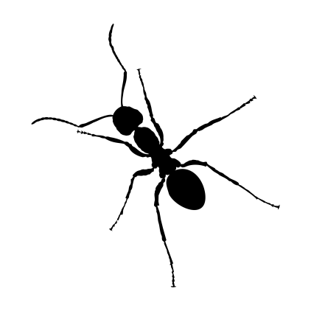
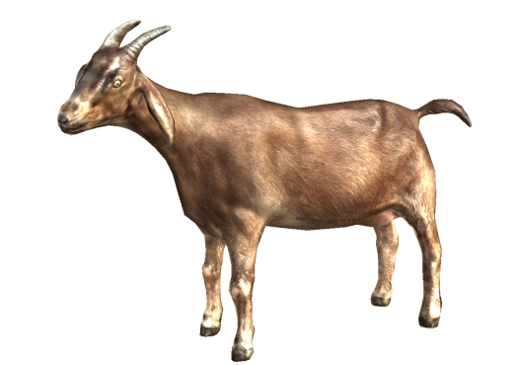
Look at the following pictures.
Listen to me and point the picture.

Slide 9
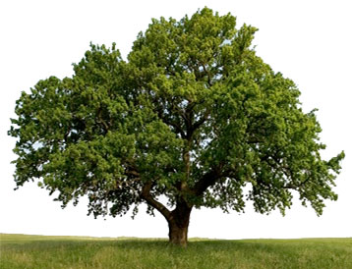
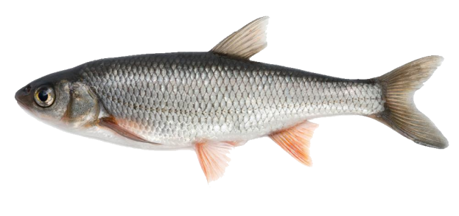
Where do they live ? Think and match.

Slide 10
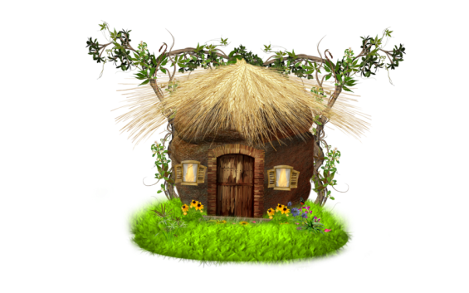
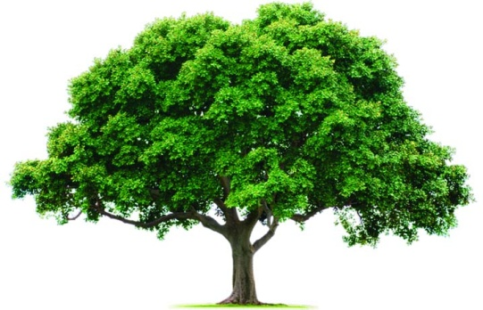
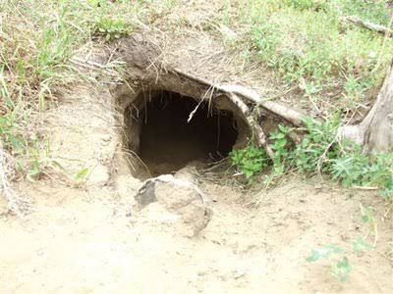
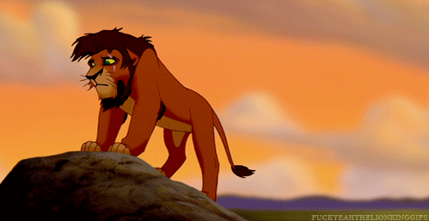
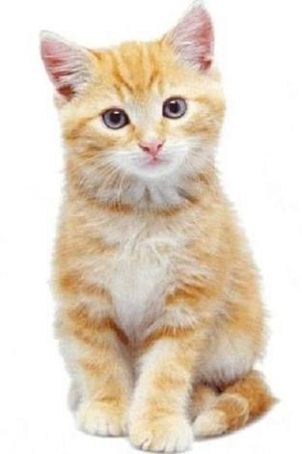
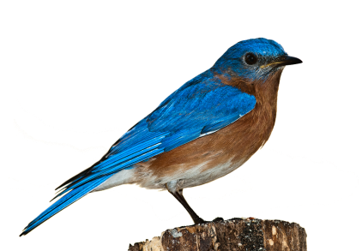
Try to say where they live.
lives in …….............
lives in …….............
lives in …….............

Slide 11
Prepared by
Muhammad Jane alam
Assistant teacher
West Rashidabad Government primary school.patiya,chittagong.

