Slide 1


শু
ভে
চ্ছা

Slide 2
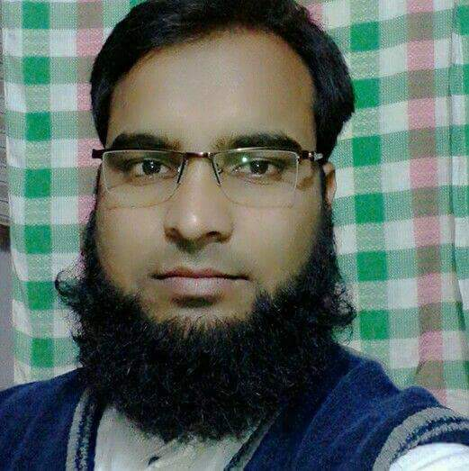
Teacher Identity
ASRAFUL ALOM
Asst: teacher
Kalmudunga got. Praimary school
sapahar, naogaon.

Slide 3
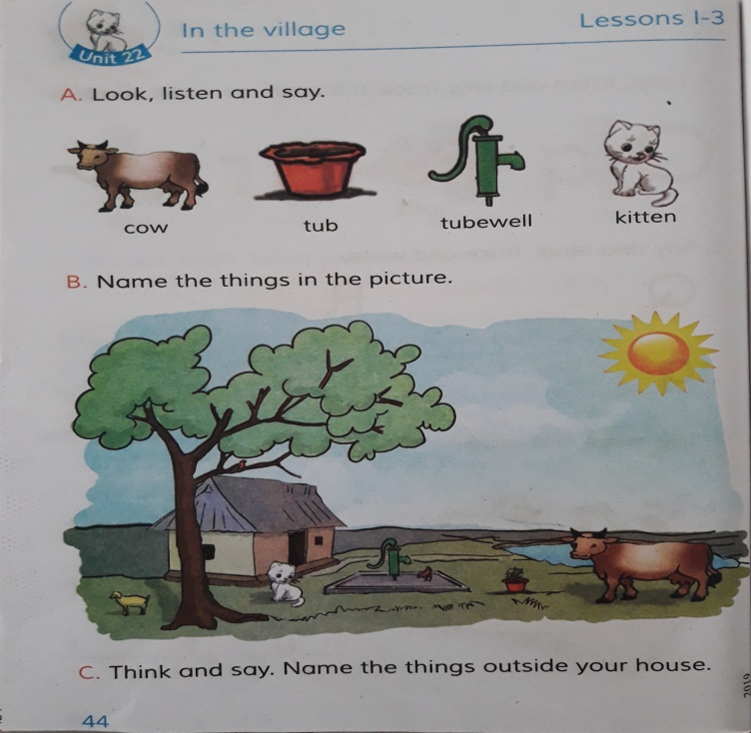
Lesson Identity
Class: One
Lesson: 1-3
Unit: 22
Parts: In the village
Page: 44

Slide 4

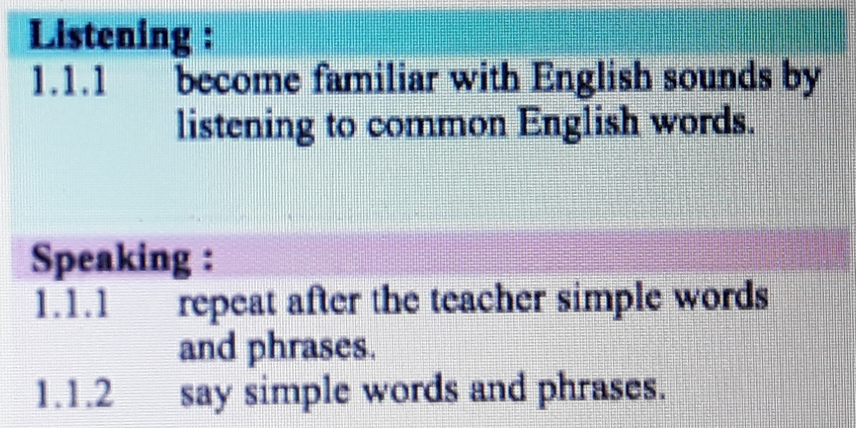
Learninng Outcomes
Students will be able to -

Slide 5

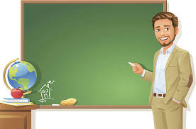
Good Morning Student!

Slide 6

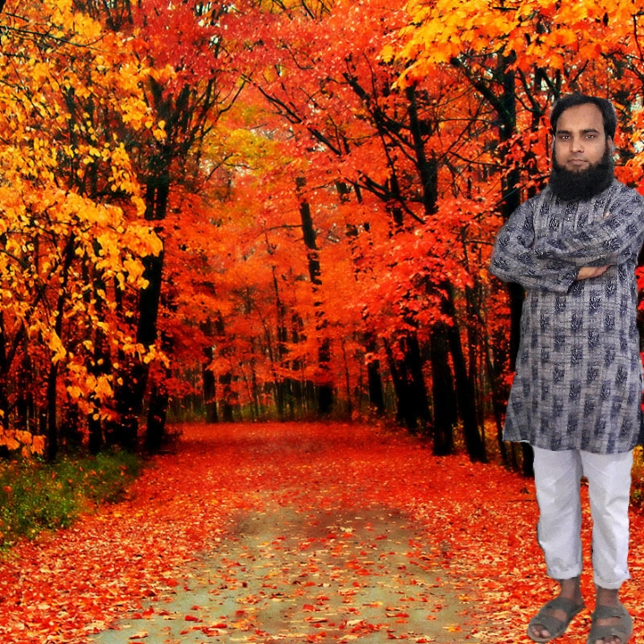

How are you?

Slide 7
চল একটি ভিডিও দেখি

Slide 8
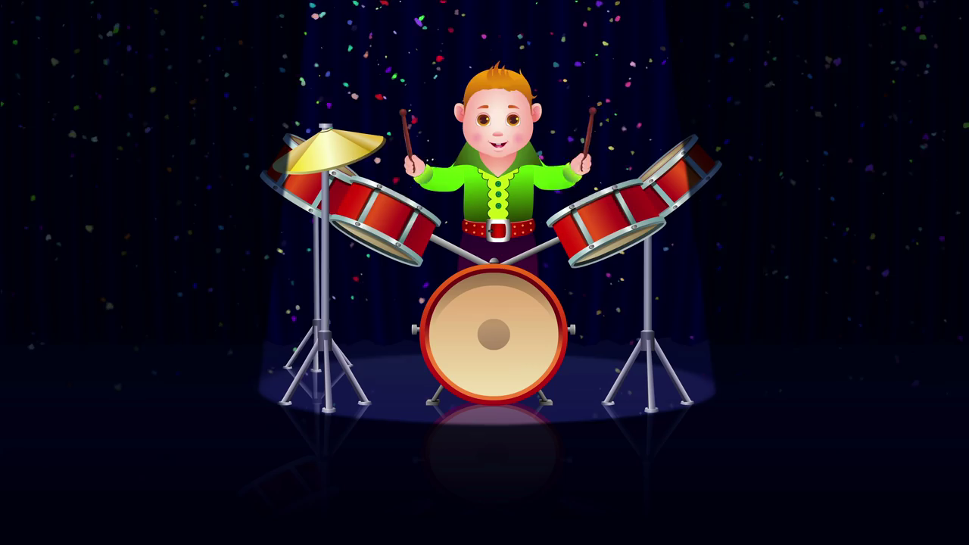

Slide 9

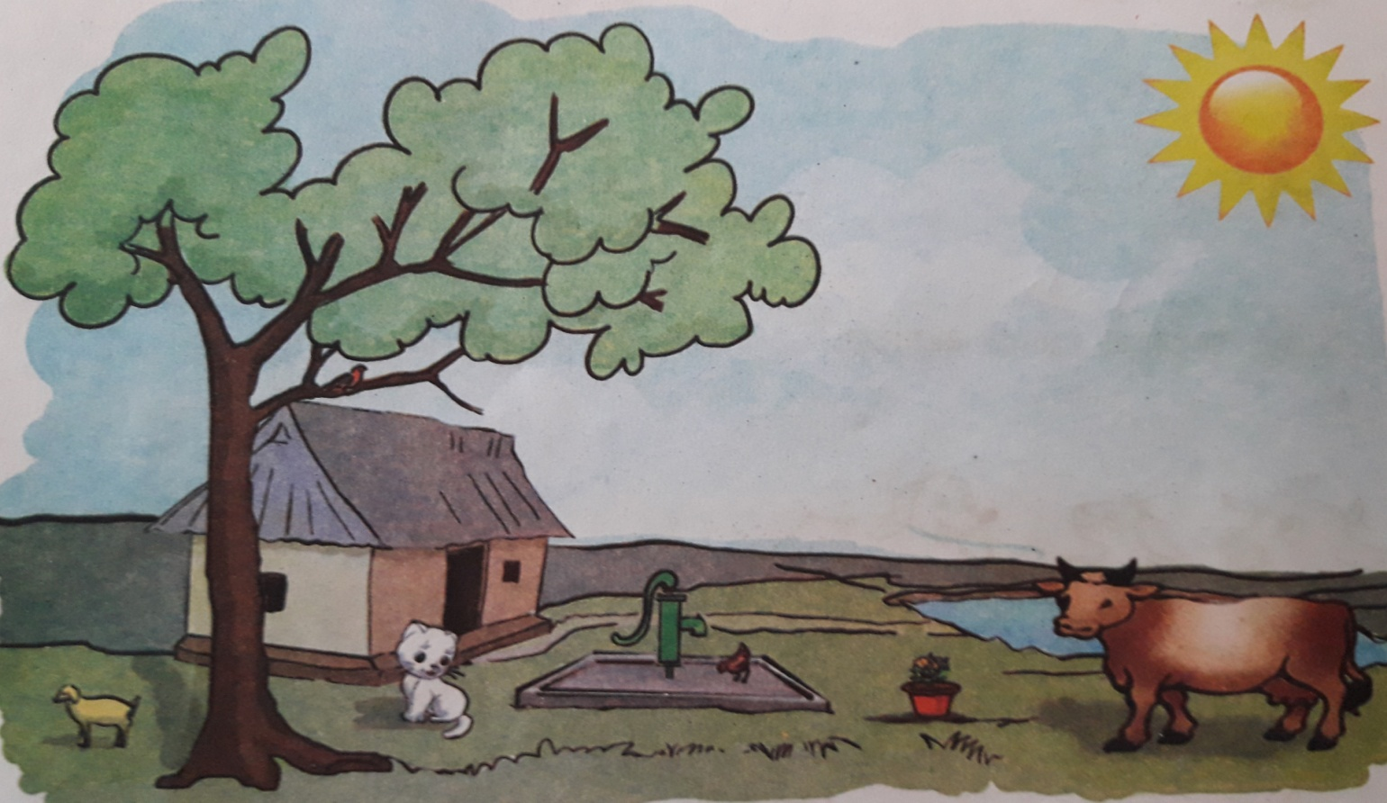

Let’see a picture in mind.
What is this?

Slide 10
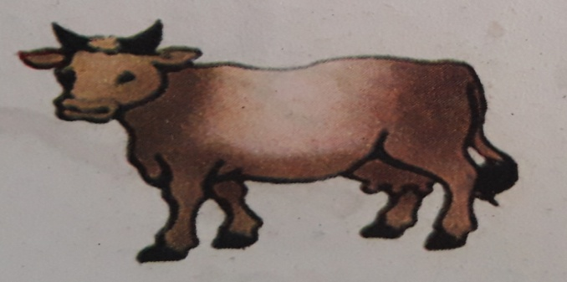
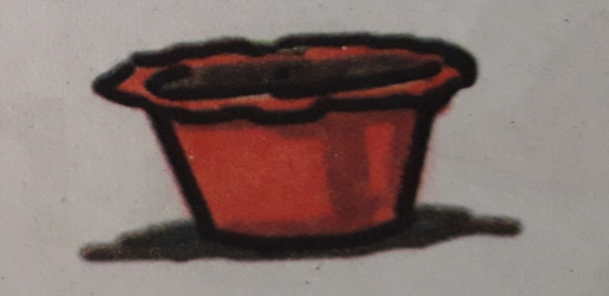
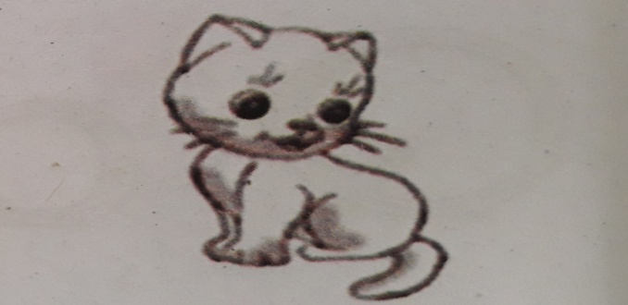
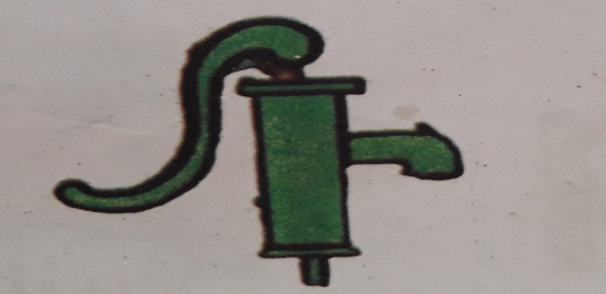
C
o
w
T
u
b
K
i
t
t
e
n
T
u
b
w
e
l
l

Slide 11

Open at page -44

Slide 12
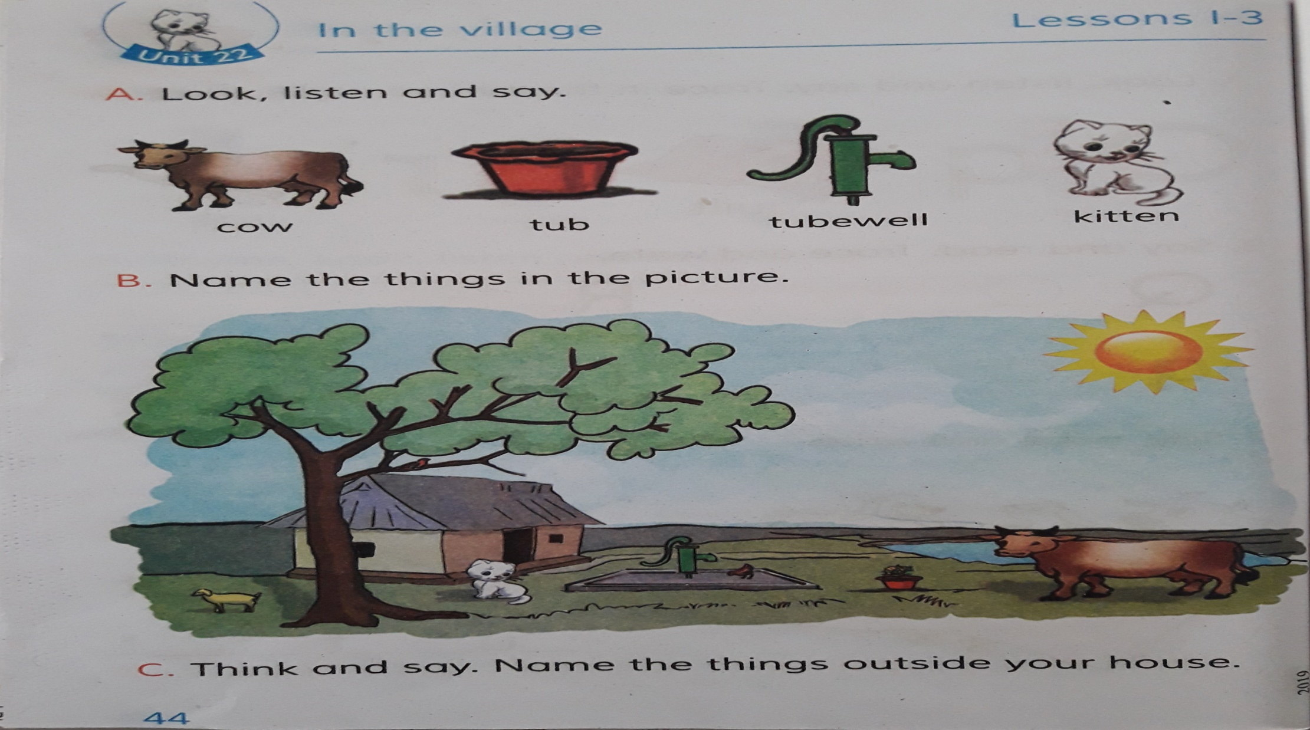
Say with me.

Slide 13

Group Work

Slide 14

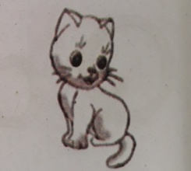


Sapla
Golap
Joba
Write the name
Write the meening
Say the picture name
Cow
Kiiten
Kitten
বিড়াল ছানা
Cow
Kitten
Tubewell
নলকূপ
Tub
Tub
Cow
Tubewell
গাভী

Slide 15



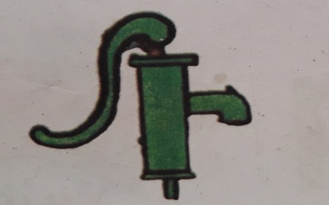
Checking learning
Kitten
Tub
Cow
Tubewell

Slide 16

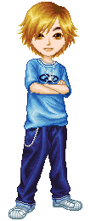
No more today

Slide 17

Thank you

