Slide 2
Lesson Introduction
Class: 5
Unit: 7
Lesson: 1-2
Be healthy
Lesson: A
Page: 26

Slide 3
Let’s play a Bingo game.
BINGO
Game
Regularly
Delicious
Tomatoes
Write down any Four of the following words in your notebook and follow my instructions.
Chocolete
Lettuce
Cucumbers
Music
Carrots
Banana

Slide 4
Tell me the name of some unhealthy foods.
Why do you think these food are unhealthy?
Which food gives us energy?
Are they healthy?

Slide 5
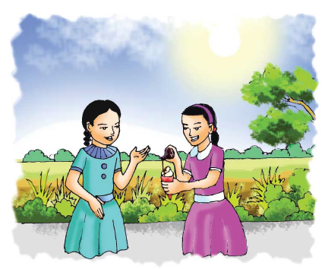
Please, open the page 26 at your text book.
Please, look at the picture.

Slide 6
Do you know them?
What is in Nasreen’s hand?
What is she doing?

Slide 7
In this picture...
She is putting some chocolate on her ice-cream.
It’s an ice-cream.
This is Sima
This is Nasreen.

Slide 8
Title declaration
Be healthy

Slide 9
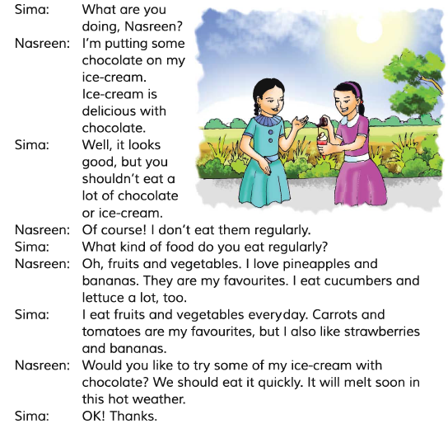
I will read the dialogue. Listen attentively.

Slide 10
New Words
Regularly
নিয়মিত
Delicious
সুস্বাদু
Chocolate
চকলেট
Tomato
টমেটো
Music
গান/সঙ্গীত
Cucumber
শসা
Carrot
গাজর
Banana
কলা
Lettuce
লেটুস পাতা
Pineapple
আনারস

Slide 11
I am reading the dialogue once again. Repeat with me.

Slide 12
Let’s check….
Which food does Nasreen eat regularly?
Fruits and Vegetables
Which food does Sima eat regularly?
Fruits and Vegetables
Which food melts quickly in hot weather?
Ice-cream

Slide 13
Read the dialogue silently…..

Slide 14
Act out the dialogue in pairs.

Slide 15
Answer the questions
Which food should we eat regularly?
Which foods are good for our health?

Slide 16
Thank you all….

Slide 17
Presented by-
Hasnat Imrul Kaysar ShaKil
Assistant Teacher
Roazapara Govt. Primary School
Lama, Bandarban.

