Slide 1

WELCOME

Slide 2
Introduction
Samiul Islam
M.A, M.Ed,
Assistant Teacher
Halimunnessa Chowdhyrani Memorial Girls’ High School, Bhaluka,Mymensingh

Slide 3
Lesson Introduction
Unit – 1, Lesson-2

Slide 4
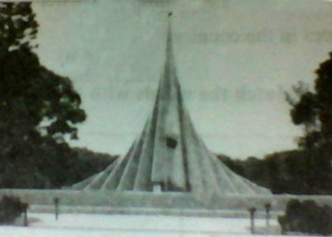

Smrity Showdho
Shaheed Miner

Slide 5
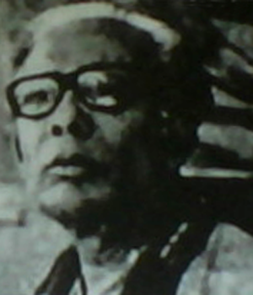
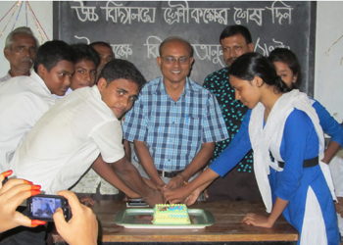
Joynul Abedin
Head Teacher

Slide 6
Knowledge, Skill and attitude

Slide 7
Learning outcomes
By the end of this lesson the students will be able to-
1. Narrate incident
2. Participate in discussions
3. Listen and Understand others
4. Describe something in writing

Slide 8
A. Group Work
Discuss the following question in group—
What do you need in addition to food, shelter, company, etc. to become a good citizen ?

Slide 9
B. Read the text—
Vucabulary
Word | Meaning
Legislative | Having a power ; law
Task | Work
Shyness | Quality of being shy; a social interaction
Disappear | Vanish

Slide 10
C. Read the text below. Then discuss with your partner and write K ( if the text is knowledge) or S (if the text is skill based) or A (if the text refers to attitude) against each text.
1 = K
2 = S
3 = A
4 = K
5 = S
6 = A
7 = S
8 = K

Slide 11
D. Discuss in Groups. Write how K S A can be shown in the following topics
Orsaline
Debate
E-mail

Slide 12
Home task
Write a story about your daily life in which there are three thing as Knowledge, Skill and Attitude

Slide 13
Thanks

