Slide 1
Welcome

Slide 2
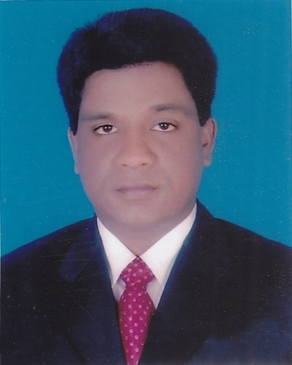
Introduction
Mohammad Azharul Islam
Assistant Teacher (English)
Hugra Habib Kader High School, Tamgail
English For Today
Class- IX - X

Slide 3
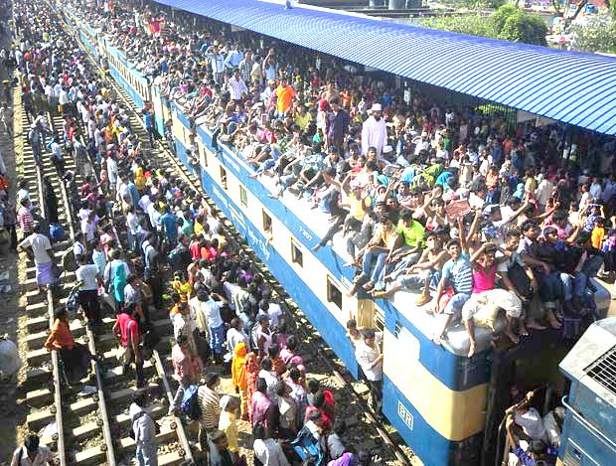
Watch & observe attentively
Where are they going?

Slide 4

What do you mean?
Root
Birth place / Paternal address
Notes:
Inner significance of roots shown here.

Slide 5
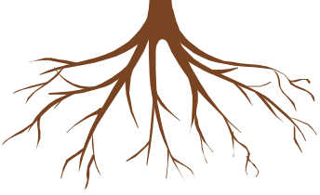
Our Today’s Lesson is--
My Root
Unit-12, Lesson-1
Notes:
Lesson declaration.

Slide 6
Learning outcomes
After we have studied this lesson, we will be able to—
Ss will ask and answer questions
Ss will present information in a chart
Ss will narrate incidents and events in a logical sequence
Ss will read and understand the text through silent reading
Notes:
All the four skills will be focused in this lesson.

Slide 7
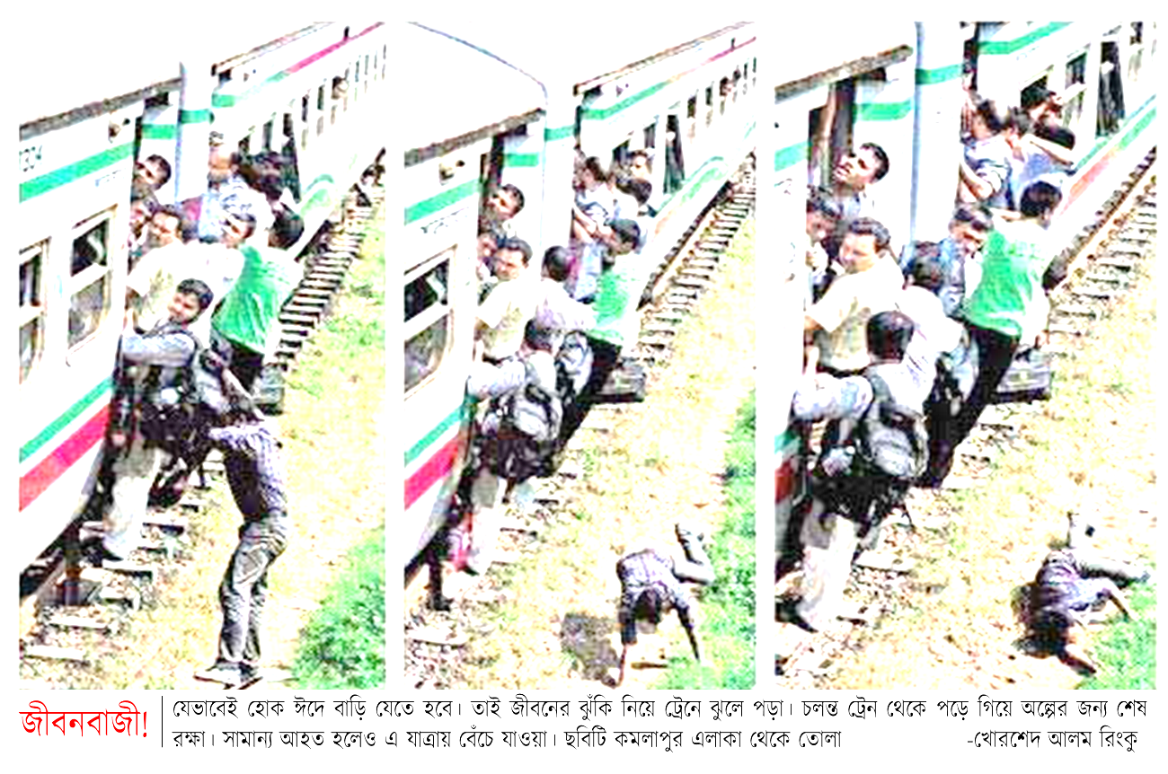
Look at the pictures and the caption below. How do you feel to see this photo? Why do you think people take such risks to go home to celebrate their Eid?

Slide 8
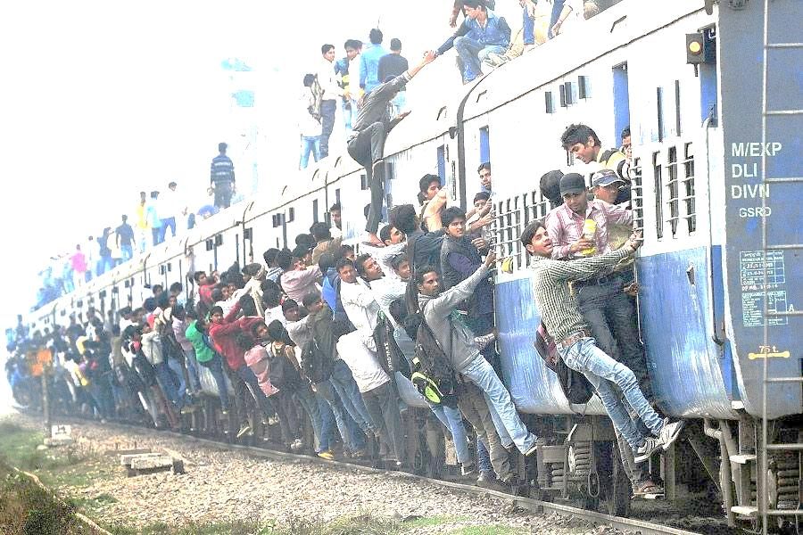
What are they doing ?
Going to village home is a must, that may be at any cost.

Slide 9
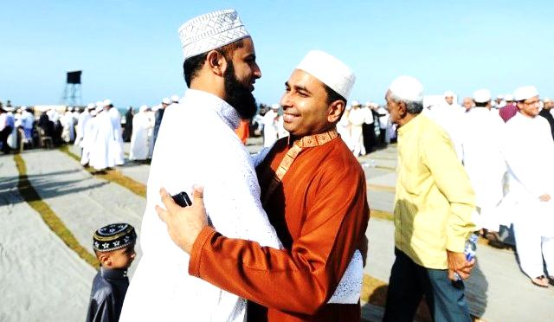
What is the picture about?
What is Eid?
Eid is the main religious festival of the Muslims in Bangladesh. Eid means happiness.

Slide 10
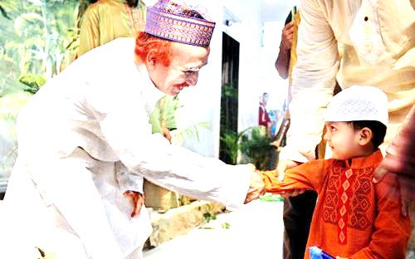
What does everyone want during Eid?
Everyone wants to share happiness with their near and dear ones during Eid.
Notes:
Text direction.

Slide 11
So what happens then? ( EID)
So most of the people, who are living outside their home for different reasons have a strong desire to get back home during the Eid vacations.

Slide 12
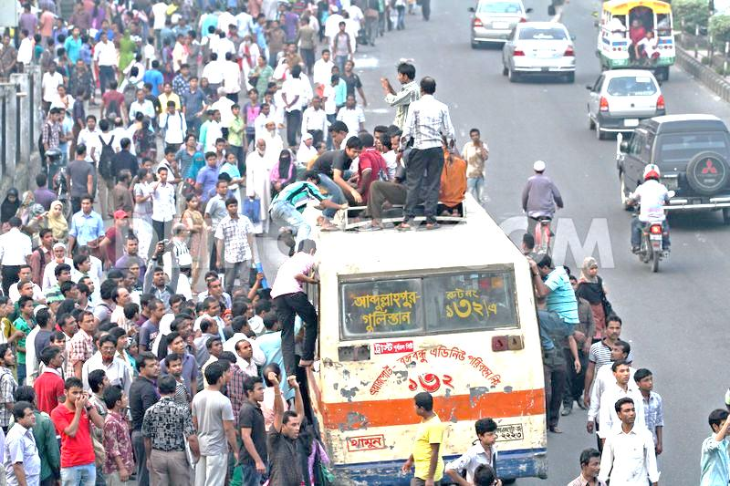
As a result, there is a mad rush in the--
buses
Notes:
Text shown by showing images.

Slide 13
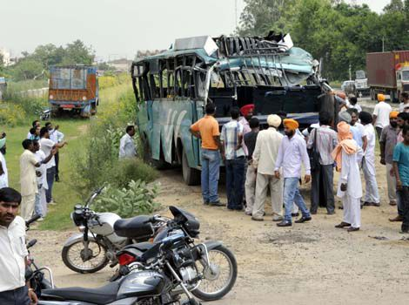
What is caused afterwards?
Accident.

Slide 14
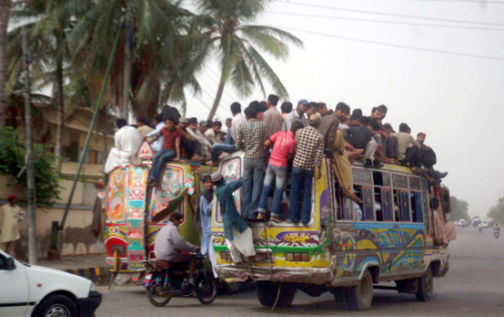
What makes people for their homes in spite of serious ?
rush
hazards

Slide 15
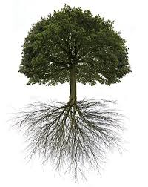
Do human beings have-
roots like the trees?

Slide 16
B Read the following text.
It's these roots that make a bond between us and family members, in­-laws, friends, neighbours or even between us and the land where we were born and grew up. In that sense our families, land of birth, relatives, our culture, traditions, or surroundings are our roots. And wherever we stay, we have a continuous pull of our roots. It's our roots that develop our identity making us what we are. When we lose that bond, we become rootless. Human beings who do not have any root or contexts, are non entity. In other words, they do not have their own identity. Such persons are devoid of values, humanity, and social responsibilities. They don't know where they are from, and/or where they are heading towards. This often makes them feel empty and lost.

Slide 17
Evaluation.
D Fill in the grid with appropriate information from the text above.
That makes our roots | The problems of a rootless person
1................................ 2................................ 3................................ 4................................ 5................................ | 1………………………… 2………………………… 3………………………… 4………………………… 5…………………………

Slide 18
E Work in pairs. Talk about these questions.
Do you have any root other than the place where you are living now? If yes, where is it and who are there?
If not, why not?
2. How do you label your roots?
My roots belong to
an extreme rural village a village
a semi-urban area (upozila) a small town
a moderate city a suburb
a city
3 Do you feel any attraction or pull of your roots?
4 How do you nourish your roots?
5 What, according to you, are the reasons why people become rootless?
F Make a classroom survey and present in a chart the types of roots your classmates have.

Slide 19
Thank you All

