Slide 1
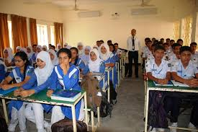


Slide 2
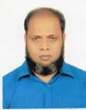

My Identity
MD. Norul Haque
Headmaster,
Hazi Rahmatullah Forquania High School,
South Tengra, Sarulia, Demra, Dhaka.

Slide 3
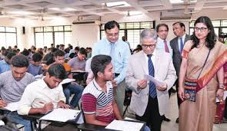
Guess the sentences clearly :
If you read, you will pass.
If you got GPA 5, you would be happy.
If you had helped me, I would have passed.
We have noticed that there is a condition whether they are real or unreal

Slide 4
So, our today’s lesson is...
Conditionals
Unit : 11
For Class : 9 & 10
Subject : English Grammar And Composition

Slide 5
Objectives :
At the end of the lesson the learners will be able to :
complete the sentences with conditionals.
make complex sentences.
apply them in conversation.
improve their writing skill.

Slide 6
Let us watch a video for getting a clear idea :

Slide 7
Let us see structures of conditionals:
Real Condition
If +present +present/Zero Condition
If+present+future
Unreal Condition
If+past+Past condttional( sub+would/could/might+ base verb) or, Second Conditional
If+past+Perfect condttional( sub+would have/could have/might have+ past participle of base verb) or, Third Conditional

Slide 8
Let us see some examples :
Real
If you have a life, you have a struggle.
If you are student, you study .
3. If you go to school, you learn very well.
If you work hard, you will get GPA 5.
If you are seriously ill, you will go to a doctor.
If you take physical exercise , you will be healthy.
Unreal
1. If I were a rich man, I would help the poor.
2. If You worked hard, you would pass.
3. If you won a lottery, you would buy a good house.
If you had not helped me , I would have failed.
If someone had mentioned her name, I would have not recognized her.
If I had gone there , I would have met him.

Slide 9
Group Work
Complete the following sentences :
If I knew him............
If you were a bird,.....
If you rise early,.........
If you read newspaper,....
If they had played well,----
If they are wealthy,.....
If you are hungry,.........
If you phoned me,-------
If you had a camera,........
If he had got GPA 5,-------
Match the answers :
1. I would meet him.
2. you would fly.
3. you will get enough time to study.
4. you will learn many things.
5.they would win the game.
6. they would set up a school.
7. you will eat.
8. I would come.
9. you would take some photographs.
10. he would have been happy.

Slide 10
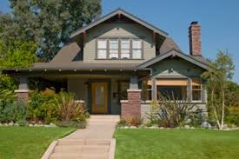
HOME WORK
Write ten sentences applying third conditional on the following :
“What would you do if you were a prime minister ? “

Slide 11
Thank You

