Slide 1

Welcome to our English class

Slide 2


IDENTITY
Manik Chandra Majumder
Senior Teacher (English)
Gazirhat High School
Senbag, Noakhali
Mobile No: 01717155169
Email: manikmajumder01@gmail.com
Class : Nine-Ten
Subject : English 1st paper
Time : 50 Minutes
Date : 00/00/2019

Slide 3
IDENTITY
Manik Chandra Majumder
Senior Teacher (English)
Gazirhat High School
Senbag, Noakhali
Mobile No: 01717155169
Email: manikmajumder01@gmail.com
Class : Nine-Ten
Subject : English 1st paper
Time : 50 Minutes
Date : 00/00/2019

Slide 4
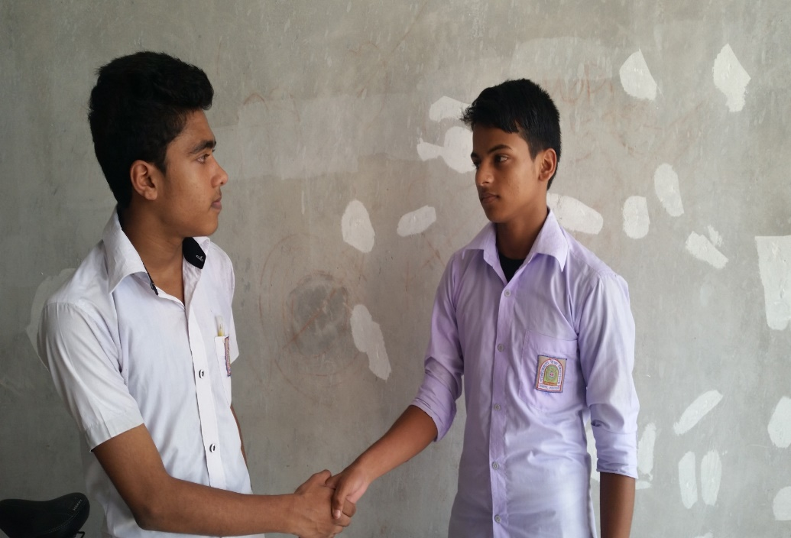
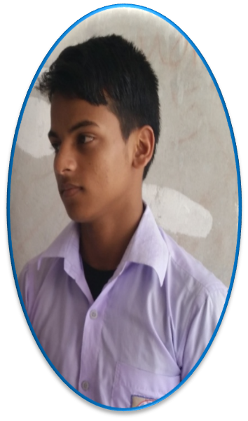
What are the images about?
How are you?
I’m fine.
I’m from Chittagong.
I’m. from Dhaka
The images are about making dialogue .

Slide 5
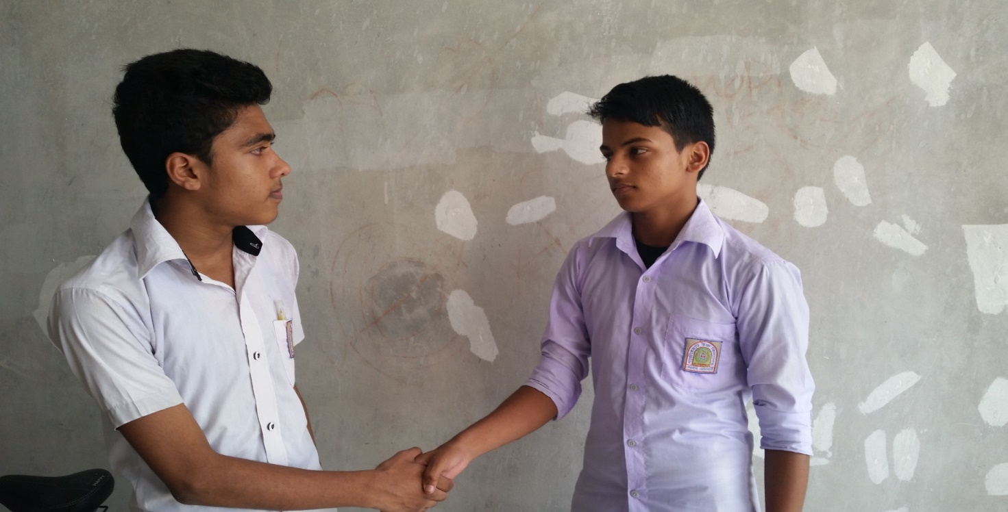
What are two friends doing here?
Two friends are making dialogue.

Slide 6

Our today’s Lesson is-
A dialogue between two friends about their aim in life.

Slide 7
Learning Outcomes
By the end of the lesson, learners will be able to :
a) ask and answer questions,
b) make dialogue,
c) take interview,
d) describe about the importance of aim in life.

Slide 8
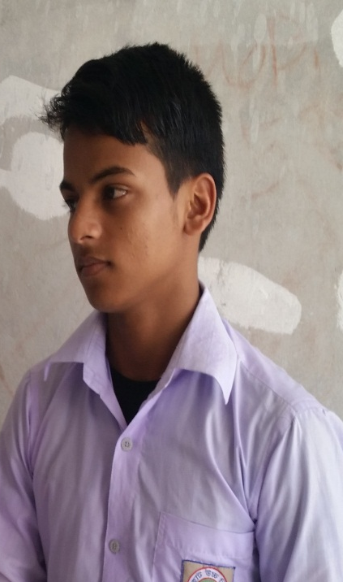
Good morning, Sohan.
Good morning, kamal.
How are you?
I’m fine & you?

Slide 9
I’m fine too. But you looks worried. What are you thinking about?
Oh, Actually I am thinking what I want to be in future.

Slide 10
Then, have you already fixed your aim in life?
Of course, Every man should have an aim in life. Similarly I have an aim in life.
Oh, That’s great! But what is that?
I want to be a doctor in future.

Slide 11
Really? Why have you decided to be a doctor?
Sure, I believe a doctor can serve the suffering humanity best.
Can you please explain it a little more?
Certainly, most of our people live in village. They are poor and illiterate. They cannot afford the expenses of treatment.
As a result, many of them die premature death.

Slide 12
In that case, how can you help them?
I want to offer treatment to the poor patients free of cost. And I dream that if I earn much I will set up a charitable hospital for the poor.

Slide 13
That’s a good idea. But do you know getting admission into medical college is very tough. What’s your plan regarding that?
I know academic performance is very much important for getting admission into medical college. So I am preparing myself to achieve the success.

Slide 14
I appreciate your aim and your heartiest effort to make your dream true. Wish you all the best.
Thank you very much.
You are mot welcome.

Slide 15
Gr0upwork
Now write five sentences about the importance of selecting aim in life.

Slide 16

Pair work
Two students make a pair and practice between them
about their aim in life.

Slide 17
Evaluation
What is aim in life?
Why is it so important?
c) When should a student select a particular aim in life?

Slide 18
HOME WORK
Suppose you are Tamim and your friend is Tareq . He does not know about the importance of learning English. Now write a dialogue between two of you about the importance of learning English.

Slide 19



