Slide 1
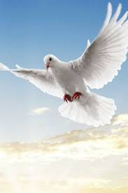

Slide 2
Introduction
Md. Zakir Hossain
Principal
Robertsongonj High School and College,Rangpur.
ENGLISH FOR TODAY
Classes Nine-Ten
Unit—Seven
Lesson--6

Slide 3
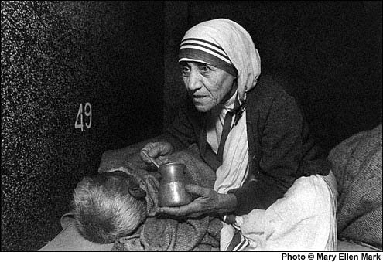
What do you see in this picture?
Mother Teresa is feeding a sick person.

Slide 4
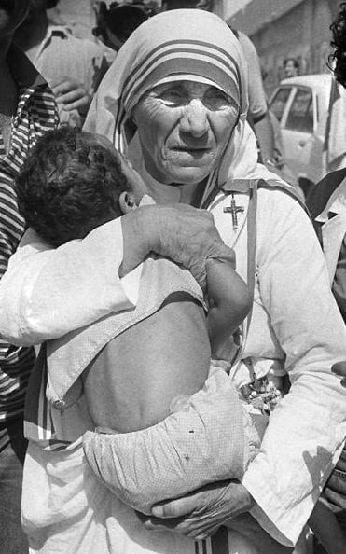
Love for humanity

Slide 5
Learning outcomes
By the end of the lesson learners will be able to –
-talk about a picture
Ask and answer the questions
Describe the activities of Mother Teresa.

Slide 6
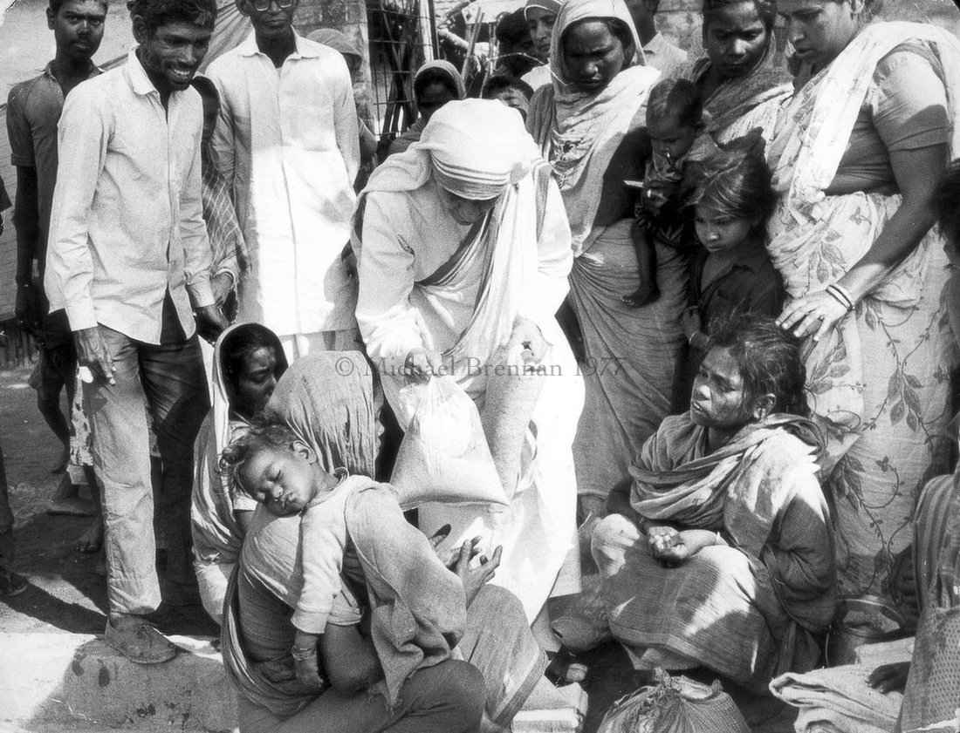
Mother Teresa was moved by the sight of the sick and dying on the streets of Kolkata.

Slide 7
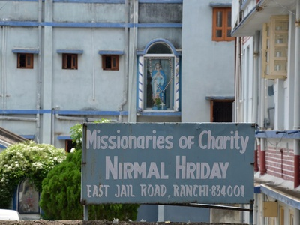
Mother Teresa founded a home for the dying destitute and named it `Nirmal Hriday`.

Slide 8
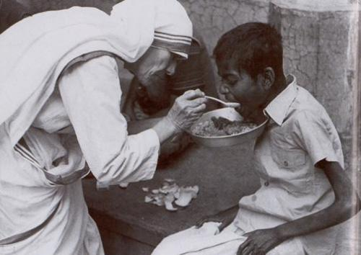
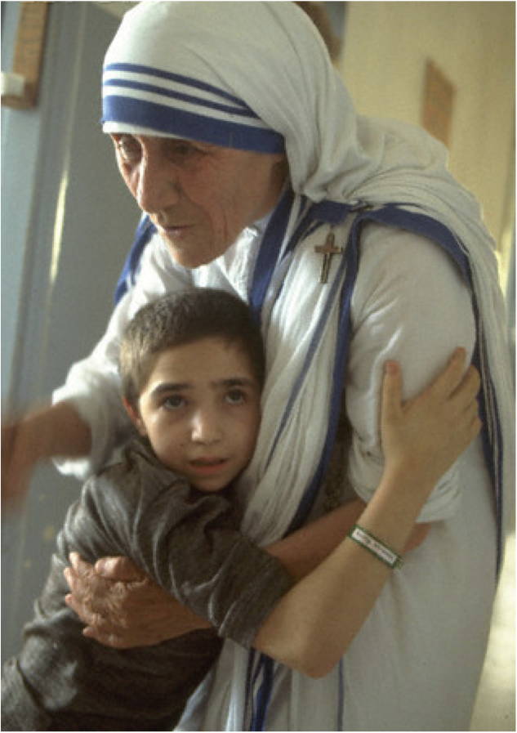
Men, women and children have been taken from the streets and carried to Nirmol Hriday.

Slide 9
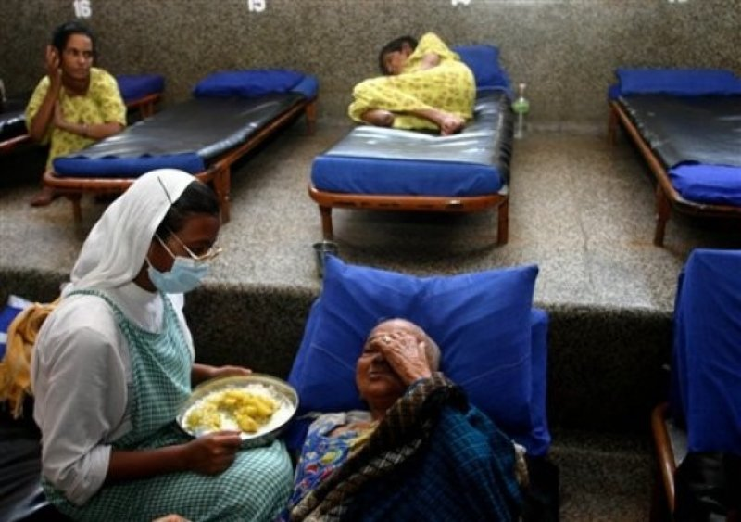
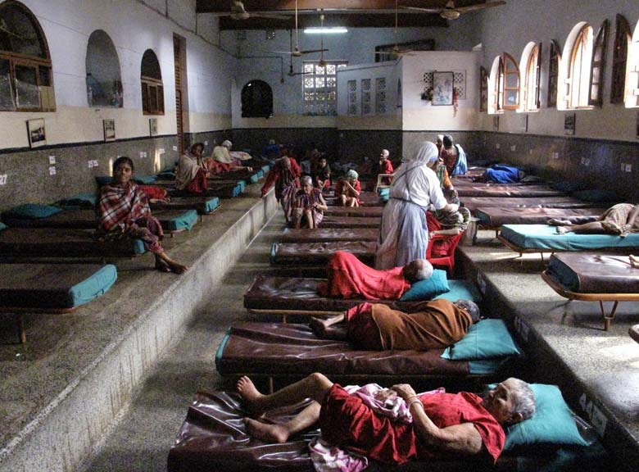
Unloved and uncared people get an opportunity to die in an environment of kindness and love.

Slide 10
Read the text and answer the questions in pairs.
1.What does `Nirmal Hriday` stand for?
Ans ` Nirmal Hriday` stands for pure heart
.
.
2’Why do you think the home is named `Nirmal Hriday`?
Ans.The home is named `Nirmal Hriday` because the people find their heart pure and peaceful after entering the home .

Slide 11
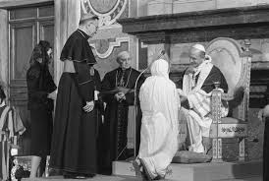
Awards given to Mother Teresa.
Pope John XX111 Peace Prize (1971)
The Nehru Prize(1972)
For her great promotion of international peace and understanding.

Slide 12
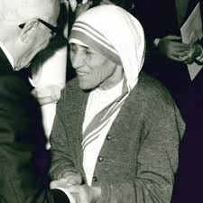
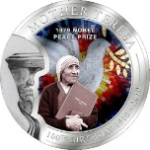
The Balzan Prize(1978)
For humanity,peace and fraternity among people
The Nobel Prize(1979)

Slide 13
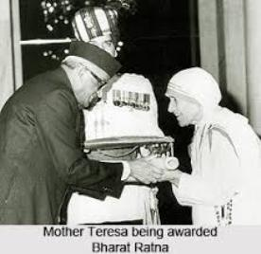
The Bharat Ratan(1980)

Slide 14
Now read the text and answer the questions in groups
1.What did Mother Teresa say regarding commitment to family?
2.Why was Mother Teresa given several
awards?

Slide 15
Evaluation.
What did Mother Teresa want the dying people to feel that they too deserve care and love?
What did Mother Teresa do for the world?
What are the things that we have learnt from Mother Teresa?

Slide 16
Home work.
Write an article on how you will help the helpless people.

Slide 17
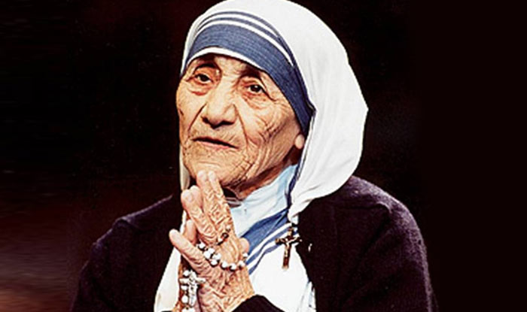
THANKS TO ALL.

