Slide 1

Welcome

Slide 2
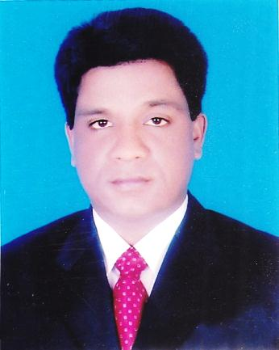
Conducted by-
Mohammad Azharul Islam
English Teacher
Hugra Habib Kader High School, Tangail
Class-9
English First Paper
Unit-10; lesson-3

Slide 3
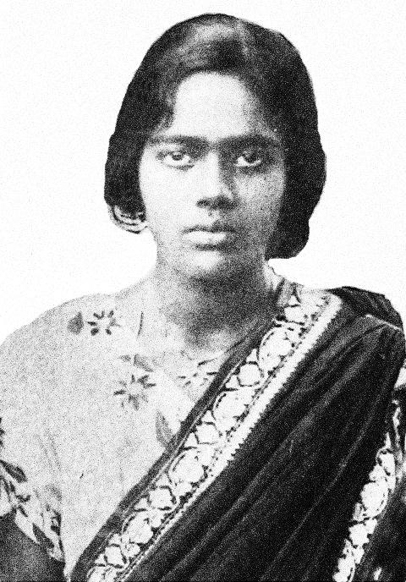
Who is the woman in the picture?
Pritilata Wadedar

Slide 4
Born - 5 May, 1911
Education:
Dr. Khastagir Govt. High School
Head Teacher in Nandakanon Aparna Char an School, Chittagong
Eden College
Dhaka
Bathune college Kolkata
Death - 1932

Slide 5

What is the picture about?
Eden college. Dhaka

Slide 6
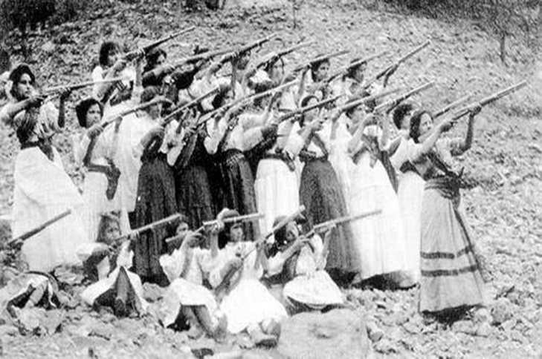
What is the picture about?
Armed resistance movement

Slide 7
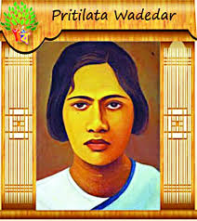
Lesson declaration
Pritilata

Slide 8
Learning outcomes:
After finishing the lessons, learners will be able to ---
Answer the questions.
Choose the best answers from the alternatives.
3. Make a dialogue.
4.Write his won history.

Slide 9
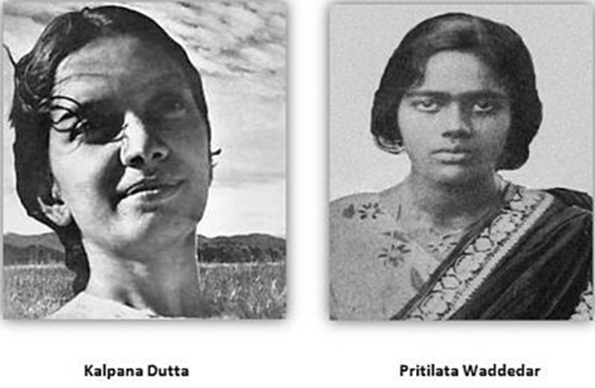
Do you Know them in the picture?
They are Pritilota Kalpana Dutta

Slide 10
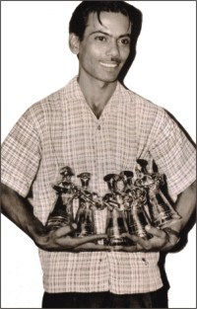
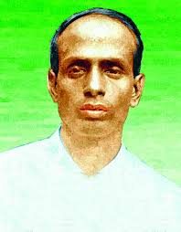
Do you Know them in the picture?
Zahir Raihan
Suraj Sen

Slide 11
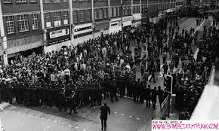
What is the picture about?
Anti- British Movement

Slide 12
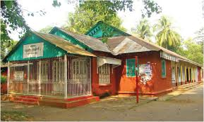
Do you know what is the picture about?
This is Pahartali European Club

Slide 13
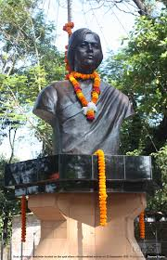
What is the picture about?
The statue of Pritilata

Slide 14
Individual work
(a) What did Pritilata dream all through her life?
(b) Why did she commit suicide ?
(c) Who assigned her to attack the European Club?
(d) What did she prove?

Slide 15
Answer:
All through her life she dreamt of two things: a
society without gender discrimination and her motherland without British colonial rule .
(b) She committed suicide to avoid arrest.
(c) Surya Sen assigned her to attack the European Club .
(d) She proved that women can work like men.

Slide 16
Evaluation:
Choose the best answer from the alternatives:
(a) Pritilata was born in----
(i) Dhaka (ii) Chittagong (iii) Raj Shahi (iv) Khulna
(b) She was a graduate of -------?
(i) English (ii) Bangla (iii) Chemistry (iv) Philosophy
(c) All through her life she dreamt of ----- things.
(i) 2 (ii) 3 (iii) 4 (iv) 5
(d) Pritilata was a ------ student.
(i) weak (ii) Strong (iii) Normal (iv) meritorious
She committed suicide by taking ----
(i) Sodium chloride (ii) Potassium chloride (iii) Potassium cyanide (iv) None
(f) Which Club did she attack?
(i) American Club (ii) African Club (iii) Asian Club (iv) European Club
(g) She died at the age of ------
(i) 21 (ii) 31 (iii) 41 (iv) 51

Slide 17
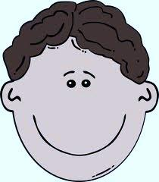
Group work:
Write the meaning of the following words;
Assign, suicide, Discrimination, Sacrifice, Activist

Slide 18
Fill in the gaps without clues:
Surja Sen was a (a) ---------anti-British movement (b) ---- and activist in (c) ---------- area that time.in 1932, Surja Sen planned an (d) -------- on the Pahartali (e) ---- Club. The Club was well known for its notorious sign Dogs and Indians not allowed.

Slide 19
Home work
Write a paragraph about Pritilota

Slide 20
See you again.
Notes:
Last greetings.

