Slide 1


Slide 2
Introducing:
Md. Saiful Islam
Assistant teacher(English)
Bagbari Chowbaria High School
Tangail Sadar Tangail

Slide 3

Introducing:
Md. Saiful Islam
Assistant teacher(English)
Bagbari Chowbaria High School
Tangail Sadar Tangail
Class: Eight
Sub: English 1st paper
Unit: Two
Lesson: 1-4
Time: 45 Minutes
Date:11/06/2019

Slide 4
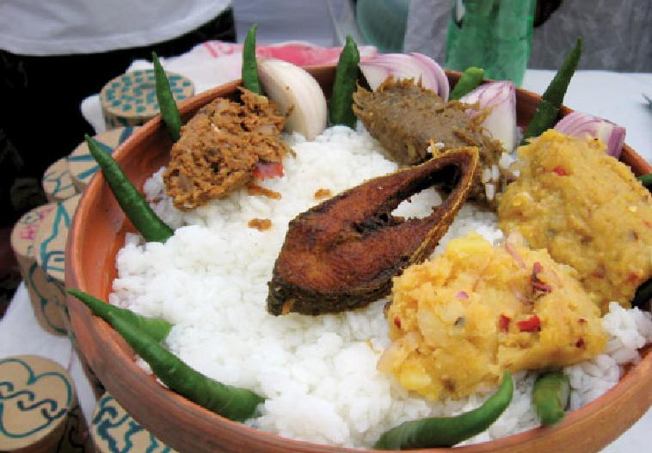
What is the picture about?
Bangladeshi foods

Slide 5
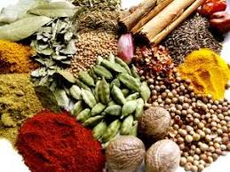
What is the picture about?
Spices

Slide 6
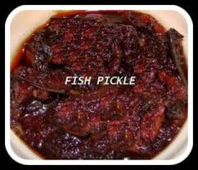
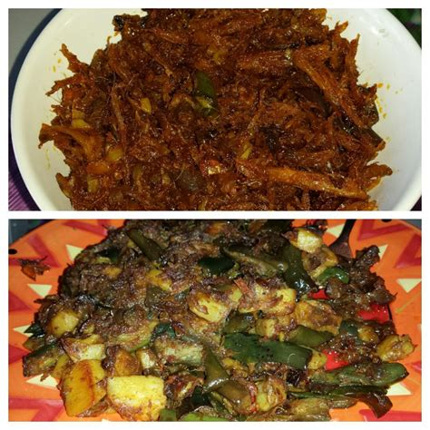
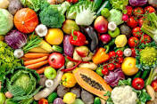

What is the picture about?
Bangladeshi foods

Slide 7

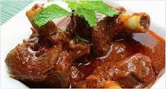
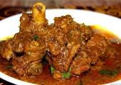
Meat

Slide 8
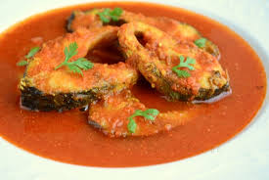
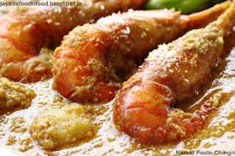
What is the picture about?
Fish curry

Slide 9
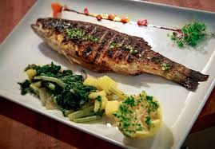
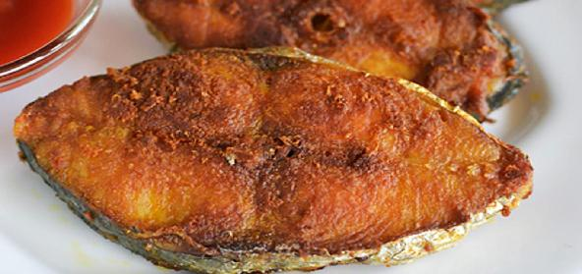
Fish fry

Slide 10
Lesson declaration:
Bangladeshi cuisine

Slide 11
Learning out comes:
After finishing the chapter the SS will be able to —
Say what is good food
match the sentences
Say true or false
Fill in the gaps without clues
Make a dialogue about good food
6. Word meaning

Slide 12
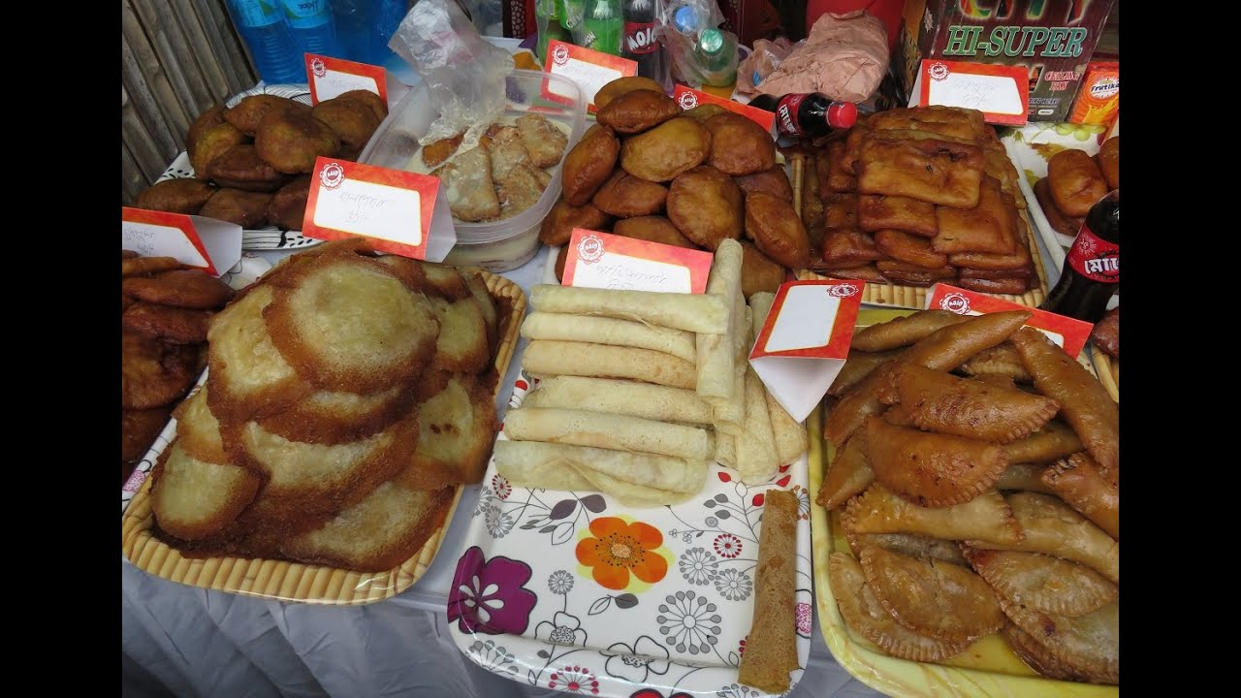
What is the picture about?
Bangladeshi pithas

Slide 13
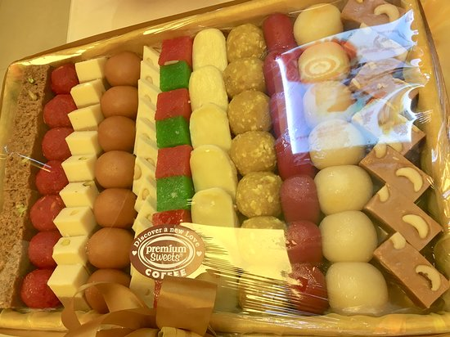
What is the picture about?
Bangladeshi sweets

Slide 14
Individual work
What is cuisine?
Cuisine means the process of cooking

Slide 15
Group work:
Write the meaning of the following words:, Appetizing, Cuisine, Delicious, Importance, Traditional,
Appetizing- Palatable
Cuisine- Caboose
Delicious- Tasty
Importance- Significance
Traditional- Conventional

Slide 16
Evaluation:
Match the sentences
Bangladeshi cuisine is rich (i) good news
Boiled rice is our (ii) sweets
Panta illish is a traditional platter (iii) with the use of spices
The people of Bangladesh are fond of (iv) staple food
Sweets are distributed on (v) of panta bhat
Ans: a+ iii, b + iv, c + v, d+ ii, e+ i

Slide 17
Say whether the following sentences are true or false. If false give the right answer.
Food is important for our body.
Good food is full of natural element.
A person should have a certain amount food .
(d) Eating too much is beneficial to health.
(e) Butter and ghee are a good source of vitamins.
True
True
True
False. harmful
False. Fat

Slide 18
Fill in the gaps without clues:
Boiled rice is our (a) ------ food. It is served with a (b)---- of vegetables. Fish is the main © ------ of protein. They are (d)--------
in ponds . We have (e) ------ types of fishes are common.
staple
variety
source
cultivated
40

Slide 19
Home work
Write a paragraph about Bangladeshi cuisine

Slide 20

Allah Hafez

