Slide 1


Slide 2

Introducing:
Class: nine-ten
Subject: English for today
Unit: 05
Lesson: 02
Time: 50 Minutes
Date: 30-08-2019
Md. Saiful Islam
Assistant Teacher (English)
Bagbari Chowbaria High School, Tangail Sadar Tangail
E-mail: hridoy9555@gmail.com

Slide 3
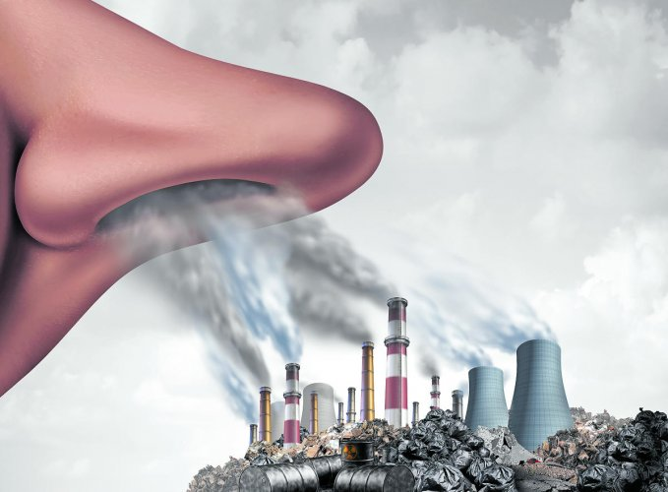
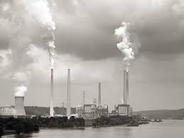
What is the picture about?
Air pollution

Slide 4
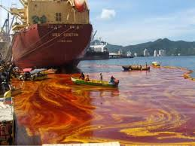
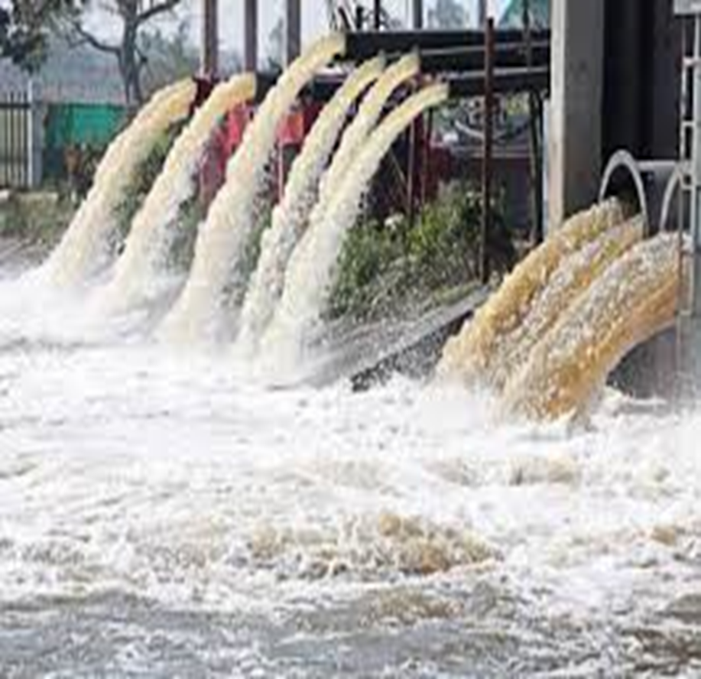
What is the picture about?
Water pollution

Slide 5
Lesson declaration:
Environment pollution

Slide 6

Learning outcomes:
After finishing the lessons, learners will be able to -----
choose the best answer from the alternatives
fill in the gaps
answer the questions
make a dialogue
write a paragraph
say the meaning of the words.

Slide 7
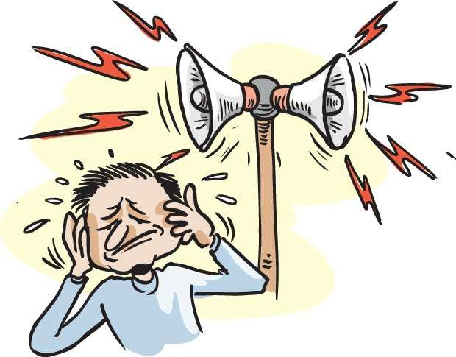
What is the picture about?
Sound pollution

Slide 8
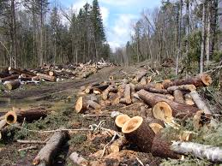
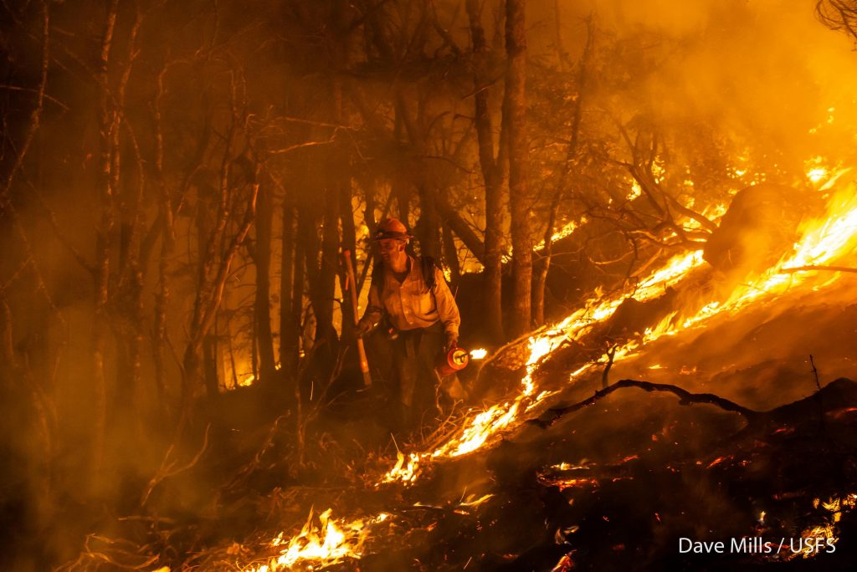
What is the picture about?
Cutting and burning trees

Slide 9
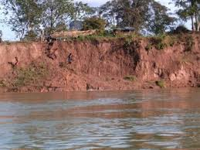
What is the picture about?
Soil pollution

Slide 10


Slide 11
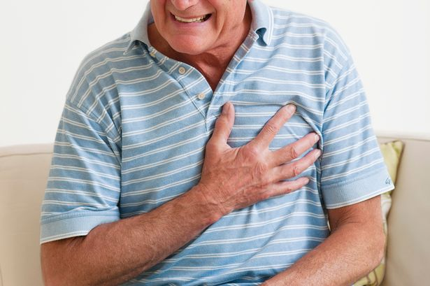

Slide 12
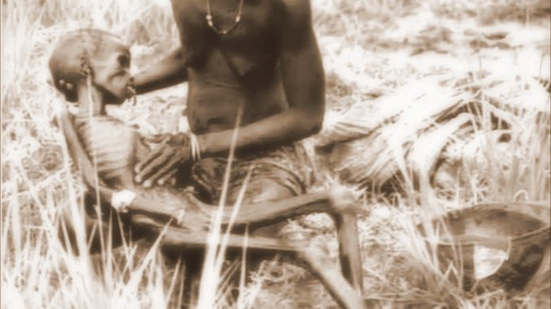

Slide 13
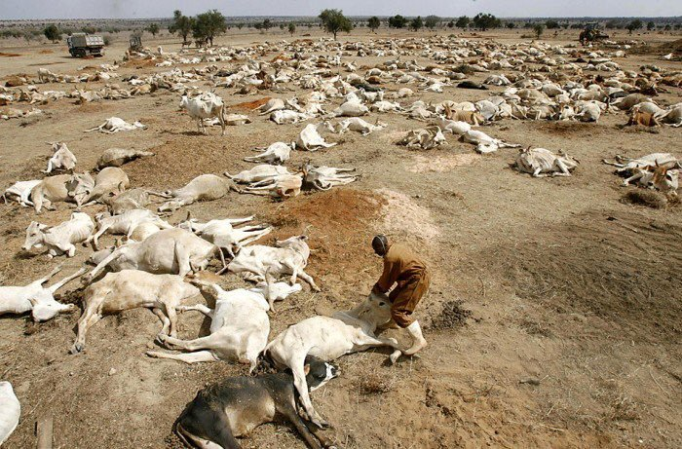
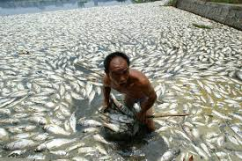
What does the pictures explain?
The results of environmental pollution

Slide 14
Individual work
(a) What do you see in each picture?
(b) What are some of the common sources of environmental pollution?
(c) Which of these sources are most threatening for your environment?
(d) What are the most important elements of our environment?
Answer:
(a) Different kinds of pollutions.
(b) Water, air, sound, soil are some common sources of environmental pollution
(c) Water and air pollution are most threatening for our environment.
(d) Water, air and soil are the most important elements of our environment.

Slide 15
Pair work:
Make a dialogue about environmental pollution

Slide 16
Group work:
Write the meaning of the following words: Erosion, automobile, pesticide, fertility leakages
Erosion- degradation - ক্ষয় .
Automobile- motor car- মোটর গাড়ি
pesticide- insect killer- কীট নাশক
Fertility- fruitfulness- উর্বরতা.
leakage- a thing that has leaked- ফুটো হওয়া

Slide 17
Evaluation:
Choose the best answer from the alternatives:
(a) Who are the worst sufferers of pollution ?
(i) rural people (ii) urban people (iii) hilly people (iv) forest people
(b) Which pollution comes from a wide variety of sources ?
(i) water (ii) soil (iii) air (iv) all
(c) We should avoid the vehicles those are older than ---------- years.
(i) 10 (ii) 15 (iii) 20 (iv) 25
(d) The elaboration of CNG is------
(i) Continuous National Growth (ii) Complete Natural Gas (iii) Commercial Natural Gas (iv) Compressed Natural Gas
(e) Which pollution occurs in oceans, rivers, lakes and ponds ?
(i) air (ii) soil (iii) water (iv) all

Slide 18
Fill in the gaps without clues:
Among the most (a) --- causes of soil pollution is the (b) ---- - volume of industrial waste which is being
(c) ---------- every day but not disposed (d) --------.The mismanagement of household wastes,(e) ---- the polythene shopping bags, has caused serious threat to the soil, and the drainage system.
significant
enormous
produced
properly
particularly

Slide 19

Home work
Write a paragraph about environmental pollution

Slide 20
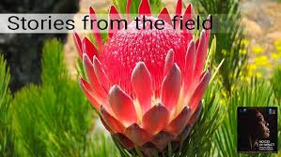
Thank you very much

