Slide 1
Well come all student Today lesson
Good morning

Slide 2
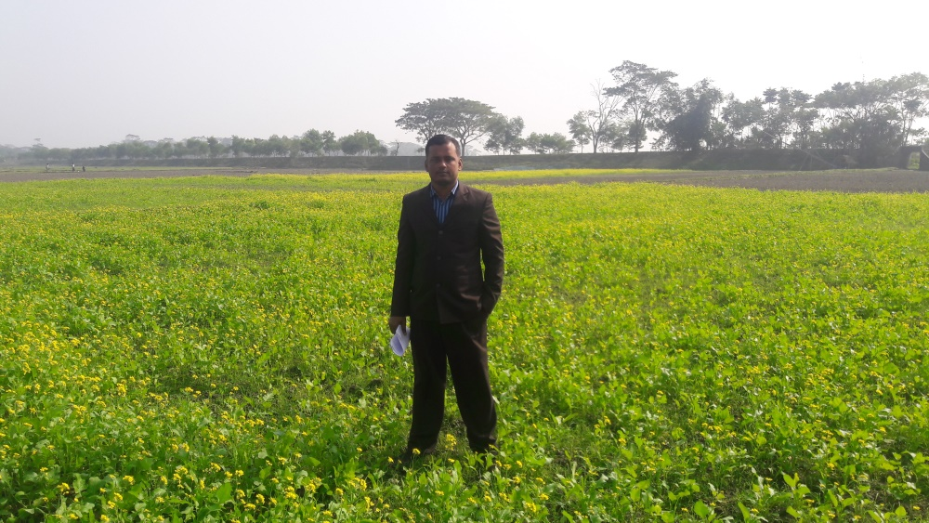
Introduce
Md. Sorfuddin Mridha
Assistant Teacher
41 No Luxmipur GPS
Matlab South, Chandpur
Mobile- 01818-490889
Class-1
Subject: English
Unit: 2
Lesson: 1-3
Text: A

Slide 3
Learning outcomes
Listening:
1.1.1 :- Become familiar with English sounds by listening to common English words.
3.1.1 :- Understand simple questions about students.
3.2.1 :-Understand simple statements.
Speaking:
1.1.1 :- Repeat after the teacher simple words and phrases.
1.1.2 :- Say simple words and phrases.
2.1.1 :- Greet each other.
2.1.2 :- Bid farewell to each other.
3.1.1 :- Answer questions asked by the teacher about students.

Slide 4
Creating a favorable environment for reading
Let see the video

Slide 5
One day One Word learning activities
Yesterday we learned a word, what is the word? Who can tell me?
Ans: Pencil
Who can tell the meaning of the word?
Pencil অর্থঃ পেন্সিল অথবা তূলী

Slide 6
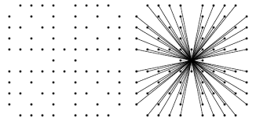
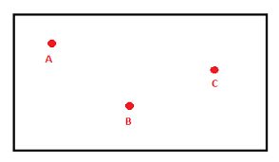
One day One Word learning activities
Today we will learn a new word. Write it down in your note book.
Point
Who can tell the meaning of the Point?
Point অর্থ
বিন্দু

Slide 7
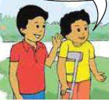
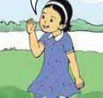
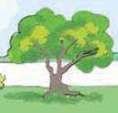
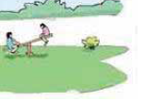
INPUT
Look at the picture. ACTIVITY .A
What can you see in the picture?
Two Boys
A Girl
A Tree
Two Child play near the river

Slide 8
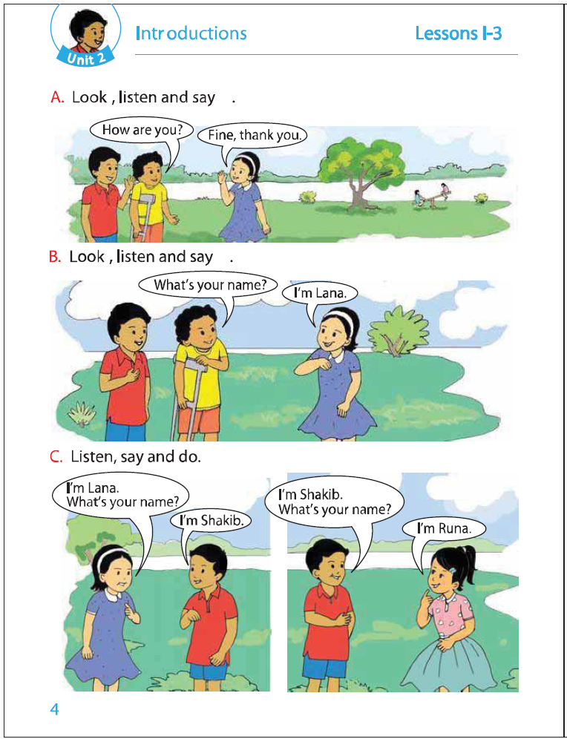
Dear student open your book, Page-4
And listen and Say with me.
At first listen a Audio player.
ACTIVITY .A

Slide 9
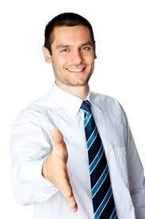
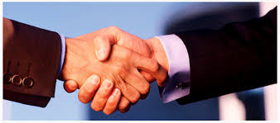
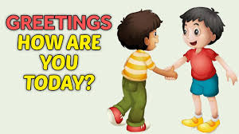
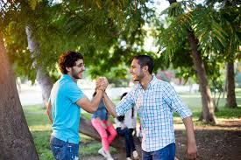
Practice
Now you Speak loudly
How are you?
Fine, Thank you.
Fine, Thank you.
How are you?
Fine, Thank you.

Slide 10
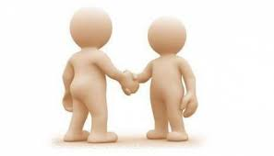
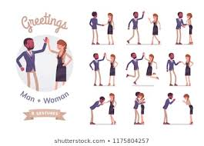
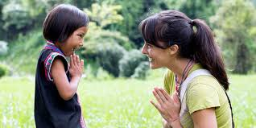
Pair Work:
As you see in the picture below, ask each other questions and answer in pairs.
Now again listen a Audio player.

Slide 11
Group Work
Now, divided into two groups, one group will ask and answer the other group.
Fine, thank you.
How are you

Slide 12
Task/Checking Learning/Assessment
What have we learned today?
Ans: We learn introductions.

Slide 13
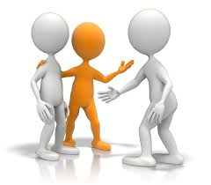
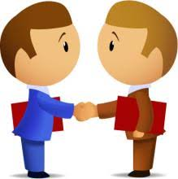
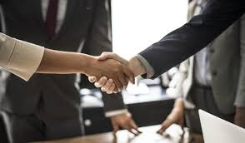
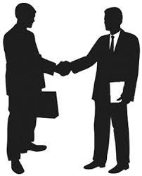
What do we say we will get to know each other?
How are you?
Fine, Thank you.
How are you?
Fine, Thank you.

Slide 14
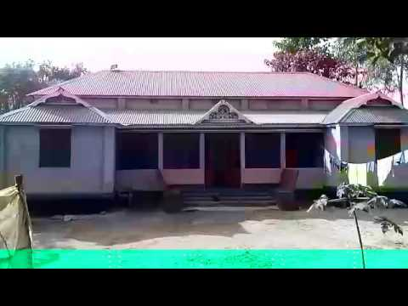
Home work
You will write English A & B Small (a, b) and capital (A, B) letters handwriting five times from home.

Slide 15
Thanks all students

