Slide 1
Welcome

Slide 2
Conducted by
S. M. Saraful Islam
Assistant teacher
Shiromoni Alim Madrasah,
Fultala, Khulna.
Phone – 01915455262
E-mail: sarafuli31@gmail.com
Subject : English 1st Paper
Class – IX-X, Unit – 5, Lesson - 1

Slide 3
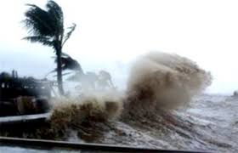
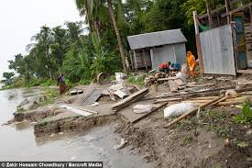
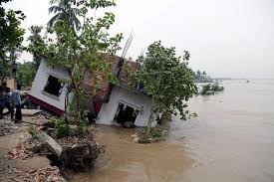
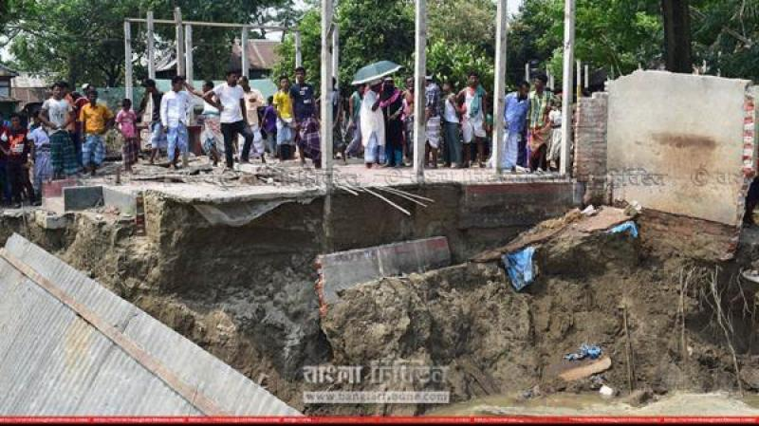
Let’s see some picture
What do you see in the pictures?
What happened their?
How was the river?

Slide 4
Our today's lesson is
The greed of the roaring rivers

Slide 5
Learning outcomes
After the end of the lesson, students will be able to...
ask and answer questions.
comprehend and summerise texts.
take part in debates on given topics

Slide 6
Vocabulary
Tremble (V)
Meaning :
to shake slightly, usually because you are cold, frightened, or very emotional.
When he came out of the water, he was trembling with cold

Slide 7
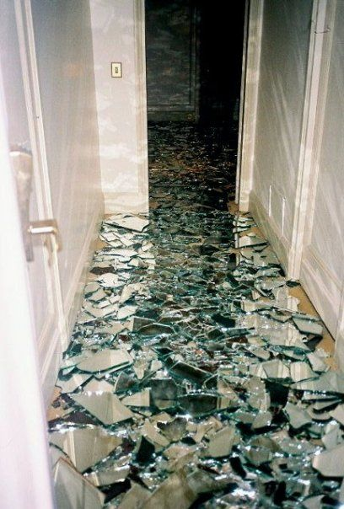
Shattered (Adj)
Meaning :
broken into very small pieces.
Shattered glass lay all over the floor.

Slide 8
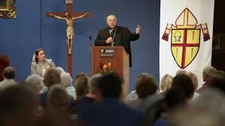
Prompt (V)
Meaning :
to make something happen.
The bishop's speech has prompted an angry response from both political parties.

Slide 9
Individually work
B. For each phrase below choose the meaning that is closest to the meaning used in the text above.
1. roaring rivers
a) rivers that flow strongly making wild sounds
b) rivers having many rowing boats in them
c) rivers that make people cry out
d) rivers that have noisy fishes
2. landed property a
a) rented piece of land
b) a piece of land on the bank of a river
c) property in the form a source of income to its owner
d) property used only as an agricultural farm
3. whispering wind
a) wind that blows from across the river
b) wind that blows with a hissing sound
c) wind that helps someone make a fire
d) wind that blows in summer
4. dancing of the flame a
a) traditional form of folk dance
b) a flame that makes people dance around it
c) a flame that is made unstable by the blast of air
d) a flame made by people to remember their pasts
Text

Slide 10
Read the following text and answer the questions.
Meherjan lives in a slum on the Sirajgonj Town Protection Embankment. Her polythene roofed shelter looks like a cage. She is nearly 45 but looks more than her age. In front of her shelter, she is trying to make a fire to cook the day’s only meal. Her weak hands tremble as she adds some fallen leaves and straw to the fire. The whispering wind from the river Jamuna makes the fire unsteady. The dancing of the flames reminds Meherjan of the turmoil in her life.
Not long ago Meherjan had everything--- a family, cultivable land and cattle. The erosion of the Jamuna consumed gradually all her landed property. It finally claimed her last shelter during the last monsoon. It took the river only a day to demolish Meher’s house, trees, vegetable garden and the bamboo bush. She had a happy family once. Over the years, she lost her husband and her family to diseases that cruel hunger and poverty brought to the family. Now, she is the only one left to live on with the loss and the pain. The greedy Jamuna has shattered her dreams and happiness.
There are thousand others waiting to share the same fate with Meherjan. Bangladesh is a land of rivers that affect its people. Erosion is a harsh reality for the people living along the river banks. During each monsoon many more villages are threatened by the roaring of rivers like the Jamuna, the Padma and the Meghna. It is estimated that river erosion makes at least 100,000 people homeless every year in Bangladesh. In fact, river erosion is one of the main dangers caused by climate change. If we can’t take prompt actions to adapt to climate change, there will be thousands of more Meherjans in our towns and villages every year.
Back

Slide 11
Pair works
C. Read the text and Ask and answer the following questions in pairs.
a) What does Meherjan use to make fire for cooking her meals?
b) What property did Meherjan lose due to river erosion?
c) What do you know about Meherjan’s family?
Text

Slide 12
Read the following text and answer the questions.
Meherjan lives in a slum on the Sirajgonj Town Protection Embankment. Her polythene roofed shelter looks like a cage. She is nearly 45 but looks more than her age. In front of her shelter, she is trying to make a fire to cook the day’s only meal. Her weak hands tremble as she adds some fallen leaves and straw to the fire. The whispering wind from the river Jamuna makes the fire unsteady. The dancing of the flames reminds Meherjan of the turmoil in her life.
Not long ago Meherjan had everything--- a family, cultivable land and cattle. The erosion of the Jamuna consumed gradually all her landed property. It finally claimed her last shelter during the last monsoon. It took the river only a day to demolish Meher’s house, trees, vegetable garden and the bamboo bush. She had a happy family once. Over the years, she lost her husband and her family to diseases that cruel hunger and poverty brought to the family. Now, she is the only one left to live on with the loss and the pain. The greedy Jamuna has shattered her dreams and happiness.
There are thousand others waiting to share the same fate with Meherjan. Bangladesh is a land of rivers that affect its people. Erosion is a harsh reality for the people living along the river banks. During each monsoon many more villages are threatened by the roaring of rivers like the Jamuna, the Padma and the Meghna. It is estimated that river erosion makes at least 100,000 people homeless every year in Bangladesh. In fact, river erosion is one of the main dangers caused by climate change. If we can’t take prompt actions to adapt to climate change, there will be thousands of more Meherjans in our towns and villages every year.
Back

Slide 13
D. Read the text and Complete the summery of Meherjan’s life with words/phrases from the box.
victims | affects | close to | slum dweller | homeless
threats | example | due to | shortage of food | one lakh
Meherjan is a typical (1) ……… woman who lives in a slum. She lost her shelter and properties (2) ……… the erosion of river Jamuna. She also lost her family. Her husband had died of diseases caused by poverty and (3) ………. Now, she is only a (4) ………. Like Meherjan there are many people who have become the (5) ……… of river erosion. River erosion is still posing (6) …….… to the lives and properties of thousands of people. People living (7) ……… the rivers are the most likely victims of river erosion. Each year about (8) ……… people become homeless due to river erosion in Bangladesh. Meherjan’s life is just one (9) …… of how climate change (10) ……… the lives of thousands of people

Slide 14
Group Work
E. Debate: Get into two groups of 3/4. Decide which group will speak for/against the motion. In your group, first, discuss and note down five/six points to support/oppose the statement given below. Then select the speakers from each group to start the debate.
Statement: Humans can’t do anything to control the course of nature.

Slide 15
Evaluation
Where did Meherjan take shelter?
How was she before losing her family?
What has shattered her dreams and happiness?

Slide 16
Home work
Write paragraph on "The greedy Jamuna."

