Slide 1
Chapter – 7
Waves & Sound…

Slide 2
Presented By:
Mohammod Jamal Uddin
Senior Teacher
Chattogram Cantonment Public College,
Chattogram Cantonment.

Slide 3
Discussed Topics
Sound
Waves
Characteristics and Kinds of waves
Complete Vibration
Time Period
Frequency
Amplitude
Phase
Wavelength
Wave Velocity
Sound Wave and Its Characteristics

Slide 4
Sound
What is Sound???
Sound is a mechanical wave that is an oscillation of pressure transmitted through some medium (like air or water), composed of frequencies within the range of hearing.
So that’s what we hear…..
No we can’t hear all kind of sound. The sound that is audible to us have frequencies of 20 Hz to 20,000 Hz…….

Slide 5
Waves
The periodic motion of particles which transfer energy from one place to another through a material medium but does not displace the particles permanently is called waves..
The wave produced in solid, liquid or gaseous medium is called mechanical waves.

Slide 6
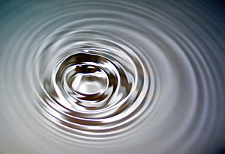
WAVE

Slide 7
The characteristics of waves are the following:
The wave is produced due to the harmonic motion of the particles but the particles are not displaced permanently.
A medium is necessary for the propagation of mechanical wave.
The wave transfers energy from one place to another
The velocity of wave depends on the nature of medium.
The reflection, refraction and superposition occur in case of wave.

Slide 8
Waves
Transverse Waves
Longitudinal Waves

Slide 9
Transverse Waves
A wave is seen to be created in the rope in the figure. The motion of the rope will always be horizontal whether the hand is moved from left to right or up to down. Here the direction of the particles is perpendicular to the direction of propogation of the wave. This very wave is called transverse wave.
The wave which moves perpendicularly to the direction of vibration of the particles is called transverse wave.

Slide 10
Complete Vibration
If a wave transmitting particle moves from a certain point and again comes back to the point then the motion is called complete vibration.

Slide 11
Time Period
The time interval in which the wave is repeated that is the times required for one complete vibration of a wave transmitting particle is known as time period. It is expressed by the letter T and its unit is second.

Slide 12
Frequency
The number of complete vibrations in one second of a wave transmitting particle is known as its frequency.
The unit of the frequency is HERTZ(Hz).
There is a relation between time period and frequency.
1
It is f= ---
t
What is 1 Hertz????
If a vibrating particle executes one complete vibration in one second then its frequency is called 1 Hz…..
How is it expressed????
It is expressed by ‘f’..

Slide 13
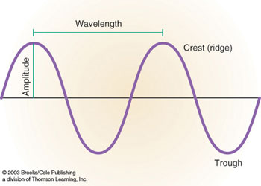
Amplitude
To produce wave the particles need to vibrate about their equilibrium position. The maximum displacement of a wave transmitting particle from the position of equilibrium is called Amplitude.

Slide 14
Phase
The overall condition of motion of a wave transmitting particle at any moment is known as phase.
The wave crest or the wave trough always remains in the same phase in case of transverse wave.

Slide 15
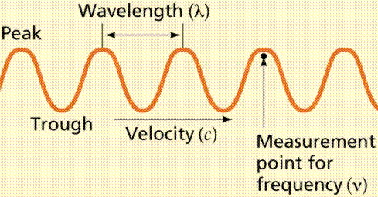
Wavelength
The distance between the two successive particles of same phase is called wave length.
Wave length is also defined as the distance through which a wave travels in a definite time during which a wave transmitting particle completes one oscillation.
The unit of wave length is meter(m). Wave length is expressed by λ (lamda)

Slide 16
Wave Velocity
What is velocity????
The distance covered by a body in one second is called velocity…..
Likewise, the distance that a wave travels in one second in a particular direction is called wave velocity…….

Slide 17
Sound Wave
Sound wave is a longitudinal wave. In the figure it is seen that during the circulation of wave, the detraction and expansion of the substance are created. The sound waves make a sense of hearing in our ear by being circulated from the medium.

Slide 18
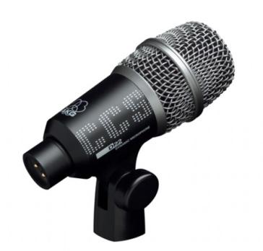
Thank You

