Slide 1

WELCOME

Slide 2
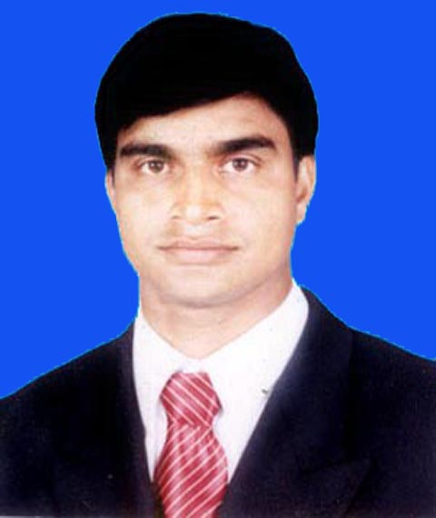

TEACHER’S INTRODUCTIONT
Md.Soriful Islam
Assistant teacher
Chowrapara Fazil Madrasha
Niamotpur, Naogaon.
soriful03@gmail.com

Slide 3
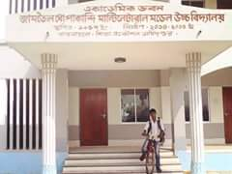

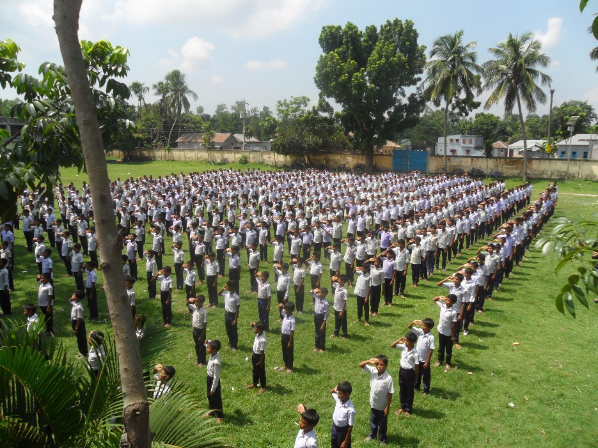

FOR WHOM
CLASS : Six
English 1st paper
Lesson: 23
Time: 45

Slide 4

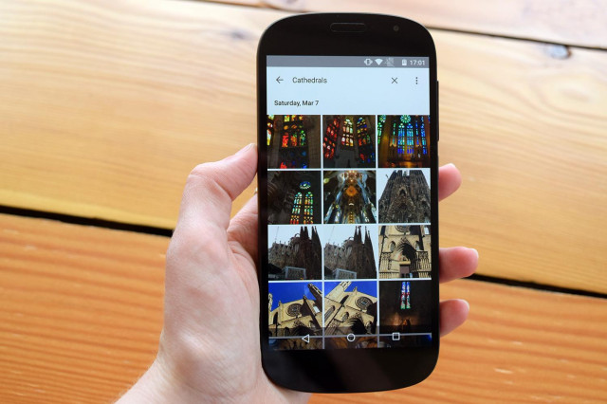
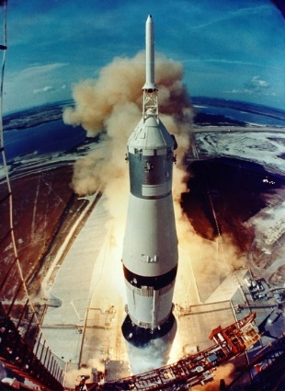
What can you see in the pictures?
Space travel
computer
Mobile phone

Slide 5
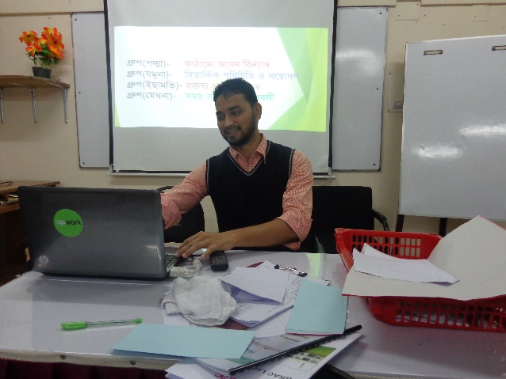

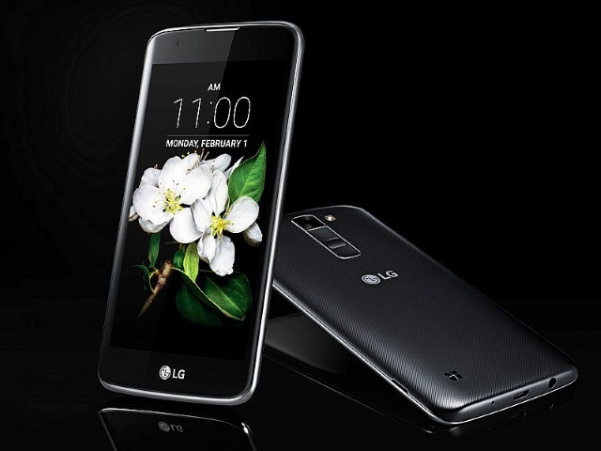
Our today’s topic is
Wonder of world - 2

Slide 6
LEARNING OUTCOMES
By the end of the lesson the students will be………
Read and understand text.
Introduced 3 new wonders
Write short paragraph
Learn new word and it’s meaning.

Slide 7

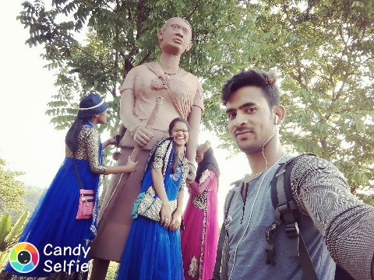
Vocabulary
Fabulous
Imaginary
Spacecraft
A traveling vehicle
Update
Modern

Slide 8
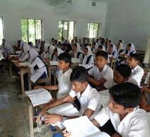
Read the text silently

Slide 9
Pair work
Match the words with the meaning
Column-A | Column –B
Lonely | Influence
Sphere | A vehicle that travels in space
Impact | Surprise
Wonder | Isolation
spacecraft | area

Slide 10
Answer
Column-A | Column -B
Lonely | Isolation
Sphere | Area
Impact | Influence
Wonder | Surprise
Spacecraft | Influence A vehicle that travels in space

Slide 11
What is this?
Computer

Slide 12

What is this?
Space travel
Notes:
First, the word will be shown. The SS will be asked to pronounce the word. If it is needed teacher will help. Then the picture will be shown and asked to guess the meaning. After that the meaning will be shown. Then they will be asked to make a sentence. Teacher will show the sentence for the feedback.

Slide 13
What is this?
Mobile

Slide 14
Read the words and match the opposite meanings given it in pair.
Column -A | Column-B
Unbelievable | Simple
Awesome | Backdated
Fabulous | Ordinary
Tremendous | Believable
Updated | Tiny

Slide 15
Answer
Believable
Unbelievable
Awesome
Simple
Fabulous
Ordinary
Tremendous
Tiny
Update
Backdated

Slide 16
Group Work
In small groups read the dialogue in section -B
and fill in the gaps.

Slide 17
Answer the fill in the gaps
Nira :Have you finished reading , Mong Pru? What do you think ?
Mong Pro : Thank you , Nira . I must say they are really pieasant .
Nira : Mong Pru , you see , most of the time we have access to mobile phones or computers . But perhaps we often do not feel the impact these innovation/things.
Mong Pru : Youare right . By the way , do you have a computer ?
Nira : Sometimes I use my parents’ laptop . I play games , or watch movies or browse the internet, I must say it is a good way to avoid loneliness
Mong Pru : So do you agree that it is not a luxury
Nira : Oh , no ! It’s not a luxury at all ! Any way , what’s your opinion about mobile phones and spacecraft?
Mong Pru : Well , I always wonder how this tiny device works without any cable and do so many things ! It’s a pleasant Surprise for us , isn’t it ?
Nira : No doubt about it ! And spacecraft ?
Mpng Pru : After reading the articles we must say that it’s Unbelievable !

Slide 18
Evaluation
What type of work can we in computer?
Whose did fly with the first Aero-plane ?
What type of work have a mobile phone ?

Slide 19
Answer
We can use computer in every sphere of life . We can use it for studies, communication, watching moves , listening music , playing games etc.
Right brothers.
Making calls , listening music , taking photographs , storing information etc .

Slide 20
Home Work
Write a short paragraph on. ………
Computer

Slide 21

Thank you all

