Slide 1
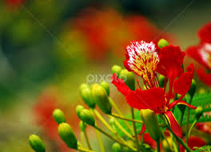
Welcome

Slide 2


INTRODUCTION
OF TEACHER
Md.Ali Hosen
Assistant teacher
Madhobpara Govt. Primary School,Kaligonj,Lalmonirhat.

Slide 3

INTRODUCTION
OF LESSON
Sub: English
Class:5
Lesson: Unit-20(1-2)
Topic: It’s ------school.
Time: 40 minutes
Date: 22.08.2019

Slide 4
Learning Outcomes
Listening:
1.3.1 Recognize which words in a sentence are stressed.
4.2.1 Understand and enjoy simple stories.
Speaking:
1.1.1 Say words sentence with proper sounds and stress
Reading:
Read words and sentence in the text with proper pronunciation, stress and intonation

Slide 5
Let,s see some pictures

Slide 6
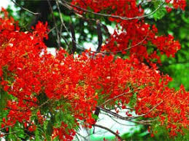

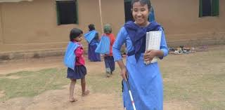
Life is beautiful

Slide 7

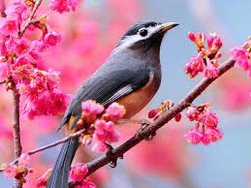
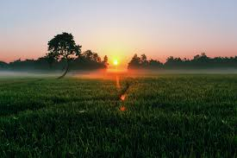
PRESENTATION
It’s a beautiful spring day.

Slide 8
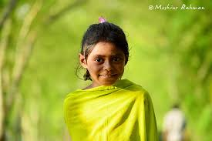
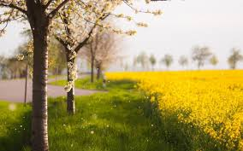
Maria get’s up early. She feels happy because she knows it’s a nice day of spring.

Slide 9
She opens the window and the singing of the birds, smell the flowers outside her room .She smell sweet and fresh air.

Slide 10
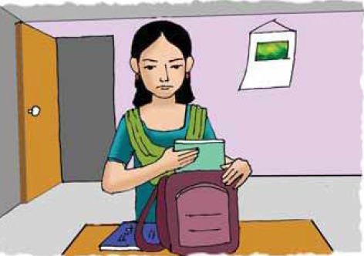
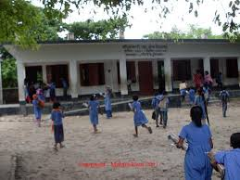
Maria
School
After Maria gets dressed and has her breakfast, she puts her books in her bag .she is ready for school.

Slide 11


Let’s go play
Let’s search stress words:
1. Beautiful

Slide 12
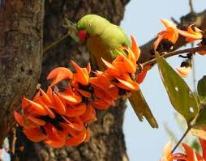
2. Spring

Slide 13
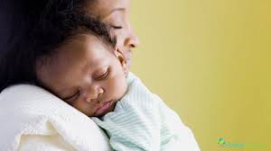
3. Warm

Slide 14
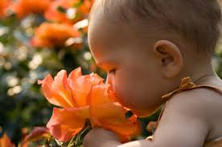
4. Smell

Slide 15

Let’s divided in Five groups included 5 students.
A. Group
1. It is nice day ----
Spring
2. It was a warm day because -------
The day was sunny

Slide 16

B. Group
Choose the best answer
It is very ----
a. hot b. warm
2. The smell is ------
a. sweet b. sweet and fresh.
3. Maria is ready for
a. school b. University
√
√
√

Slide 17
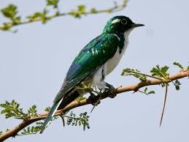
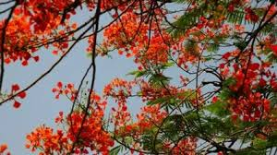
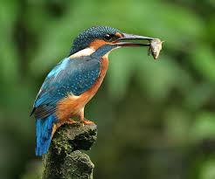
C. Group
A column B column
Spring
Cuckoo Birds

Slide 18

D. Group
Make WH Question
1.Maria feels happy.
Who feels happy?
2. It’s a beautiful day.
How the day is?

Slide 19

E. Group
Re-arrange
1. Maria the window opens.
1.Maria opens the window.

Slide 20
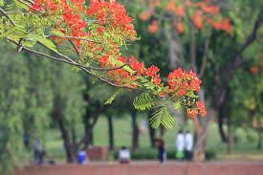
2. It’s day spring beautiful a.
2. It’s a beautiful spring day

Slide 21
Write some flowers and birds name of Spring season in next class.

Slide 22

Let’s listen a song.
Good bye

