Slide 1


Welcome

Slide 2

Teacher’s Information
Md. Shamsul Alam
BA(Hons.)MA in English.
Assistant Teacher( English)
Sikondarpur Alhaj Abdul Hafiz High School
Osmaninagar, Sylhet.
Phone:01917-452052,01722-922691
Email:shamsul101085@gmail.com

Slide 3
LESSON INTRODUCTION
Class : Ten.
Subject : English 1st Paper.
Unit : 05
Lesson : 02
Total s’s : 52
Time : 45 minutes.
Date : 30/09/2019

Slide 4
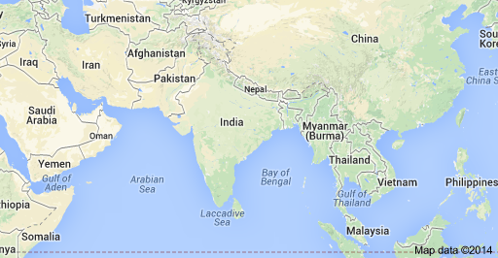
What do you see in the picture?
We see the world map in the picture.

Slide 5
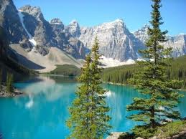
What do you see in the picture?
ROCKY MOUNTAIN

Slide 6
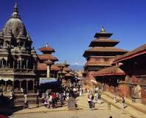
What do you see in the picture?
The capital city of Katmandu.

Slide 7

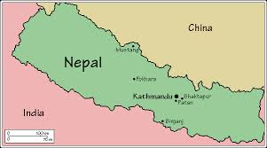
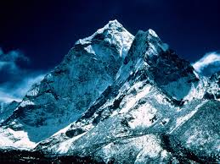
Today’s Lesson
Nepal, the land of Everest
National flag
Map of Nepal
Mount Everest

Slide 8
Learning Outcomes
By the end of the lesson the learner will be able to
*read, comprehend and summaries texts.
*ask and answer questions.
* learn about mountain Everest.
*Learn about the climate of Nepal.

Slide 9
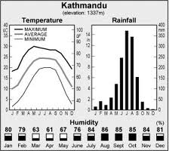
The climate of Nepal

Slide 10
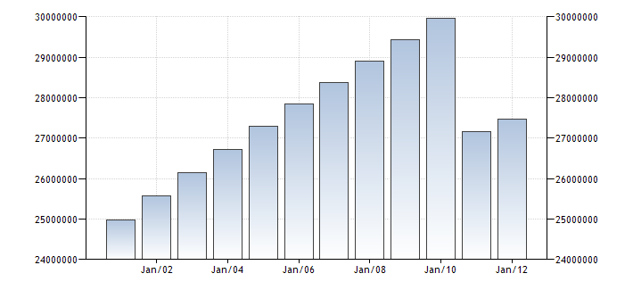
﻿The population of Nepal, as of late 2012 and early 2013, was estimated to be 29,860,686. Today, however, it is only 28,704,260. Among this population estimate, the majority of Nepalís inhabitants are women. Moreover, about 34.1% of the total population lies in the 25-54 year old age bracket, providing Nepal with a significant working force in its ranks.
The population of Nepal

Slide 11
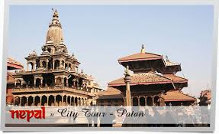

The temple of Nepal

Slide 12
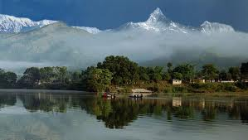
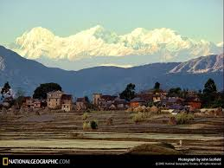
Natural beauty and cultural heritage.

Slide 13
Vocabulary
Temple
Holy place
Vale/dale
Valley

Slide 14
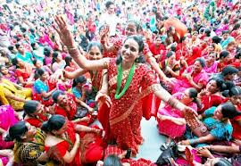
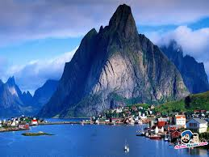
Festival
Function
Hill/Rock
Mountain

Slide 15
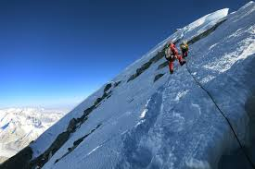
Individual work
Write 5 sentences about Mount Everest.

Slide 16
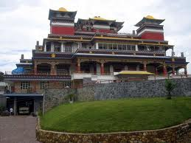
Group work
Group--A
Look at the picture and about them.

Slide 17
Group--B
Write 4 sentences about pokhara valley.

Slide 18
EVALUATION
*What is the name of capita city of Nepal ?
*Where is Pokhara valley?
*Write 4 sentences about the climate of Nepal?

Slide 19
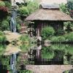
HOME TASK
Write 5 sentences about Mount Everest

Slide 20

Shamsul

