Slide 1

Welcome

Slide 2
Introducing
Md. Saiful Islam
Assistant Teacher (English)
Bagbari Chowbaria High School
Tangail Sadar Tangail
E-mail: hridoy9555@gmail.com

Slide 3
Class: Six
Subject: English 2nd paper
Unit:06
Lesson:1-6
Students: 70
Time: 50 minutes
Date: 12-06-19

Slide 4
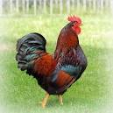
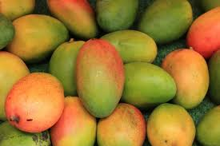

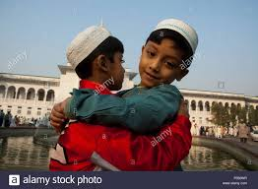
This is a hen.
Give me these mangoes please.
What is she doing?
Eid mubarak.
How nice the flowers are!

Slide 5
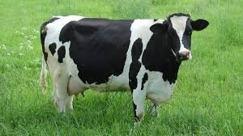
The cow is a domestic animal.

Slide 6

How sweet the apple is!

Slide 7

Eat small fish every day

Slide 8
Lesson declaration
Sentence

Slide 9
Learning outcomes
After finishing the lesson, learners will be able to---
Define the sentence.
Write their names.
Match the sentences.
Classify the sentences.

Slide 10
Classification of sentence
Sentence
Assertive
Exclamatory
Interrogative
Imperative
Optative

Slide 11
Individual work
What is called sentence?
How many kinds of sentences are there?
What is assertive sentence?
Answers
A group of words that gives a complete sense is called sentence.
There five kinds of sentences.
A sentence that asserts something
is called assertive sentence.

Slide 12
Peer work
Identify the following sentences:
They go to school.
Where are you coming from?
Please open the window.
May you be happy.
What a fool you are!

Slide 13
Group work
How many kinds of sentences are there?
Write their names with example.
Answer
There are five kinds of sentences. They are:
(1) Assertive (2) Imperative (3) Interrogative (4) Optative (5) Exclamatory

Slide 14
Evaluation
Match the following sentences
How nice the flower is! (a) Assertive
Come here please. (b) Imperative
Don’t they play cricket? (c) Optative
We go to school. (d) Exclamatory
May Allah bless you. (e) Interrogative
Answer:
(1) + (d), (2) +(b), (3) +(e), (4) +(a), (5) + (c)

Slide 15

Home work
Write definition of the sentences with example.

Slide 16

Thank you very much

