Slide 1
WELCOME

Slide 2
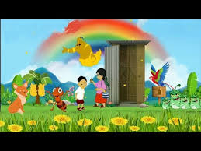
Teacher’s Identification
Lilufa Begum
Assistant Teacher
Patanondi Government Primary School
Chouddagram, Cumilla.
Notes:
Insert a picture illustrating a season in your country.

Slide 3

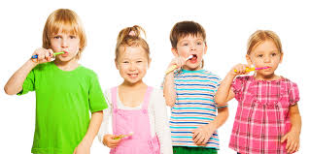
Introducing Lesson
Class: 3
Subject: English
Unit: 38, Lesson: 1-2
Title: Cleanliness
Time: 35 minutes
Notes:
Insert a picture of an animal and or plant found in your country.

Slide 4
CLEANLINESS
Title of the lesson

Slide 5
Learning outcomes : Students will be able to
Speaking :
1.1.1 repeat words, phrases and sentences after the teacher with proper sounds and stress
1.1.2 say words, phrases and sentences with proper sounds and stress.
Reading :
5.1.3 read texts
Notes:
Add key points in the history of your country to the timeline.

Slide 6
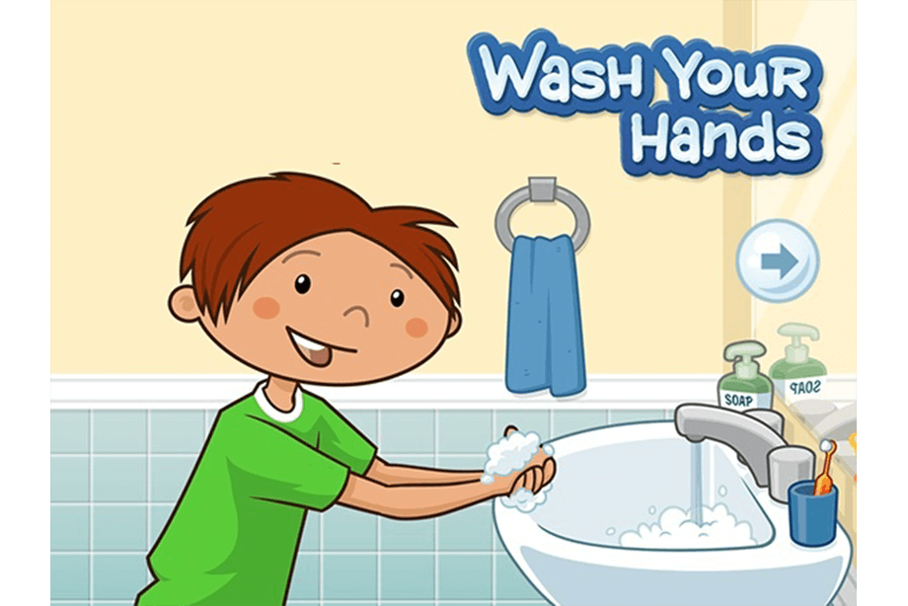
Look at the poster
What about the picture?
Notes:
Insert a picture of one of the points of interest for your country.

Slide 7
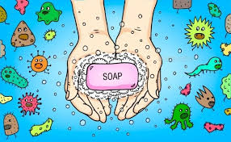
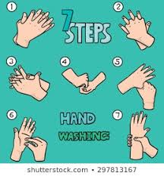
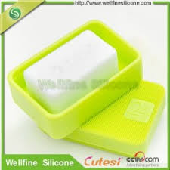
What about the picture?

Slide 8
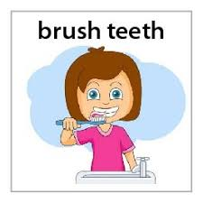
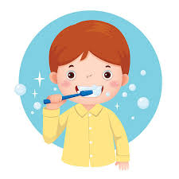
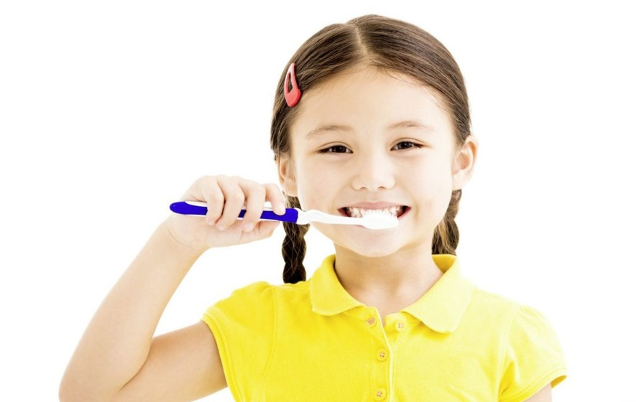
What about the picture?

Slide 9
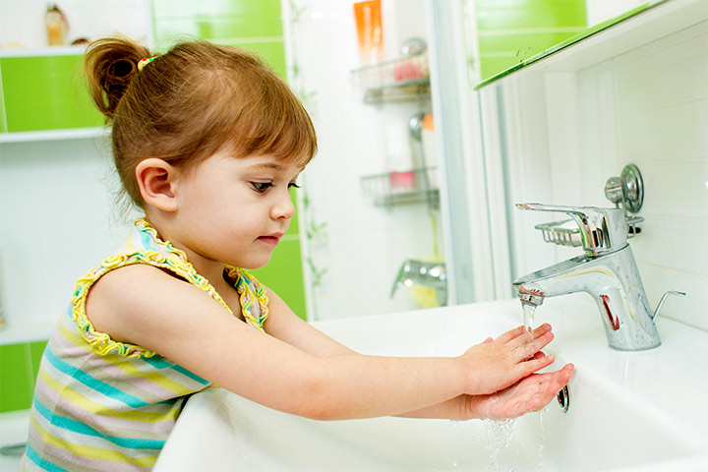
What about the picture?

Slide 10
BRUSH YOUR TEETH
Notes:
Insert a map of your country.

Slide 11
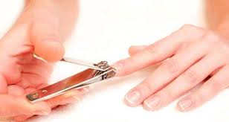
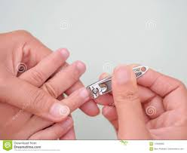
Clip Your Nails
Notes:
Insert a picture of one of the geographic features of your country.

Slide 12

Video Clips about Cleanliness

Slide 13
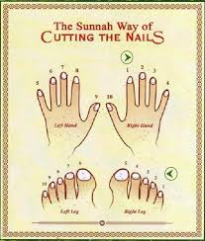


A. Listen and say.
Say after me
Repeat after me.
What do you see in the picture?
Soap
Nails
Clip
Toilet
Do you have any idea of meaning of the words?
Notes:
Insert a picture illustrating a custom or tradition here.

Slide 14
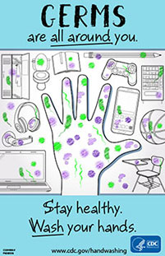
B. Read and say
BE HEALTHY
1. You should wash your hands with soap before and after meals.
2.You should brush your teeth every morning and every night.
3.You should clip your nails.
2.You should keep your nails clean
Notes:
Insert a picture of the head leader of your country.

Slide 15
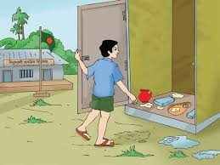

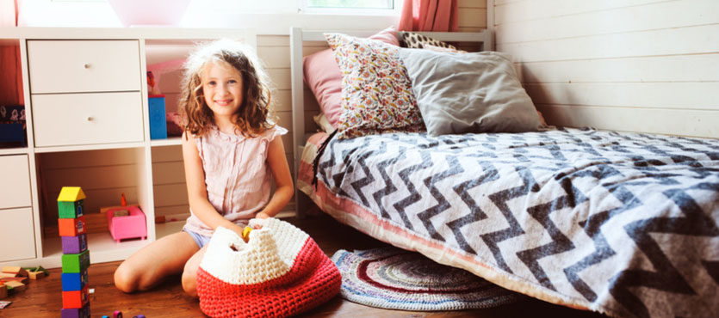
C. Look and say.
What do you see in the picture?
Notes:
Insert a picture that illustrates some part of your country’s economy.

Slide 16
Remember
Good habits for cleanliness:
Wash your hands with soap after going to the toilet.
2. Brush your teeth twice a day.
3. Cut your nails at least once a week.
4. Wash your hands before and after meals.
5. Take birth everyday with soap and water.

Slide 17
Pair Work
Discuss with one another about the rules of hygiene.

Slide 18
EVALUATION
1. Let the students to read the poster.
2. Repeat words, phrases and sentences with proper sound and stress.

Slide 19
THANK YOU & GOOD BYE
Lilufa Begum
E-mail: lilufab8@gmail.com

