Slide 1
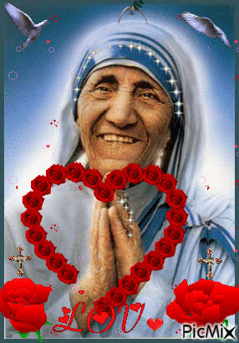
WELCOME

Slide 2
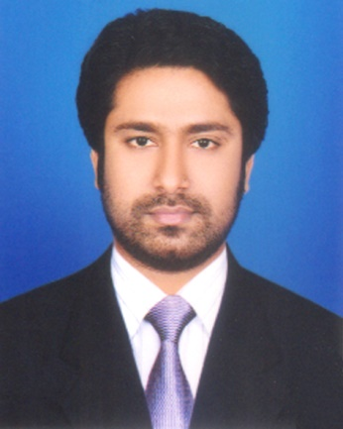
Presented by
M Humayun Kabir
English Teacher
Bhayeta Abdul Quddus Dakhil Madrasah, Tangail Sadar
Cell : 01727-425565 ; 01924-320532
E-mail : hkabir082009@gmail.com

Slide 3
Lesson Identity
People who stand out
Class Nine
Unit Seven
19 January 2019

Slide 4
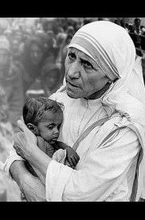

Slide 5
TOPIC
The missionary
Subject : English 1st Paper
Lesson : 5
Period : 1st
Time : 40 minutes
Date : 21 October 2019

Slide 6
Learning outcomes
After we have studied this lesson, we will be able to
listen to a text for specific information.
describe a person.
read and understand text throw silent reading.
ask and answer questions.

Slide 7
Lesson Presentation
According to
Learning outcomes-1 ; 2 :
listen to a text for specific information.
describe a person.

Slide 8
Let’s Listen to an Audio & Fill in the gaps
Part : A Open your book…

Slide 9
Evaluation
poor 11. significant
training 12. benefit
Patna 13. expanded
gather 14. orphans
forward 15. twenty-two
humanity 16. countries
official 17. continued
traditional 18. missions
obedience 19. England
service 20. two hundred

Slide 10
Part : B Check True or False. If false give the correct information.

Slide 11
Mother Teresa took a thorough medical training from the USA.
False. Corr. Inf. : Mother Teresa took
a thorough medical training in
India.
2. At first she collected children from the
streets and gave them food and clothing.
False. Corr. Inf. : At first she collected
children from slum and began
to teach them.

Slide 12
3. She and her group started to look after
and care for the lepers.
4. It took them a long time to go to other
cities of India.
False. Corr. Inf. : It took them very little
time to go to other cities of India.
5. Mother Teresa went to several countries.

Slide 13
Part : C Read the text in A again and complete the chart given below.

Slide 14
Dates
Events
Mother Teresa’s group received official status as a religious community.
1950
The Missionary of Charity began to work with lepers.
1957
1970s
Mother Teresa’s group continued to expand.
Mother Teresa’s group had more than two hundred different operations in over twenty-five countries around the world, with dozens more ventures to follow.
1979

Slide 15
Part : D Read the text in A again and answer the following questions.

Slide 16
What did Mother Teresa initially do before
beginning to work for humanity ?
Before beginning to work for humanity, Mother Teresa took an intensive medical training with the American Missionary Sisters in India.

Slide 17
2. How many vows did the Missionaries of
Charity take ? What were they ?
The Missionaries of Charity took four vows. They are :
Poverty
Chastity (purity)
Obedience and
Free service

Slide 18
3. What did Mother Teresa and her group do ?
Mother Teresa and her group worked for the lepers. They set up schools in Kolkata. Besides, they opened home for orphans and abandoned children.

Slide 19
Part : D Do you know anyone in your locality who helps the needy and does so to make others happy ? Write a short composition about him / her.
Home Task

Slide 20
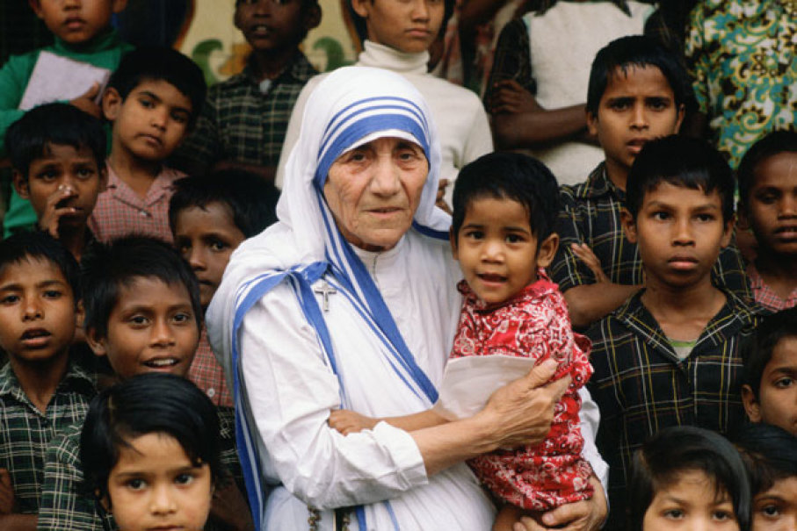
May Allaah swt donate us ability to work for humanity.

Slide 21
Thank you all

