Slide 1
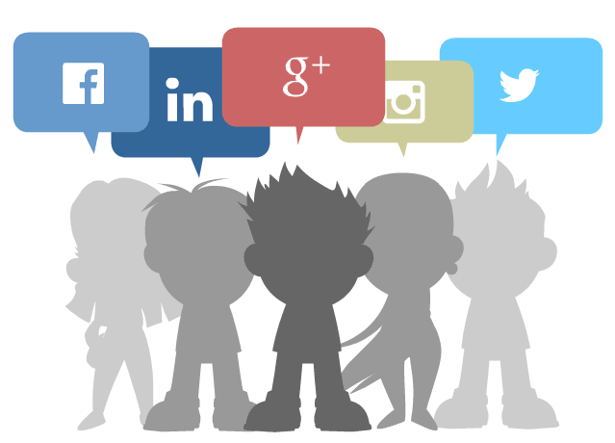

Slide 2


Welcome to all.

Slide 3
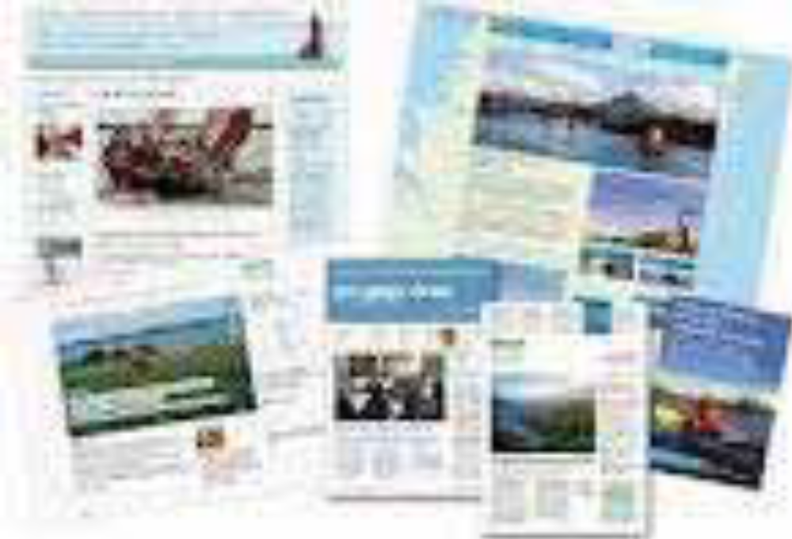


A: Look at the pictures and say what you see in them.

Slide 4
Let us watch the video.
Please click here to go to internet for watching Video.
What could you see on the video?

Slide 5
Media and modes of e-communication
Unit : XIII
[Media and modes of e-communication]
Lesson : 1

Slide 6
Learning outcomes
After the students have studied the lesson, they will be able to --- ---
surf the Internet;
read and write e-mails;
narrate incidents in a logical sequence;
understand texts;
participate in debate.

Slide 7
B: Work in pairs. Discuss which of the following words you are familiar with.
How are they related to e- communications?
Facebook,
e-mail,
web site,
blog,
e-commerce,
twitter,
e-learning,
iPod,
tablet pc,
information super highway,
social network,
smart phone,

Slide 8




Slide 9



New Words
Sth that you say or do to greet sb
Syn: complements
Greeting
Take over
Syn: control
Dominate
See in your mind’s eye
Syn: visualize, envisage
imagine

Slide 10
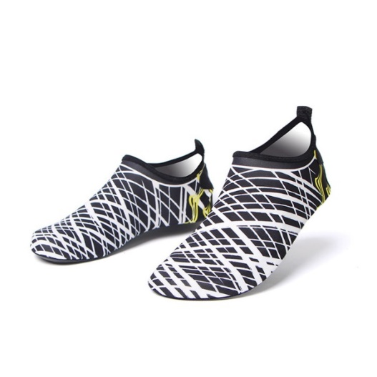
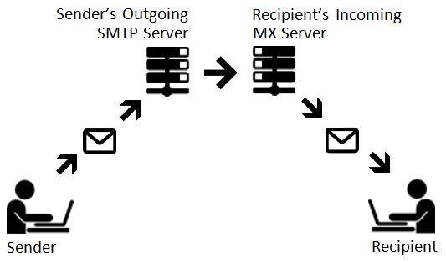

That you cannot avoid or prevent
Syn: inseparable
inevitable
A person or thing that receives
Syn: receiver,
Ant: donor
recipient
Involving several parts, elements or members
Syn: manifold, numerous
multiple

Slide 11
C: Open at page no. 165 from the text and read it to answer the questions that follow.
10 Minutes
Let’s imagine a citizen’s ordinary day at work. The morning --- ----- --- --- --- --- --- --- --- --- --- --- --- ---
--- --- --- --- --- --- --- powerful communication tool in modern life.

Slide 12
B - Questions:
1. What is an e-mail?
2. How do emails operate?
3. How do the commercial servers serve in the process of an e-mail?
4. ‘It has been a powerful communication tool in modern life.’ Explain the statement.
5. How do e-mails affect our daily work schedule?
Answer to the question no-5:
Sending and receiving dozens of e-mails in everyday has become a habit of many of us. Thus e-mail affects our daily work schedule.
Answer to the question no-4:
Here ‘it’ means an e-mail. At present we can instantly communicate with any person with the help of an e-mail. Thus it has been a powerful communication tool.
Answer to the question no-1:
An e-mail is an electronic mail used for sending and receiving digital text message.
Answer to the question no-3:
The commercial servers serve in an e-mail process by accepting the text message from the sender, following it and delivering instantly to the digital mailbox of the recipient.
Answer to the question no-2:
E-mails operate through a networks of computers linked by internet.
Now we see the answers of the four questions serially here.

Slide 13

SPEAKING TASK

Slide 14
D: Work in pairs and discuss the steps of your normal days, weekends, etc.
At first discuss in pairs.
Group Leader A: --- --- ----
Group Leader B: --- --- ----
Group Leader C: --- --- ----
Group Leader D: --- --- ----

Slide 15
E: Pair work. Read the following e-mail exchanged between two friends. Like an informal letter, an e-mail to a close one is casually written. Identify the mistakes in the main body of the message, discuss with your partner, and correct them.

Slide 16
Subject: Details of Dhaka Tour
FROM: Alexa Dowson<alexa.dowson@yahoo.com>
TO: Moutushi Laboni<moutushi1997@ymail.com>
Monday, May 21, 2012 6:20 AM
Hi Moutushi!
Thanks for your mail. I’ll fly from Ottawa on 7:36 hours local time on 13 July with Qatar Airlines via London-Doha and land Dhaka on 15 July around 13:41hours local time. Wish to stay 2 days in the Cox’s Bazar and 1 day in khulna. Return flight on 21 july at 3:04 hours local time.
Keep fine and in touch. Hope to see you soon!
Alexa

Slide 17
F: Pairwork. The email in section E is a reply by Alexa to Moutushi’s previous email. Imagine what Moutushi might have written to Alexa. Write that email.

Slide 18
G: Read the following text. It gives the information about the origin of the email. Choose the appropriate forms of the verbs from the box to complete the sentences. You can use a verb more than once.

Slide 19
send | say | use | remain | call
expand | allow | develop | spread
said
Sending text messages electronically could be ____ to date back to the Morse code telegraph of the mid 1800s and the 1939 New York World’s Fair. In the fair, IBM ____ a letter of congratulations from San Francisco to New York on an IBM radio-type, ____ it a high-speed substitute for mail service in the world of tomorrow. Teleprinters were ____ in Germany during World War II. The use ________ until the late 1960s
sent
calling
used
expanded

Slide 20
send | say | use | remain | call
expand | allow | develop | spread
when there was a worldwide Telex network. Additionally, there was the similar American system ____ TWX which ________ important until the late 1980s.
With the introduction of MIT’s Compatible Time-Sharing System (CTSS) in 1961, for the first time multiple users were _______ to log into a central system from remote dial-up terminals. They were also able to store and share files on the central disk. Informal methods of using this to pass messages ________ and were ____ to create the first true email system.
called
remained
allowed
developed
spread

Slide 21
H: Read the following grid first. Then listen to the CD/teacher and tick the right box in the following grid.
Comparison among emails, phone conversations and face to face meetings.
CLICK HERE TO LISTEN THE TEXT.
 | Time-consuming |  | reliable |  | efficient
 | less | more | less | more | less | more
E-mails
Phone conversations
F to F meetings
√
√
√
√
√
√
√
√
√

Slide 22


Slide 23
Answer the following question taken information from the passage C.
1. Which of the following has the closest meaning of the word ‘log’ in the passage?
a) send b) timber c) start d) enter
2. E-mails work through a network of computers connected by the ---- ---- .
a) television b) transistor
c) radio d) internet
3. If we use e-mail, we can save our --- --- --- .
a) wealth b) paper
c) property d) riches
d) enter
d) internet
b) paper

Slide 24

Every student will write one advantage and one disadvantage of the e-mail.

Slide 25
Thank you all.

