Slide 1
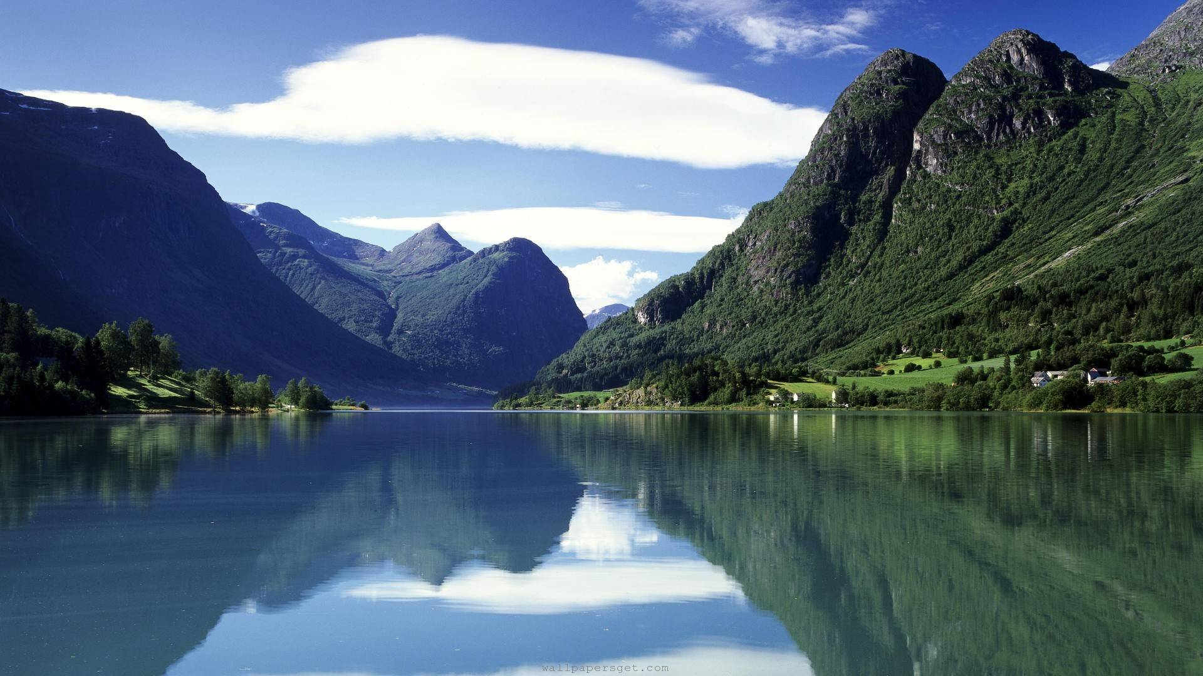
WELCOME

Slide 2

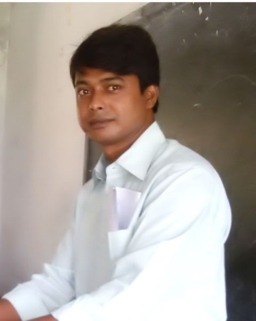
identity
Teacher
MD.TAIBUR RAHMAN
Assist teacher at
M:01718640068
Class & Subject
English 2nd paper
Grammar item
Class IX & X

Slide 3

No other boy in the class is as good as Rohim.
Rohim is better than any other boy in the class.
Rohim is the best boy in the class.
What do the lines refer …?
DEGREE

Slide 4

Yes, today’s topic is
Degreea

Slide 5
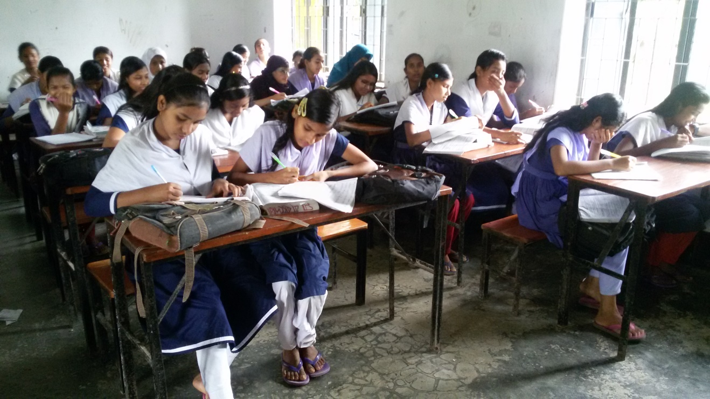
Learning out comes
At the end of the lesson the students will be able to
identify Positive, Comparative & Superlative form.
change the Positive into Comparative & Superlative.

Slide 6

Degree means
The comparison of adjective

Slide 7
Classification of degree is three
Positive
Good
Tall
Beautiful
Comparative
Better
Taller
More beautiful
Superlative
Best
Tallest
Most beautiful

Slide 8
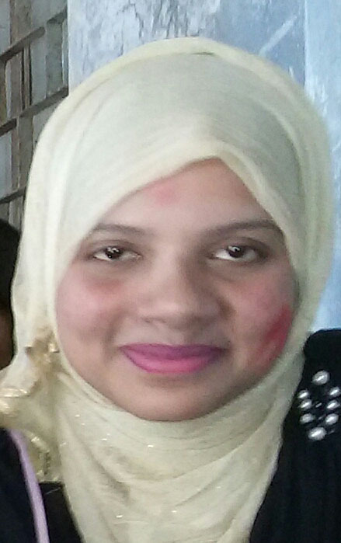
The positive sentence to comparative & superlative sentence.
No other girl in the class is as good as Rohima.(pos)
Rohima is better than any other girl in the class.(com)
Rohima is the best girl in the class.(sup)

Slide 9
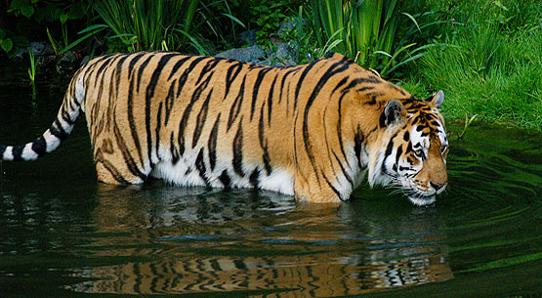
Lets try the positive sentence to comparative & superlative senence.
form no: 01
Posi:No other animal in the jungle is as ferocious as tiger.
Com:Tiger is more ferocious than any other animal in the jungle.
Sup: Tiger is the most ferocious animal in the jungle.
Change the positive sentences into comparative & superlative form.
No other girl in the village is as tall as Runa.
No other person in our school is as honorable as Kasem sir.

Slide 10
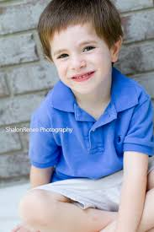

The positive sentence to compound & superlative
No other boys in the class are as good as Rohim. (posi)
Rohim is better than all other boys in the class.(com)
Rohim is the best of all boys in the class.(sup)

Slide 11
Lets try the positive sentence to comparative & superlative sentence.
form no: 02
Posi:No other girls in our village are as beautiful as she.
Com: She is more beautiful than all other girls in our village.
Sup: She is the most beautiful of all girls in our village.
Change the positive sentences into comparative & superlative form.
No other girls in the village are as tall as Runa.
No other persons in our school are as honorable as Kasem sir.

Slide 12
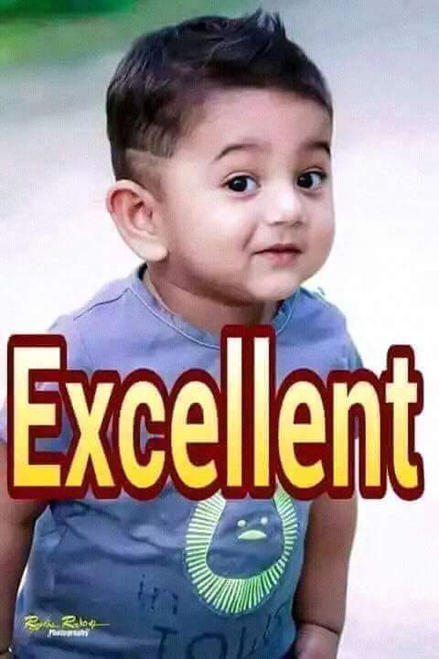
The positive sentence to compound & superlative
Very few boys in the class are as good as Rohim. (posi)
Rohim is better than most other boys in the class.(com)
Rohim is one of the best boys in the class.(sup)

Slide 13
Lets try the positive form to comparative & superlative.
form no: 03
Posi: Very few boys in our college are as tall as he.
Com: He is taller than most other boys in our college.
Sup: He is one of the tallest boys in our college.
Change the positive sentences into comparative & superlative form.
Very few girls in the village are as tall as Runa.
Very few persons in our school are as honorable as Kasem sir.

Slide 14

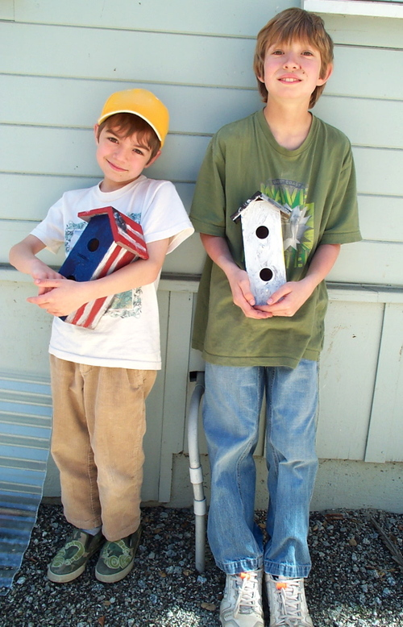
Here we can see that Jack is tall & Nion is short.
Jack
The comparative sentence to positive sentence
Nion
_
+
Com: Jack is taller than Nion
Posi: Nion is not as tall as Jack
Change the comparative sentences into positive
Rohim is better than Korim.
Runa is more beautiful than Bithi.
She is younger than he.

Slide 15


Here we can see that both Rifat & Sizan are same.
Rifat
The comparative sentence to positive sentence
Sizan
+
+
Com: Rifat is not taller than Sizan
Sup: Sizan is as tall as Rifat
Change the comparative sentences into positive
Rohim is not better than Korim.
Runa is not more beautiful than Bithi.
She is not younger than he.

Slide 16
Here we can see that Nion is short & Jack is tall.
Jack
_
The comparative sentence to positive sentence
Nion
Com: Nion is less tall than Jack
Pos: Nion is not as tall as Jack
Change the comparative sentences into positive
Rohim is less good than Korim.
Runa is less beautiful than Bithi.
She is less young than he.

Slide 17
Here we can see that both Rifat & Sizan are same.
The comparative sentence to positive sentence
Rifat
Sizan
+
+
Com: Rifat is not less tall than Sizan
Sup: Sizan is as tall as Rifat
Change the comparative sentences into positive
Rohim is not less good than Korim.
Runa is not less beautiful than Bithi.
She is not less young than he.

Slide 18
HOME WORK
HOME WORK
HOME WORK
It is the most important story in this book. (sup into posi & com)
He is the shortest of all students in our school. (sup into posi & com)
She is one of the most beautiful girl in the class.(sup into posi & com)
Shikha is taller than Beauty. (com into posi)
Ratul is not taller than Mintu. (com into posi)
It is less tall than that. (com into posi)
She is not less tall than he. (com into posi)

Slide 19

THANKS TO ALL

