Slide 1
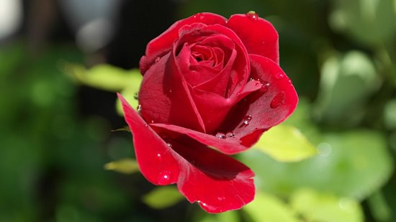
Welcome
everybody
to
Multimedia
class
Good
Morning

Slide 2


Identity
Nurul Aziz
Assistant Teacher (English)
Krishnakumari City Corporation Girls’ High School,
Nandankanan,Chittagong
E-mail : naziz13.na@gmail.com
Skype: naziz3924
English For Today
Class : 9
Time : 45 Minutes
Date : 17/07/2019

Slide 3
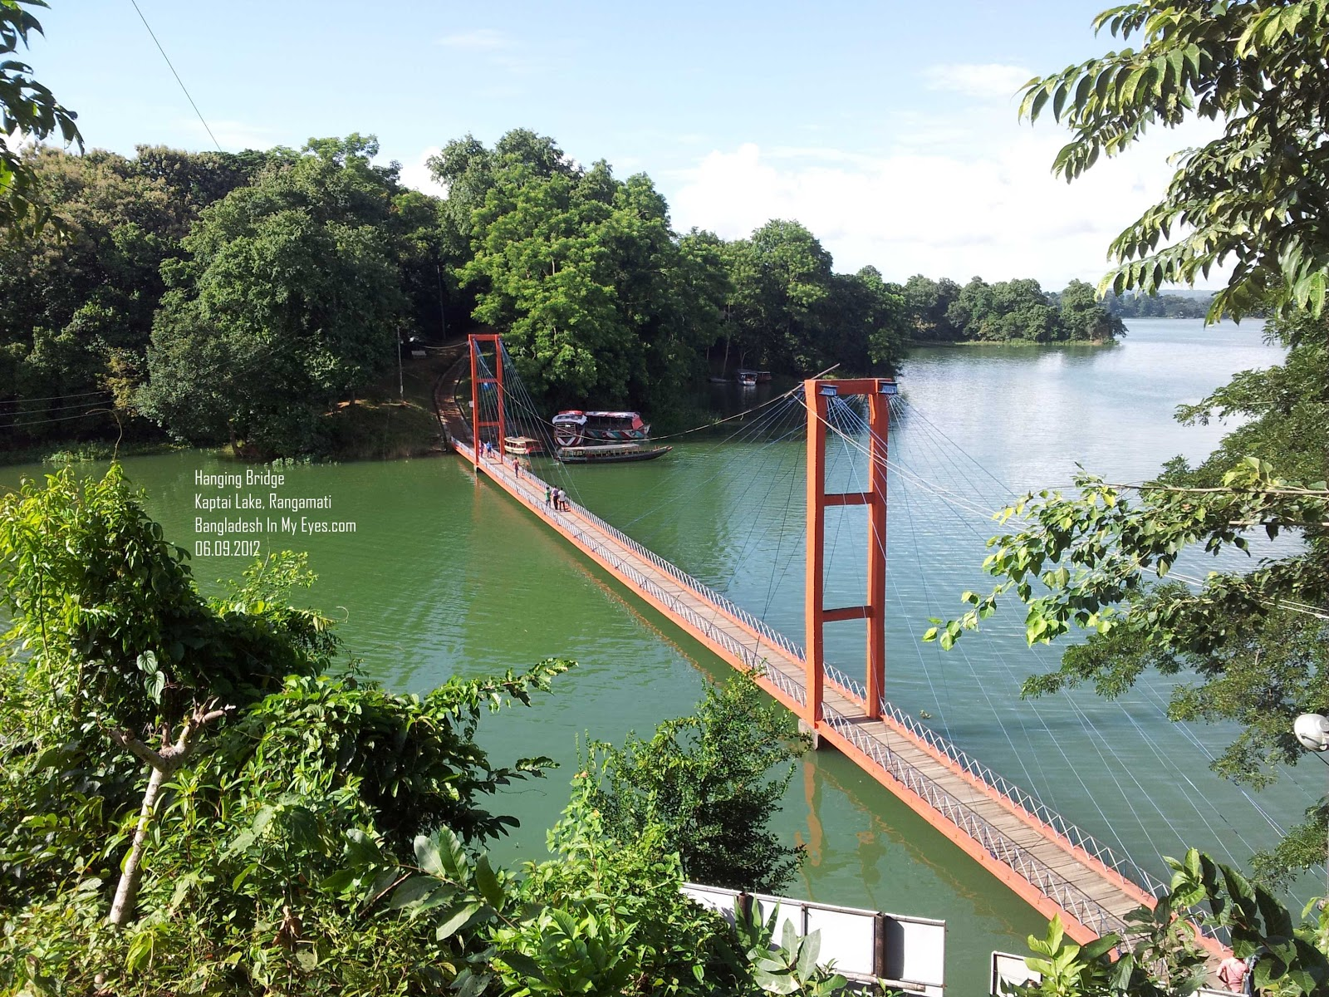
What do you see in the picture?
Kaptai Lake

Slide 4

Let’s watch a video…

Slide 5
Can you guess our today’s lesson?
Yes, Lake Baikal
Lake Baikal
Unit : 8, Lesson: 4
English For Today
Our today’s lesson is…..

Slide 6
Lesson outcomes
After the end of the lesson students will be able to
learn about the largest fresh water lake in the world,
tell about importance of Lake Baikal,
complete a chart ,
learn synonyms,
fill in the blanks using their own word,
summarize the given text.

Slide 7
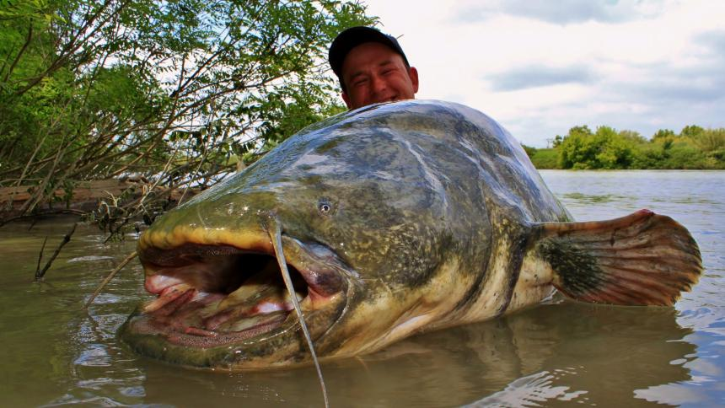
Vocabulary Presentation
Gigantic
(Adj.) Something oversize or massive
Syn. - huge, vast Ant. - Tiny, little
This is a gigantic fresh water fish.

Slide 8

Vocabulary Presentation
Autonomous
(Adj.) governing without any interference
Syn.- self-ruling
Ant.- dependent
Buryat is an autonomous republic.

Slide 9
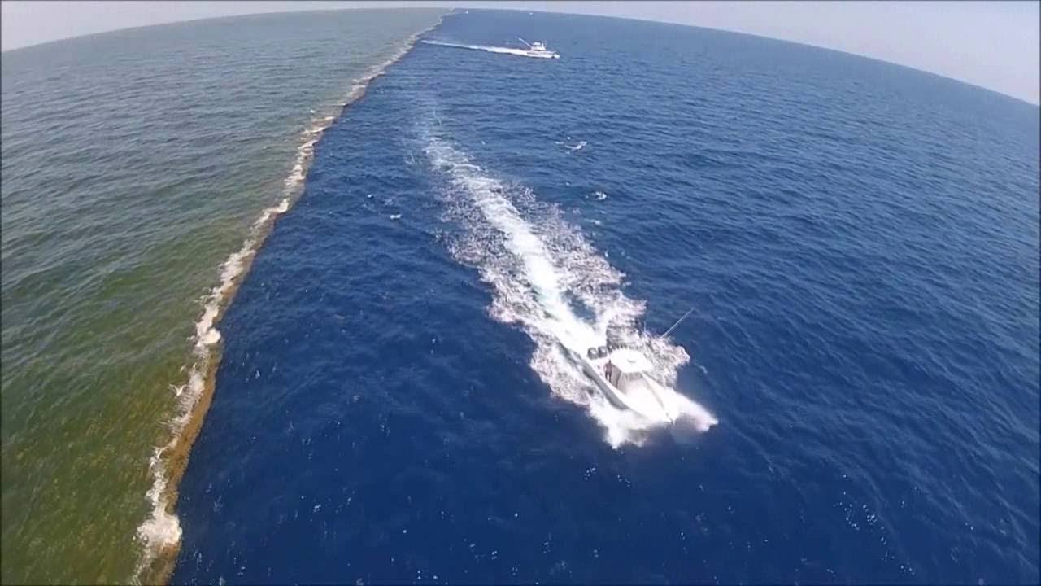
Vocabulary Presentation
Miracle
(Noun) Wonderful surprising event or thing
Syn.- wonder
Ant.- normalcy
Allah has created so many miracles in the world.

Slide 10
Individual Work
Complete the chart below with appropriate words.
words
Meaning
Miracle
An act believed to be caused by God
exceptional
outstanding
Basin
Bowl-shaped depression filled with water
Crest
top
Brook
Small stream

Slide 11
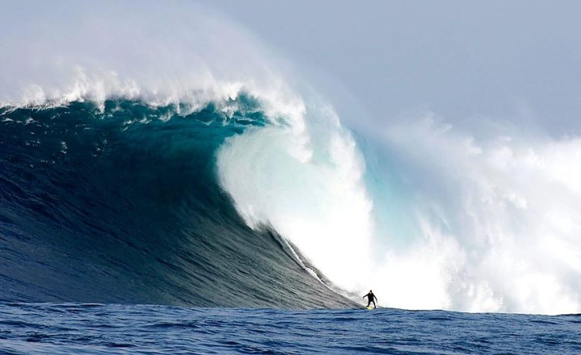
The picture below is related to para no. 4 of the passage.
Strong storms of Lake Baikal
Notes:
Note for teachers : Please let the students read the text from EFT book silently.

Slide 12
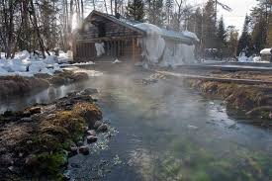
The picture below is related to para no. 4 of the passage.
Hot springs in the surrounding of Lake Baikal
Notes:
Note for teachers : Please let the students read the text from EFT book silently.

Slide 13
Pair work
The biggest lake in the world is so (a) that it is called a sea, the Caspian Sea. It is in Asia. It (b) an area of 31,500 square kilometres. This is the (c) lake having an (d) depth of 730 metres. The weather pattern of Lake Baikal is (e) to the direction of the wind-flow.
Fill in the blanks with appropriate words
vast
covers
deepest
average
subject

Slide 14
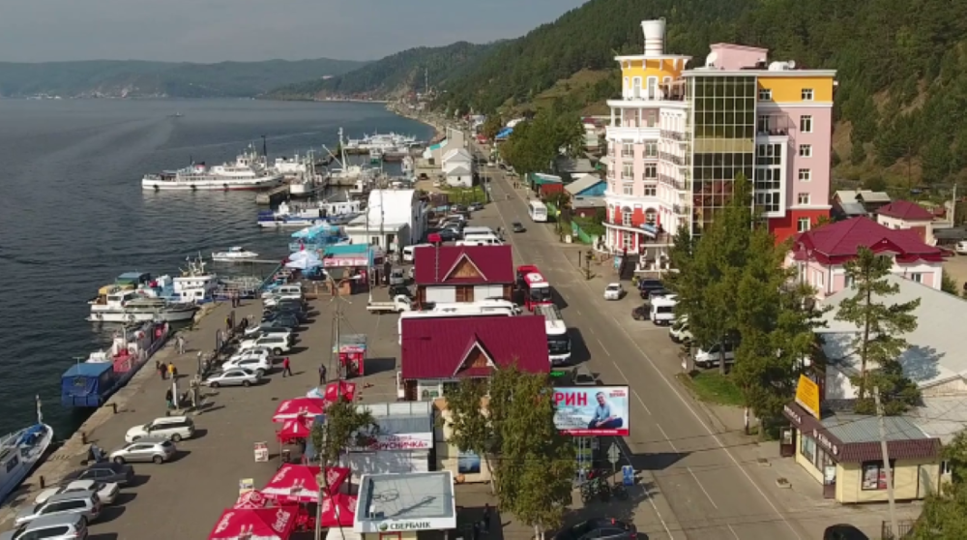
The picture below is related to para no.5 of the passage.
Bright and sunny weather of Lake Baikal
Notes:
Note for teachers : Please let the students read the text from EFT book silently.

Slide 15
Group Work
Answer the following questions
a)From your reading of the first paragraph, what do you know about Lake Baikal?
b) Do you think the beauty of the Lake Baikal is exceptional?
c) From your reading of the text, mention Baikal’s water-reserving capacity.

Slide 16
Evaluation
The Lake covers ------ sq. km.
It is 636 km long and an average of ---- km wide.
The widest point is ----- km
The water basin occupies ------ sq. km
The basin contains ------- cu.km of water.
The average water level is never higher than ----- meter
The average depth ----- meter
Maximum depth in the middle is ----- meter.
Please match the answers in the next slide.

Slide 17
Answers
The Lake covers 31,500 sq. km.
It is 636 km long and an average of 48 km wide.
The widest point is 79.4 km
The water basin occupies 557,000 sq. km
The basin contains 23,000 cu.km of water.
The average water level is never higher than 456 meter
The average depth 730 meter
Maximum depth in the middle is 1,620 meter

Slide 18
Home Work
Summarize the given text on Lake Baikal within 90 words.

Slide 19
Thank you all for your cooperation..

