Slide 1
WELCOME

Slide 2
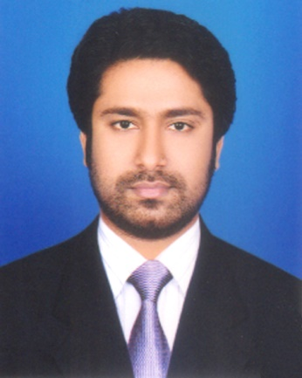
Presented by
M Humayun Kabir
English Teacher
Bhayeta Abdul Quddus Dakhil Madrasah, Tangail Sadar
Cell : 01727-425565 ; 01924-320532
E-mail : hkabir082009@gmail.com

Slide 4
Lesson Identity
A List of Auxiliary (Helping) Verbs and Uses
Class Six
Unit Ten
16 October 2019

Slide 5
Learning outcomes
After we have studied this lesson, we will be able to
know about auxiliary verbs.
find out auxiliary verbs and
use them properly.

Slide 6
Let’s Enjoy a Song

Slide 7
A List of Auxiliary Verbs
01. I recite am was have had shall
02. we recite are were have had shall
03. You recite are were have had will
04. You recite are were have had will
05. He recites is was has had will
06. She recites is was has had will
07. It recites is was has had will
08. Sami recites is was has had will
09. Meena recites is was has had will
10. Cat recites is was has had will
11. They recite are were have had will

Slide 8
The Uses of Auxiliary Verbs
Let’s Practise in our Tenses

Slide 9
Simple
Present Simple : I recite a poem.
Past Simple : I recited a poem.
Future Simple : I shall recite a poem.

Slide 10
Simple
s/es
Present Simple : He recites a poem.
Past Simple : He recited a poem.
Future Simple : He will recite a poem.

Slide 11
Simple
Present Simple : He is a student.
Past Simple : He was a student.
Future Simple : He will be a student.

Slide 12
Modals
Not s/es
Present Simple : He can recite a poem.
Past Simple : He could recite a poem.
Future Simple : He will be able to recite a poem.

Slide 13
Continuous
Present Continuous : I am reciting a poem.
Past Continuous : I was reciting a poem.
Future Continuous : I shall be reciting a poem.
am; is; are Ving
was ; were Ving
shall; will be Ving

Slide 14
Perfect Continuous
P. P. Continuous : I have been reciting a poem for 10 minutes.
P. P. Continuous : I had been reciting a poem for 10 minutes.
F.P. Continuous : I shall have been reciting a poem for 10 mn.

Slide 15
Perfect
Present Perfect : I have recited a poem.
Past Perfect : I had recitied a poem.
Future Perfect : I shall have recitited a poem.

Slide 16
am; were; has; shall
Assessment
Use 11 Subjects with following auxiliaries
can; should; might; must

Slide 17
Text Book (English for Today)
Home Task
Remember our class and try to find out the auxiliaries in your text books and journals
Newspaper (The Daily Star)

Slide 18
Thank you all
May Allaah swt learn and develop us the Auxiliary Verbs (our roots).

