Slide 1

Welcome to all

Slide 2
Presented by
Shahrina Bin Sweety
Assistant Teacher
Chormonai Madrasha Government primary school
Barishal

Slide 3
Lesson Introduching
Class: One
Unit: 12
Lesson:1-3
Subject:English
Topic:Number

Slide 4
Students will be able to
Reading:
2.1.1 recognize and read cardinal numbers 1 to 5.
Writing:
2.1.1 write cardial numbers 1 to 5 in figures and in words

Slide 5
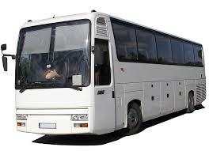
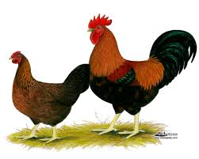
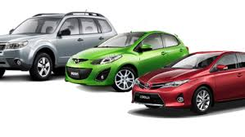
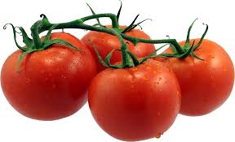
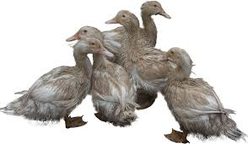
What can you see ?
3 Cars
1 Bus
2 Hens
5 Ducks
4 Tomatoes

Slide 6
Today’s lesson
Numbers

Slide 7

Look, listen, say and count.
1
ball

Slide 8
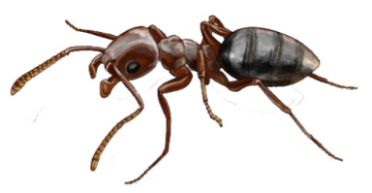

1
2
ants

Slide 9

1
2
3
cats

Slide 10
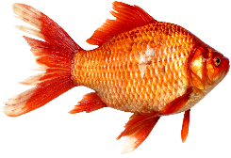



1
2
3
4
fishes

Slide 11

1
2
3
4
5
tomatos

Slide 12
Look and say.
1
2
3
4
5

Slide 13



Group work
Count and write the number of the balls.
5
Group-A
3
Group-B
4
Group-C

Slide 14
Number
5
4
1
2
3

Slide 15
Open your book page No. 24

Slide 16
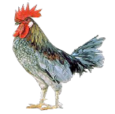

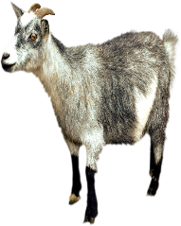








Count and write the numbers.
Evaluation
4
1
5
3
2

Slide 17

Good bye

