Slide 1
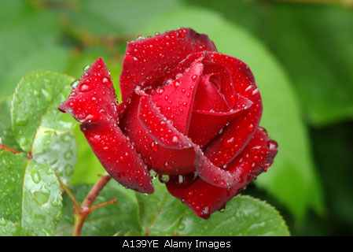
Welcome to Grammar class.
For class seven

Slide 2

Introduction
Abul kalam rubel
Assistant Teacher (commerce)
Shaheed alauddin High School
Mirzapur, Pakundia, Kishoreganj
Class: Six Time: 40 Minutes
Contact # 01712276872

Slide 3
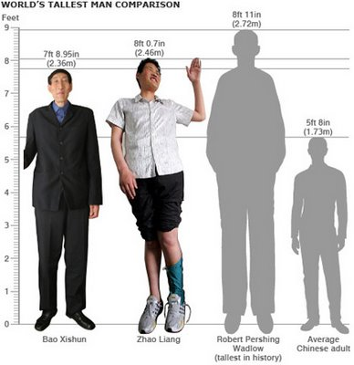

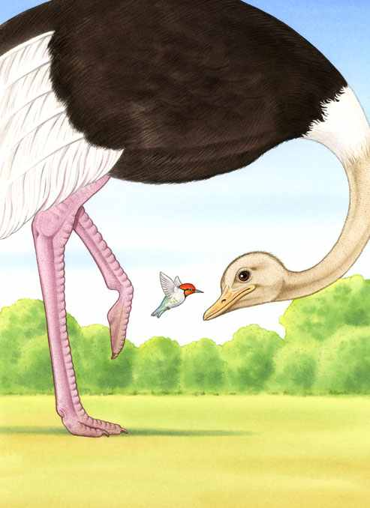
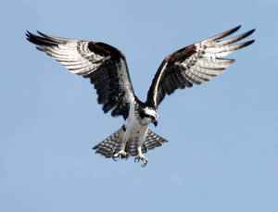

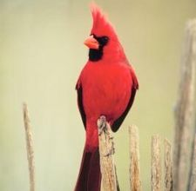
Look at the pictures carefully & try to guess what do they tell about:-
Taller
biggest
bigger
smallest
small
smaller
big
Tallest
Taller
Tall
Tall

Slide 4
Our today’s lesson is comparison of Adjective.

Slide 5
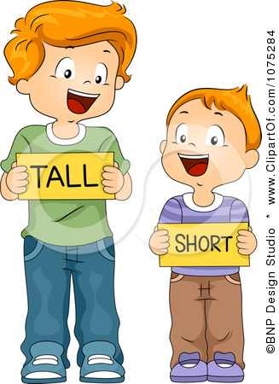
Students will be able to learn
Learning Outcome
Comparison of adjective
It’s classification
And their uses

Slide 6

Let’s watch a video.

Slide 7

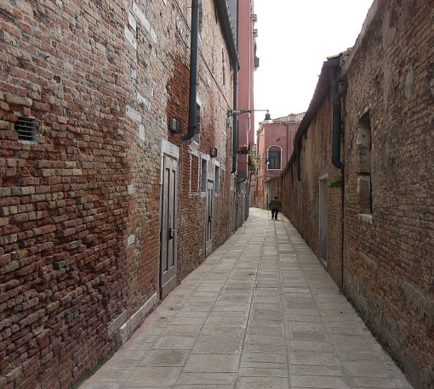
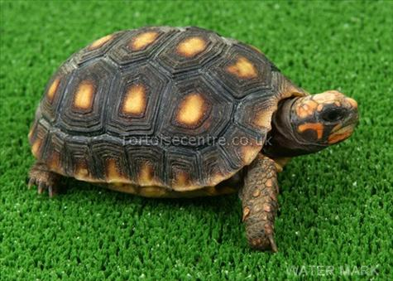
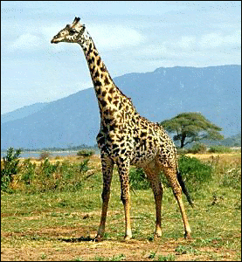
Positive
Tall
Narrow
Slow
Hot

Slide 8


Positive degree (continued)
Eifel tower is a
tall
man-made structure.
One noun with one quality – ‘tall’ adjective in positive form
Rahim is as
strong
as
Karim.
‘strong’ – adjective in positive form showing equality

Slide 9
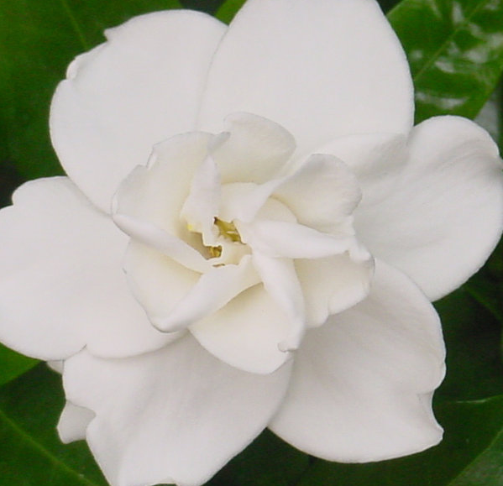

Degrees of Comparison:-
The white flower is as as the red flower.
beautiful

Slide 10
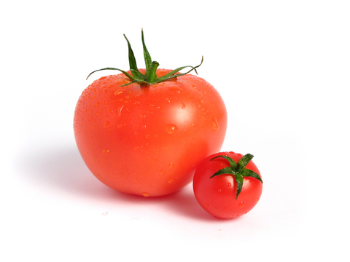
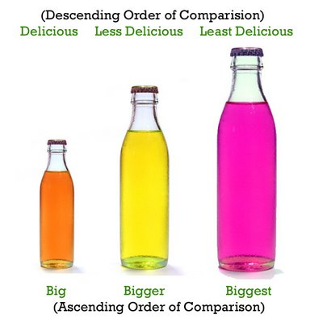
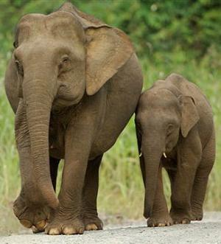
When comparison between two people or things we use the comparative form of the adjective & have to add “er” after word.
Small
Taller
Smaller
Larger
Tall
Large

Slide 11


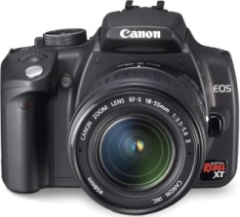
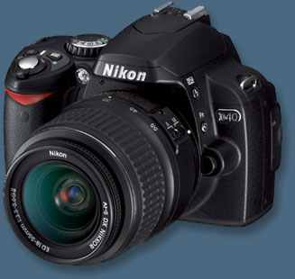
Comparative Degree: example
A horse can run than a dog.
faster
Nikon
TK. 20,000/-
Canon
TK. 10,000/-
The canon camera is than Nikon camera.
cheaper

Slide 12
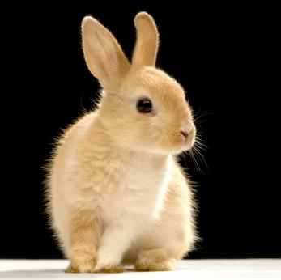
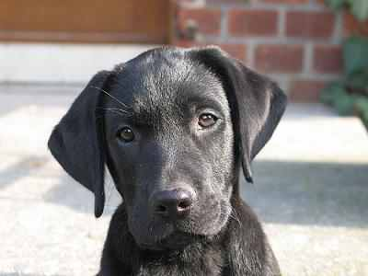
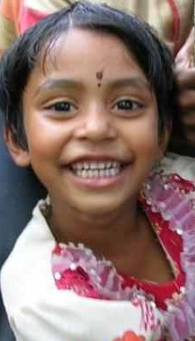
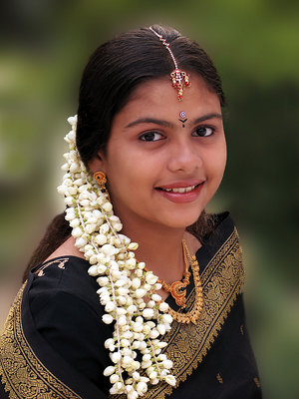
Example:-
A rabbit has ears.
large
A dog has ears than a rabbit.
larger
longer
I have hair than my sister.

Slide 13


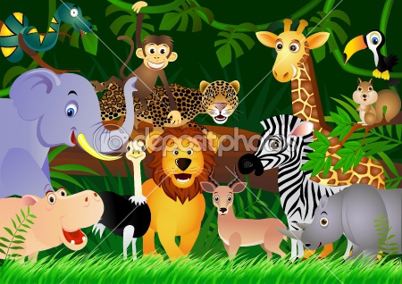
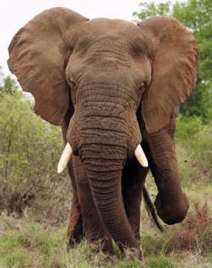
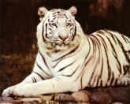
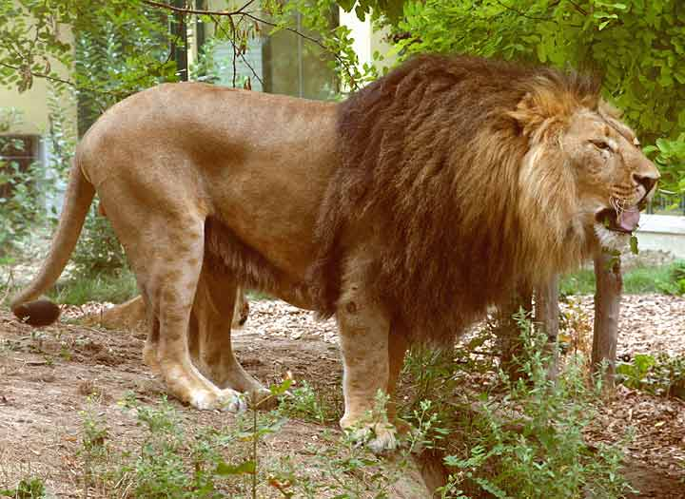
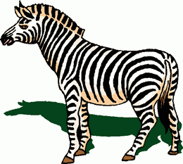
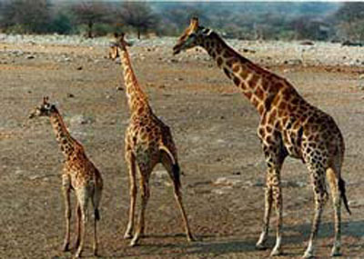
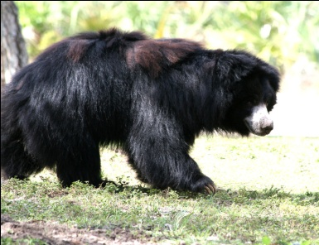
Superlative

Slide 14


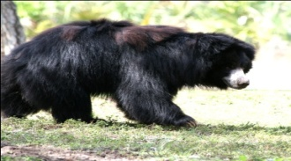
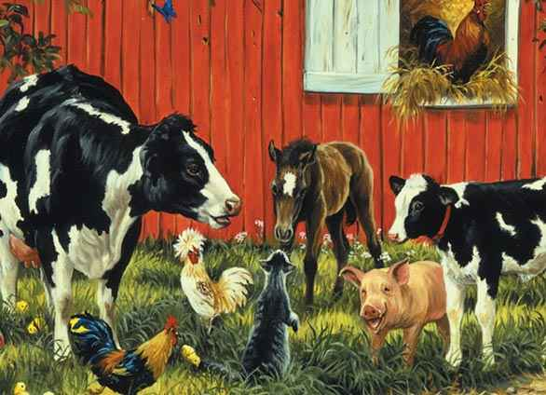
Superlative Degree:-
The elephant is the biggest of all land animals.
The tortoise is the slowest of all animals.

Slide 15

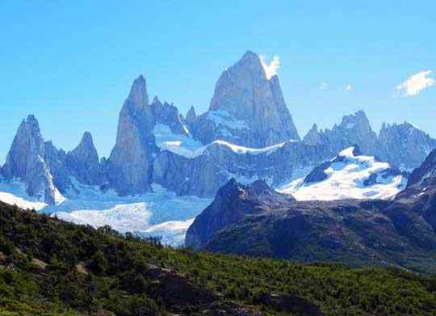
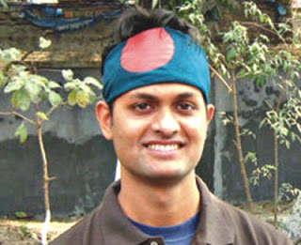
Superlative Degree:-
Mount Everest is mountain in the world.
the highest

Slide 16
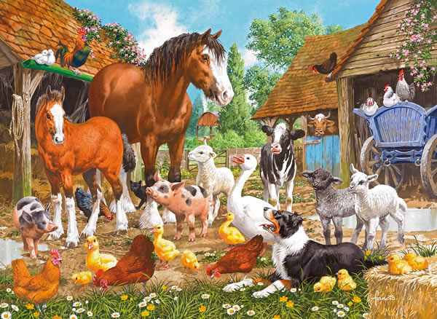
Group Work:-
Positive Form of Adjective
Comparative Form of Adjective
Superlative form of Adjective

Slide 17
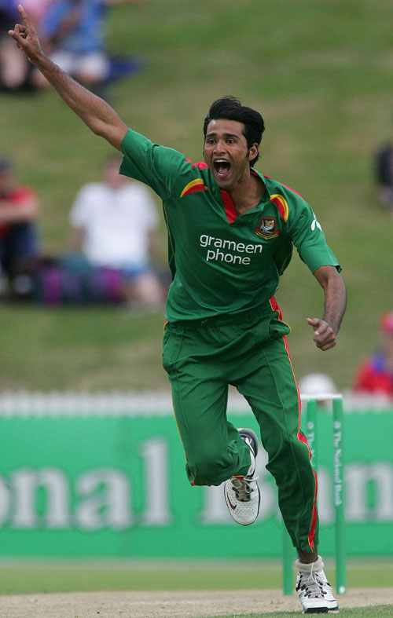
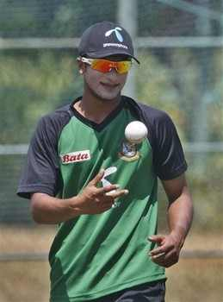
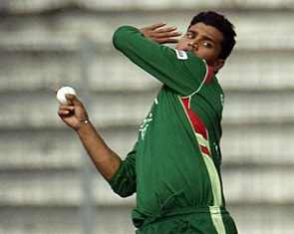
Evaluation:-
Tamim Iqbal is a bowler.
good
Sakib Al Hasan is a bowler than Tamim Iqbal.
better
Masrafe Mortaza is the bowler of all.
best

Slide 18
Home work :- Make 5 sentences by using the following words.
POSITIVE | COMPARATIVE | SUPERLATIVE
Wise | Wiser | Wisest
Good | Better | Best
Bad | Worse | Worst
Cold | Colder | Coldest

Slide 19


