Slide 1

WELCOME

Slide 2
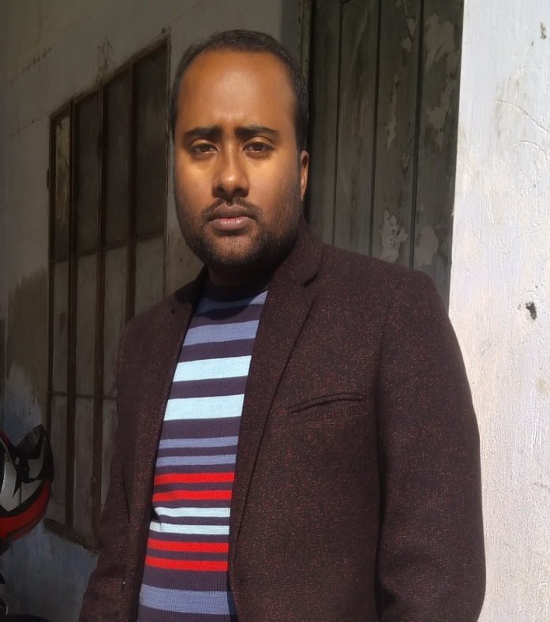
Teacher ‘s Identity
CHANDAN BISWAS
ASSISTANT TEACHER
ANDHA HIGH SCHOOL
E-mail: chandanb13@gmail.com

Slide 3
Class Identity
English-1st Paper
Class-Six
Lesson-14
Our pride

Slide 4

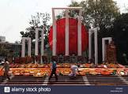
Look at the picture
National Monument
Shaheed Minar

Slide 5
Learning outcomes
After completing the lesson students will be able to-
*Read and understand the texts.
*To know about Our pride.
*Ask and answer the questions.
* Write short paragraph.

Slide 6
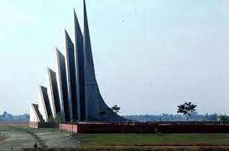
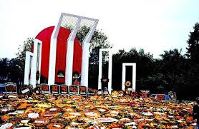
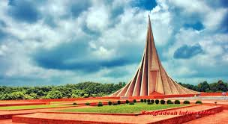
Look at the pictures
Our Pride

Slide 7
Learn the meanings of these words :
Pride
Declared
Unforgettable
Swooped
Surrendered
Martyr
Pledge
– গর্ব
ঘোষিত
- অবিস্মরণীয়
- চড়াও, পতিত হওয়া
- আত্মসমর্পণ
- শহীদ
- অঙ্গীকার

Slide 8
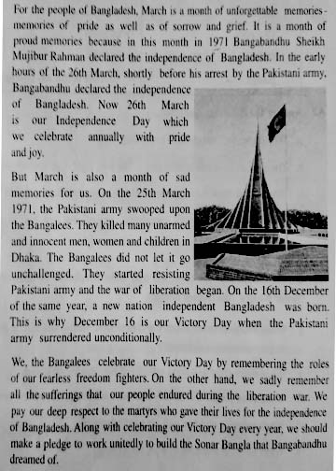
Read the following Passage

Slide 9
Match a word in column A with a word column B that has similar meaning.
Culumn A | Culumn B
Annually | Courageous
Heroic | Freedom
Liberation | Once a year
Surrender | Promise
Endure | To bear
Pledge | To admit defeat and give up

Slide 10

Home work
* Write a short paragraph about Our pride.

Slide 11

Thank you
everybody

