Slide 1
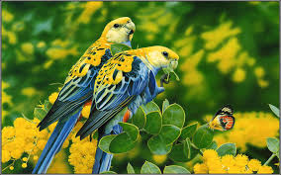
WELCOME

Slide 2
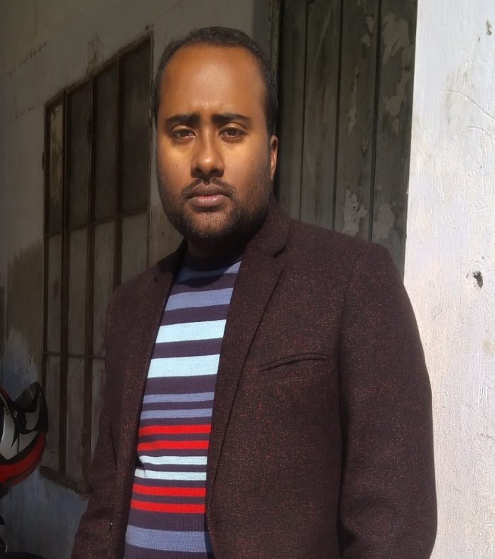
Teacher ‘s Identity
CHANDAN BISWAS
ASSISTANT TEACHER
ANDHA HIGH SCHOOL
E-mail: chandanb13@gmail.com

Slide 3
Class Identity
English-1st Paper
Class-Six
Lesson-21
Hason Raja
The mystic bard of Bangladesh.

Slide 4
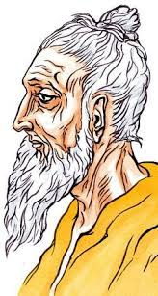
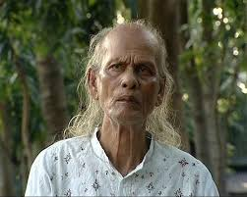
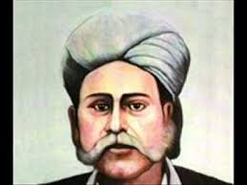
Can you match the names with the pictures ?
Shah Abdul Karim
Hason Raja
Lalon Shah
They are mystic bard of Bangladesh.

Slide 5
Learning outcomes
After completing the lesson students will be able to-
*Read and understand the texts.
*Understand and enjoy the stories .
*Ask and answer the questions.
*Read aloud with proper
* pronunciation,stress and intonation.

Slide 6
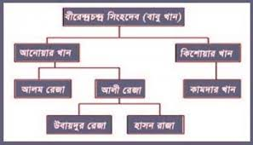
The family Identity of Hason Raja

Slide 7
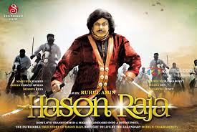
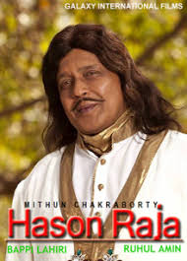
Early life of Hason Raja
The luxury life and wealthy landlords of Hason Raja.

Slide 8
Read the following text.
Early life
Raja was born on 21 December 1854 in Lakshmansree, now Sunamganj. His father was Dewan Ali Raja, a direct descendant of Birendraram Singhdev (later converted from Hinduism to Islam and renamed as Dewan Raja Babu Khan). Hason Raja's mother was Hurmutjan Bibi, the last and fifth wife of Ali Raja. Hason Raja spent most of his childhood in Lakshmansree with his mother as his father married widow of his first cousin late Amir Baksh Chowdhury who was living at Lahshmansree (Sunamganj) the most north-eastern part of now Bangladesh. His father started on and off living in Lakshmanshree of Sunamganj, 33 miles away from Rampasha, for at least three or four months of the year. Ali supervised and managed his wife's properties at Lakshmansree. That is why Lakshmansree, Sunamganj was hisbirthplace of the poet.
The death of Raja's elder step-brother, Ubaidur Raja, followed by the death of his father (in about 40 days gap), put the power and responsibility of the whole family upon Hason Raja at a very young age.

Slide 9
Later life of Hason Raja
Later life
Raja established schools and religious centres like mosques, temples and churches, and he is said to have been widely engaged in charities within his immediate communities. He donated vast land properties for the well-being of the people. He was interested in the well-being and protection of birds and animal life. He spent a large quantity of his money on those lives. The 12 June 1897 Assam earthquake was one of the biggest earthquakes that occurred in the Assam and Sylhet area. The largest known Indian interpolate earthquake (at 8.0 on the moment magnitude scale) resulted in the destruction of structures over much of the Plateau and surrounding areas, and caused widespread liquefaction and flooding in the Brahmaputra and Sylhet floodplains. He found out many of his kin and relatives as well as his people wounded and killed. His thatched house was fully damaged. He lost many of his tamed birds and animals.

Slide 10
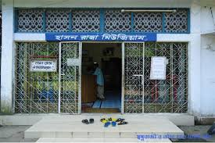
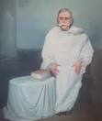
Death
Raja died on 6 December 1922. Two museums were established in his name in two places. One, Hason Raja Museum sponsored by "Hason Raja Museum Trust" at Sunamganj at his birthplace, Lokkonshri, Sunamganj, and another, Museum of Rajas' at RajaKunjo, Sylhet, sponsored by "Educationist Dewan Talibur Raja Trust".

Slide 11
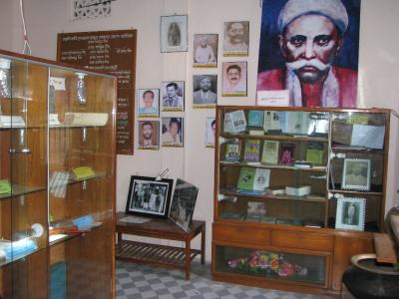
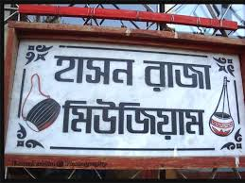

In popular culture
Raja's songs are collected in books Hachhan Udas and Shaukhin Bahar It was reported by Washington Bangla Radio in May 2013, that an epic Bengali feature film Hason Raja is under production, based on the life and music of Raja played by Mithun Chakraborty, directed by Ruhul Amin, and produced by Galaxy Films between UK, India and Bangladesh.A volume called Hason Raja Samagra was also published. It contained 500 poems and songs.

Slide 12
Group work
Answer the following the question.
a. When was Hason Raja born ?
a. Ans : Hason Raja was born in 1854 in a wealthy landlord`s family in Sylhet ?
b. Where did he come from ?
b. Ans : Hason Raja was came from in a wealthy landlord`s family in Sylhet ?
c. What was the other name by which Hason Raja was known ?
c. Ans: The other name of Hason Raja was ‘Crazy Hason Raja’ or the ‘Pagla Hason Raja’ ?

Slide 13

Home work
* Write a short paragraph about The mystic bard of Bangladesh.

Slide 14

Thank you
everybody

