Slide 1
WELCOME

Slide 2
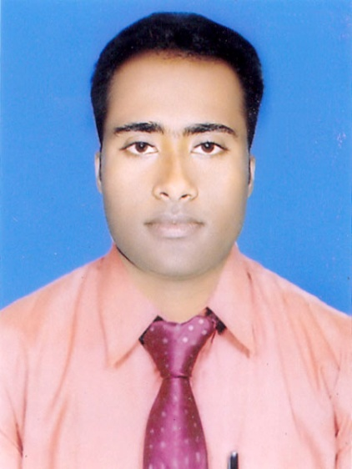
Teacher ‘s Identity
CHANDAN BISWAS
ASSISTANT TEACHER
ANDHA HIGH SCHOOL
E-mail: chandanb13@gmail.com

Slide 3
Class Identity
English-1st Paper
Class-Six
Lesson- 25
We live in a global village

Slide 4
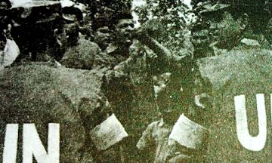
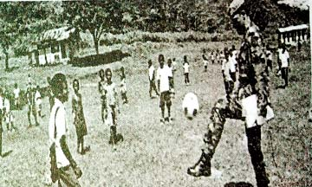
Look at the pictures

Slide 5
Learning outcomes
After completing the lesson students will be able to-
*Read and understand the texts.
*Understand and enjoy stories and poems.
*Ask and answer the questions.
* Write simple informal letter.

Slide 6
Vocabulary
Letter
Busy
peace
distribute
medicine
parents
Organisation
শান্তি
পিতা-মাতা
বিতরন করা
সংস্থা
ঔষধ
চিঠি
ব্যস্ত

Slide 7
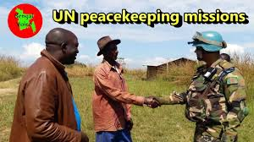
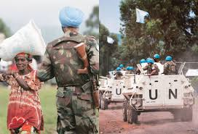
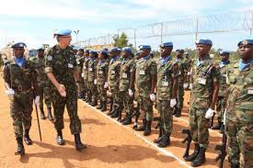
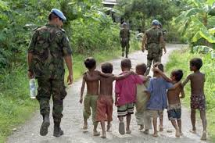
Look at the pictures in Congo in a UN Peacekeeping Mission.

Slide 8
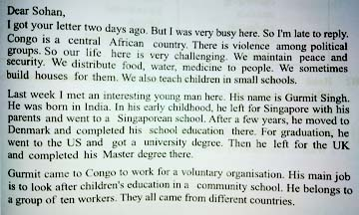
Sohan`s uncle works in the army. At present he is in Congo in a UN Peacekeeping Mission. Read his letter and do the following activity.

Slide 9
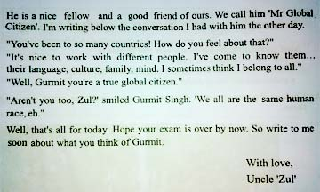

Slide 10
Individual work
Now match the words in column A with their meaning in column B.
column A | column B
Challenging Maintain Graduation Clash Global | Keep up International Difficult University degree fight

Slide 11
EVALUATION
Answer the following questions.
Where is Congo ?
Who call Gurmit Singh “Mr Global Citizen” ? Why ?
What do you mean by “Global citizen” ?
Who is Mr. Zul ?
What does Mr. Zul do ?

Slide 12
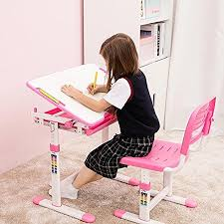
Home work
Write a short composition about global village.
Write a letter to your friend about global village.

Slide 13
Thank you
Everybody

