Slide 1

WELCOME

Slide 2
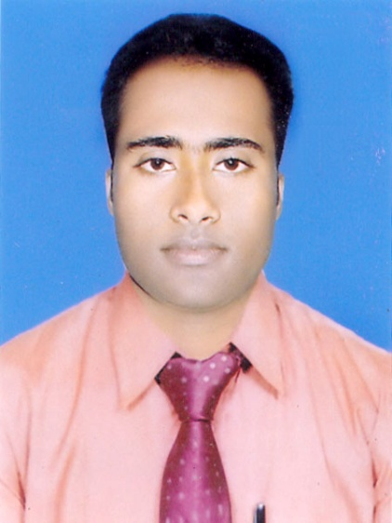
Teacher ‘s Identity
CHANDAN BISWAS
ASSISTANT TEACHER
ANDHA HIGH SCHOOL
E-mail: chandanb13@gmail.com

Slide 3
Class Identity
English-1st Paper
Class-Six
Lesson- 34
An invention for Robin

Slide 4


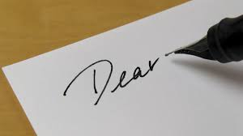
Look at the picture

Slide 5
Learning outcomes
After completing the lesson students will be able to-
*Read and understand the texts.
*Write a short paragraph.
*Ask and answer the questions.
* Write simple informal letter.

Slide 6
Vocabulary
Letter
Over
Excited
Aunt
Countryside
Listen
Ran
উত্তেজিত
শ্রবন করা
চাচি,পিসি,খালা
দৌড়িয়েছিল
গ্রামাঞ্চলের
চিঠি
উপর

Slide 7
Read the following passage.
Robin read the letter over and over.He was very excited. It came from his aunt Amina. Aunt Amina and her family live in the countryside forty miles away from Dhaka. Robin ran to his mother and said, “Mom, listen to his letter.” He then read it to her.

Slide 8
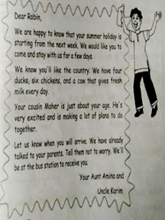
Look at the picture and read the letter.

Slide 9
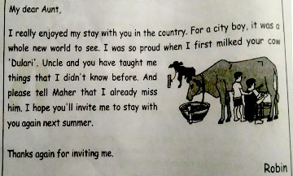
A few days after Robin came back home from his aunt`s house, he wrote the following letter to his Aunt Anima. Read the letter.

Slide 10
Group work
What do you think is the main idea of the letter ? Choose the best answer :
To ask his aunt to invite him again.
To thanknhis aunt for inviting him.
To tell his aunt that he learned many things in the country.

Slide 11
EVALUATION
Answer the following questions.
Why was Robin excited ?
How would he go to the country ?
Who writes the letter ?
Who is Mr. Karim ?
What is name of Robin`s Aunt ?

Slide 12
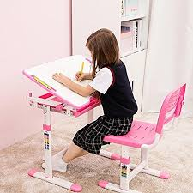
Home work
1. Write a similar invitation letter to a friend. Tell him / her about some of the things you plan to do together.

Slide 13

Thank you
everybody

