Slide 1
WELCOME

Slide 2
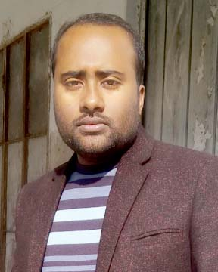
Teacher ‘s Identity
CHANDAN BISWAS
ASSISTANT TEACHER
ANDHA HIGH SCHOOL
E-mail: chandanb13@gmail.com

Slide 3
Class Identity
English-1st Paper
Class-Six
Lesson-26
Our wage earners

Slide 4
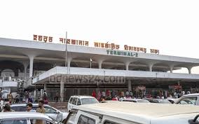
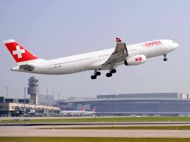
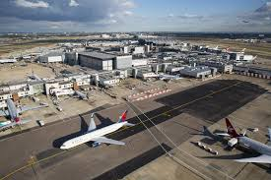
Look at the picture

Slide 5
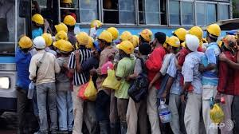
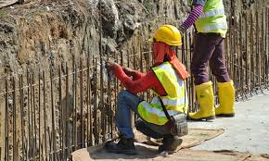
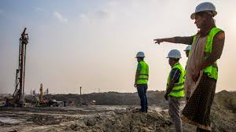
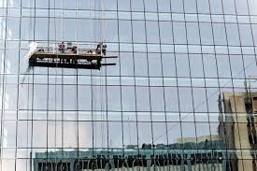
Look at the picture
Bangladeshi workers because they are hard working.

Slide 6
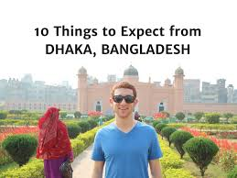
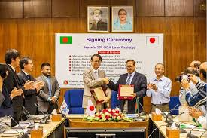
Look at the picture
They are language skills persons
they have developed their language skills,So they get good jobs and send more money to our country.

Slide 7
Learning outcomes
After completing the lesson students will be able to..
* Read and understand the texts.
* ask and answer the questions.
* Participate in short dialogues and conversations on familiar topics.

Slide 8
Vocabulary
Wage earner
Skilled worker
Economy
Job
Tourist
Pleasure
Abroad
– বেতনভোগী কর্মী
দক্ষ কর্মী
- অর্থনীতি
- কাজ
- পর্যটক
- আনন্দ
- বিদেশে

Slide 9
Foreign
Demand
Regret
Skills
Develop
Language
Demand
বিদেশী
- চাহিদা
- দুঃখ প্রকাশ
- দক্ষতা
- উন্নতি করা
- ভাষা
- চাহিদা

Slide 10
Read the following text
A huge number of Bangladesh go abroad for jobs. There is always a high demand of workers in some foreign countries like UAE , oman , saudi Arabia,qatar, Bahrain,etc.They like Bangladeshi workers because they are hard working. But this is a matter of regret that our workers are doing odd jobs.As a result they are not paid much. This is because our workers are not good at English, Arabic, or other languages. So we should develop languages skills of our wokers for the countries they go for work. If they can develop their language skills,they can get good jobs and send more money to our country.Thus the wage earners of our country can help develop our economy.

Slide 11
EVALUATION
Q*1 ) Why is there demand for Bangladeshi workers ?
A*1 ) There are demand of Bangladeshi workers because they
are hard working.
Q*2 ) What countries they work in ?
A*2 ) They works in some foreign countries like UAE , Oman ,
Saudi Arabia , Qatar , Bahrain , etc.
Q*3 ) Why don’t they earn much money ?
A*3 ) They don’t earn much money because our workers are
not good at English , Arabic , or other language.

Slide 12
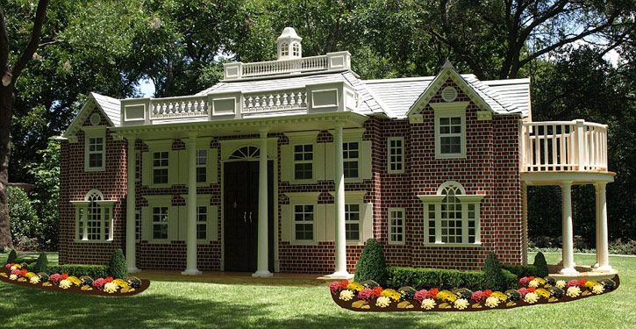
Home work
* Write a short dialogues and conversations.

Slide 13
Thank you
everybody

