Slide 1
ME
MD. ABDUR RAZZAK
HEAD TEACHER
DHALAHARA WESTPARA
SECONDARY GIRLS’ SCHOOL
E-mail: abdurrazzakmtrt@gmail.com
Phone number: 01721588402
DHALHARA WESTPARA SECONDARY GIRLS’ SCHOOL
Preposition
CLASS : IX & X
TIME: 50 MIN

Slide 2
LEARNING OUTCOMES
By the end of the lesson the Ss will be able to-
Say the definition of preposition.
Use preposition practically in their real life situation.
Develop written skill using preposition.
DHALHARA WESTPARA SECONDARY GIRLS’ SCHOOL

Slide 3
Warm up
5 min.
Dhalahara Westpara Secondary Girls’ School
WELCOME TO MULTIMEDIA CLASS
ENGLISH
DHALHARA WESTPARA SECONDARY GIRLS’ SCHOOL
DHALHARA WESTPARA SECONDARY GIRLS’ SCHOOL

Slide 4
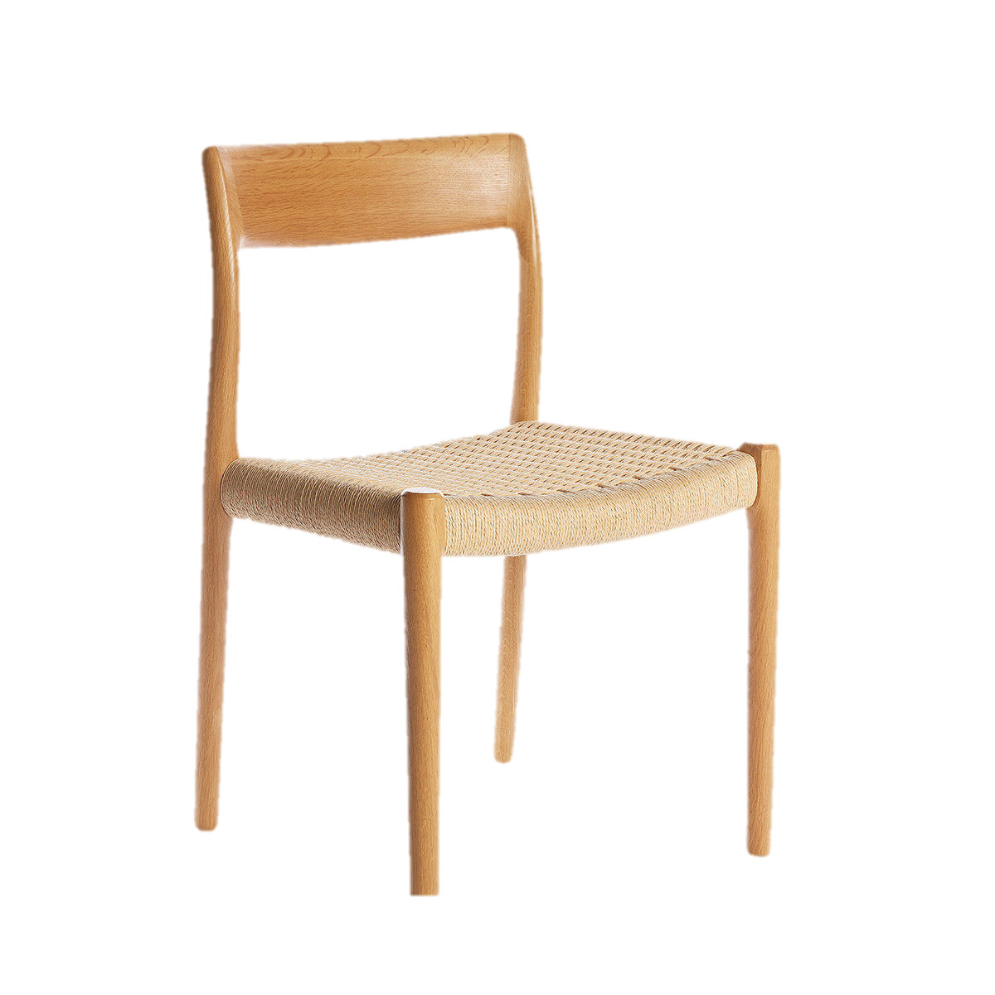
Let’s see some pictures.
under
The cat is ----------the chair.
by
The cat is ----------the chair.
DHALHARA WESTPARA SECONDARY GIRLS’ SCHOOL
on
The cat is ----------the chair.

Slide 5
So, what kinds of part of speech under, by and on are ?
They are preposition
DHALHARA WESTPARA SECONDARY GIRLS’ SCHOOL

Slide 6
So, our today’s lesson is ----
Preposition
DHALHARA WESTPARA SECONDARY GIRLS’ SCHOOL

Slide 7
Let’s enjoy a video clip.
https://www.youtube.com/watch?v=dQPFmztOA-g
DHALHARA WESTPARA SECONDARY GIRLS’ SCHOOL

Slide 8
Cat is Noun.
Before/in front of modifies another noun car
Car is Noun.
Behind modifies another noun car.
behind
The cat is--------------the car.
DHALHARA WESTPARA SECONDARY GIRLS’ SCHOOL
before/in front of
The cat is-------------------------the car
Noun or pronoun
SO,A preposition sits before a------------------------. What?
Noun or pronoun
And it modifies other -------------------------?

Slide 9
So what is preposition?
Pre means before and position means place >> preposition= before place
Before what?
noun or pronoun
A preposition is a word placed before a noun or a pronoun to show its relation to some other words in the sentence. In other words, a preposition is a modifying word that modifies other noun or pronoun.
DHALHARA WESTPARA SECONDARY GIRLS’ SCHOOL

Slide 10
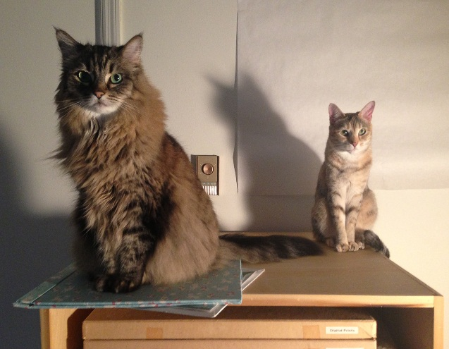
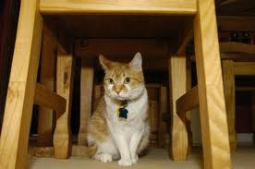
Let’s discus about prepositions and their use.
on
There are two cats……the table. Where?
DHALHARA WESTPARA SECONDARY GIRLS’ SCHOOL
under
There is a cat………the table. Where?

Slide 11
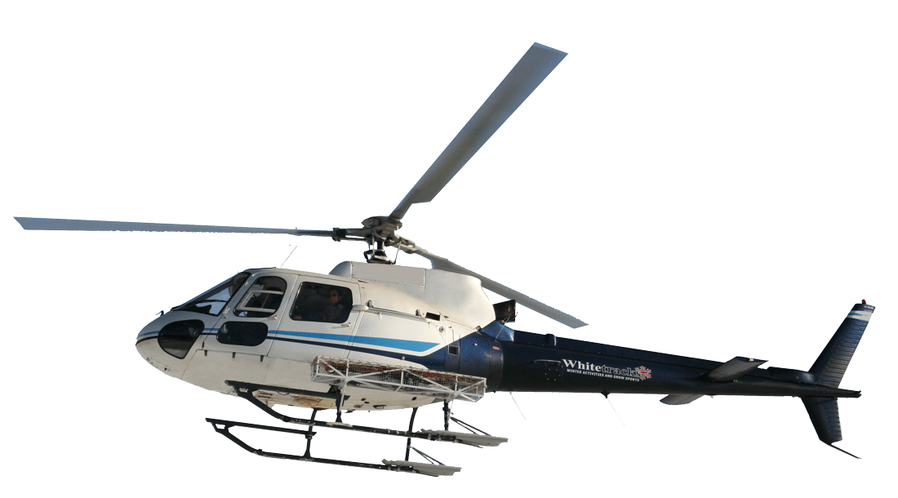
above
The helicopter is flying ------- the cloud.
cloud
DHALHARA WESTPARA SECONDARY GIRLS’ SCHOOL
over
The cat jumped -------- the chair.

Slide 12
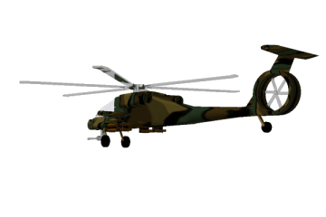
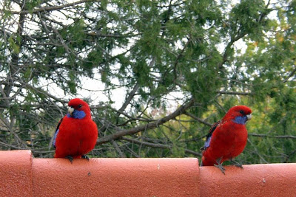
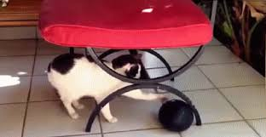
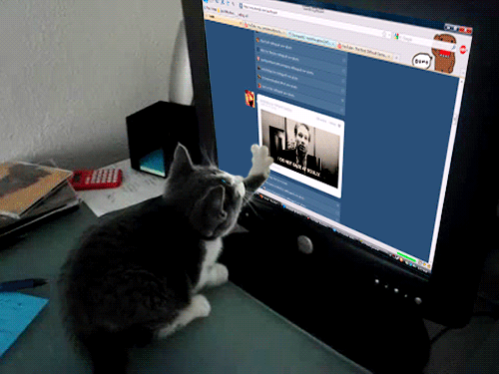
INDIVIDUAL WORK
Match the preposition from the above list with the pictures below.
on
under
over
before
up
DHALHARA WESTPARA SECONDARY GIRLS’ SCHOOL

Slide 13
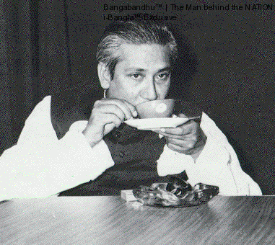
More about preposition.
of
BANGA BONDHU would fond------ tea.
in
DHALHARA WESTPARA SECONDARY GIRLS’ SCHOOL
There are ten mangoes -----the basket.
off
The cat jumped---------the chair.

Slide 14
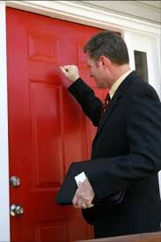
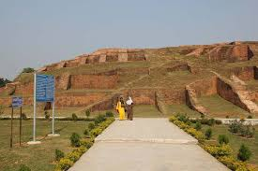
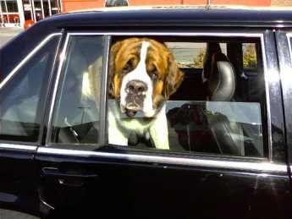
at
A man is standing……….the door.
in
Mahasthangor is …..Bogra.
DHALHARA WESTPARA SECONDARY GIRLS’ SCHOOL
in/inside
The dog is ……………... the car.

Slide 15
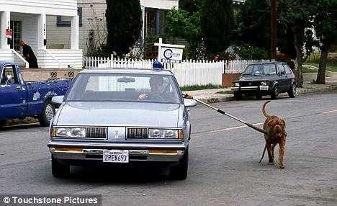
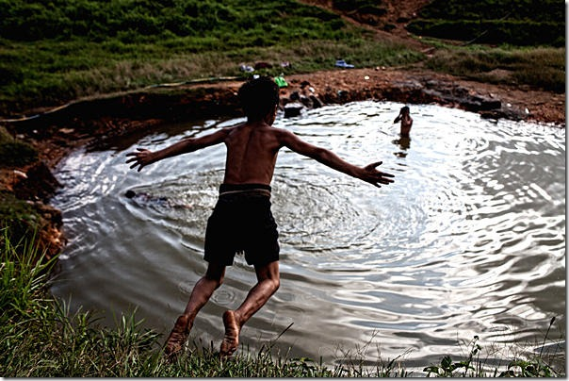
by/beside
The dog is ……………..the car.
DHALHARA WESTPARA SECONDARY GIRLS’ SCHOOL
into
A boy is jumping ……..the pond.

Slide 16
PAIR WORK
Fill in each blank with suitable preposition in the list below.
off
beside
into
at
in
DHALHARA WESTPARA SECONDARY GIRLS’ SCHOOL
Before entering ………the room, he is put …….his shoes. Then he sat down on a chair …………..the wall.
In the mean time a man knocked …….the door who lived ……….a village belong to him.

Slide 17
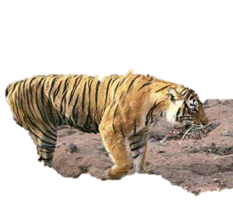
between
There is a cat -----------------the two lions.
Between – two persons/things
DHALHARA WESTPARA SECONDARY GIRLS’ SCHOOL
among
There is a tiger -----------------the cats.
Among- more than two persons/things.

Slide 18
through
The bus is running ---------------the ring.
DHALHARA WESTPARA SECONDARY GIRLS’ SCHOOL
earth
sun
round
The sun is moving ---------------the sun.

Slide 19
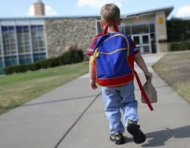
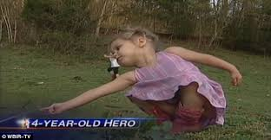
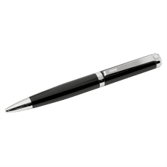
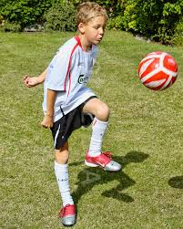
The boy is going ……school.
The boy is going……
the school.
I know nothing ……. .the old hero.
We write ………pen.
Football is played……the boy.
towards
by
with
DHALHARA WESTPARA SECONDARY GIRLS’ SCHOOL
to
about
Goal/ target is
school
Goal/ target is not
school
With for things
By for person

Slide 20
Different use of some same prepositions
on
under
by
at
to
over
at
with
into
in
behind
Our school will start …………Monday next.
Magura is …………Khulna division.
We work……….day and sleep ……..night.
The boy came…..me danching.
The night is …………. .
He goes to school …….10 am.
I go to market ………my father.
He fell ………….a deep sleep.
He is ……….danger.
Man is mortal, no doubt …………..this matter.

Slide 21
GROUP WORK
Fill in each blank with suitable preposition in the list below.
of
to
Rna is a student ……….class 8. He goes …… school regularly. He starts ……..school…… 9.30 am. ………the way to school he never mix …….bad boys. He is always attentive ……his lessons. He always cut good figure ……the exam. So he is respected …….all. We wish he will be a good citizen ……future.
for
at
On
with
to
in
by
in

Slide 22
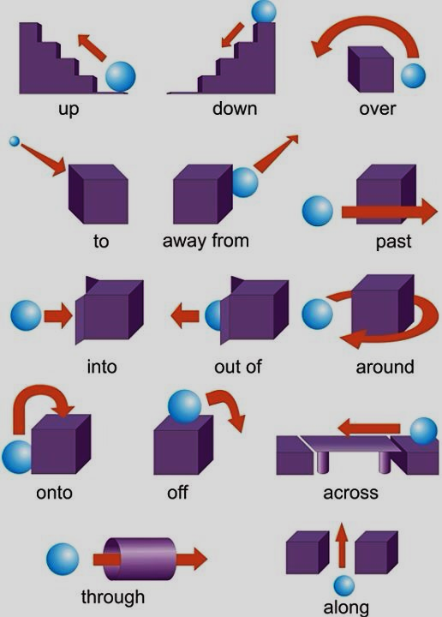
LET’S SEE AGAIN.

Slide 23
HOME WORK
Fill in the blank with suitable prepositions.
Mr. Roy is going …………office……..foot. Every day he goes to office ……rickshaw. But today he is going there …foot because today is a hortal day. He does not like it because hortal causes a lot……suffering ……the common people.

Slide 24
Thanks

