Slide 1

To everybody

Slide 2



Introduction
Teacher’s Introduction
MD. Shohag chowdhury
Assistant teacher
Daudpur govt. primary school.
Nobabgonj, Dinajpur.
Lesson’s Introduction
Class: Two
Subject: English
Unit: 6 (colours)
Lesson: 4_6

Slide 3



What is this?
Rainbow

Slide 4

Today’s Lesson:
Colours

Slide 5
Learning Outcome:
At the end of the lesson students will be able to-.
Identify different colours.
Recite the rhyme with correct pronunciation.

Slide 6

Presentation
W.C.W
W.C.W

Slide 7








Look, listen and say
Red
Orange
Yellow
Green
Blue
Indigo
Violet

Slide 8
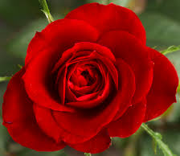
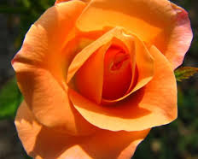
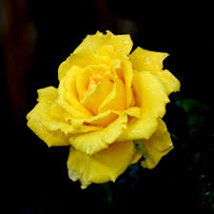
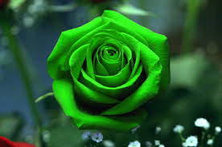


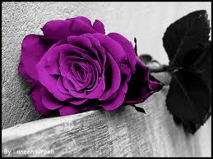
Group Work
Red
Orange
Yellow
Green
Blue
Indigo
Violet

Slide 9
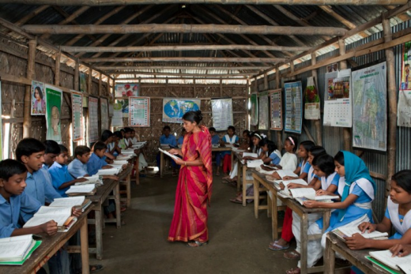
W.C.W

Slide 10

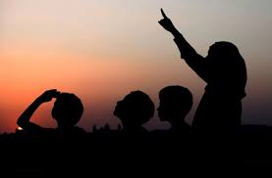
Listen this audio and repeat.
Rainbow, rainbow,
I see you!
Red and orange,
Yellow, green and blue,
Indigo and violet, too!

Slide 11
Pair work
Read this lines and select the colours .
Rainbow, rainbow, I see you!
Red and orange
Yellow, green and blue
Yellow, green and
ue
Indigo and violet, too!

Slide 12

How many colours are there in the rainbow
There are 7 colours in rainbow.
Indigo
Blue
Violet
Green
Red
Yellow
Orange

Slide 13
assessment
Say the rainbow rhyme.
How many colours are in rainbow?

Slide 14
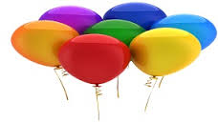
Say the colours in the rainbow.

Slide 15



