Slide 1
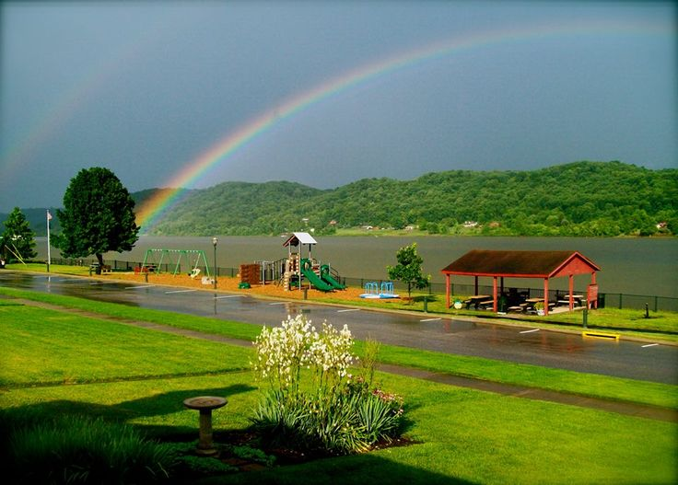
Welcome To My Class

Slide 2
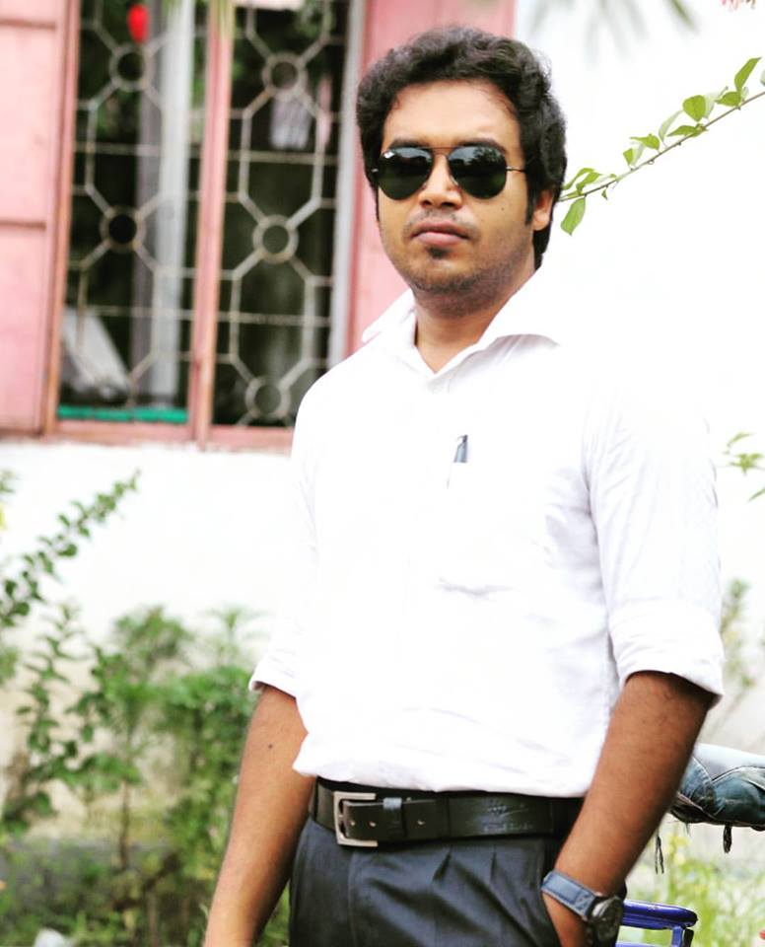
Teacher’s Identity
Md. Imran Kabir
Pabna Collectorate Public School And College
Mobile: 01756005577
Email: i.kabir01111@gmail.com
Class- Eight
Subject- English 1st paper
Unseen Passage
Time- 50 minutes
Date-26/10/2019

Slide 3
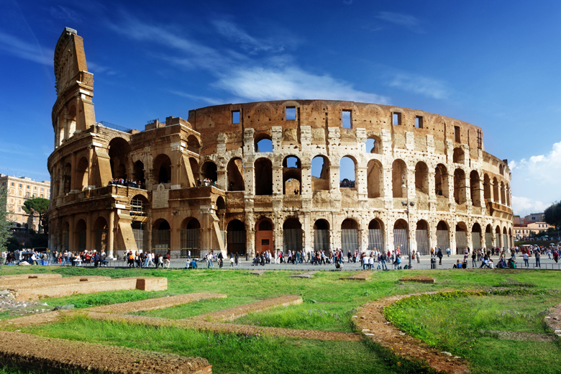
What do you see in the picture?
The Roman Colesseum, Itly.

Slide 4
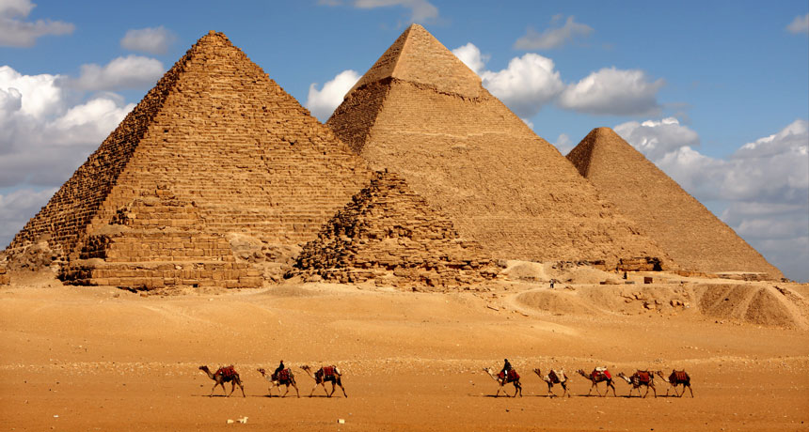
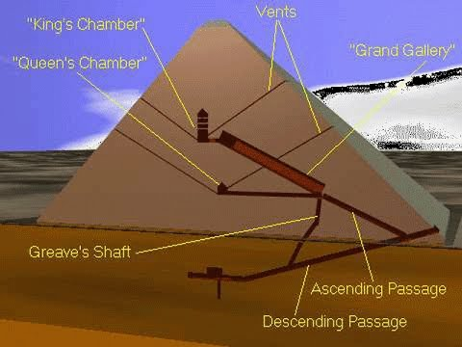
The Pyramids

Slide 5
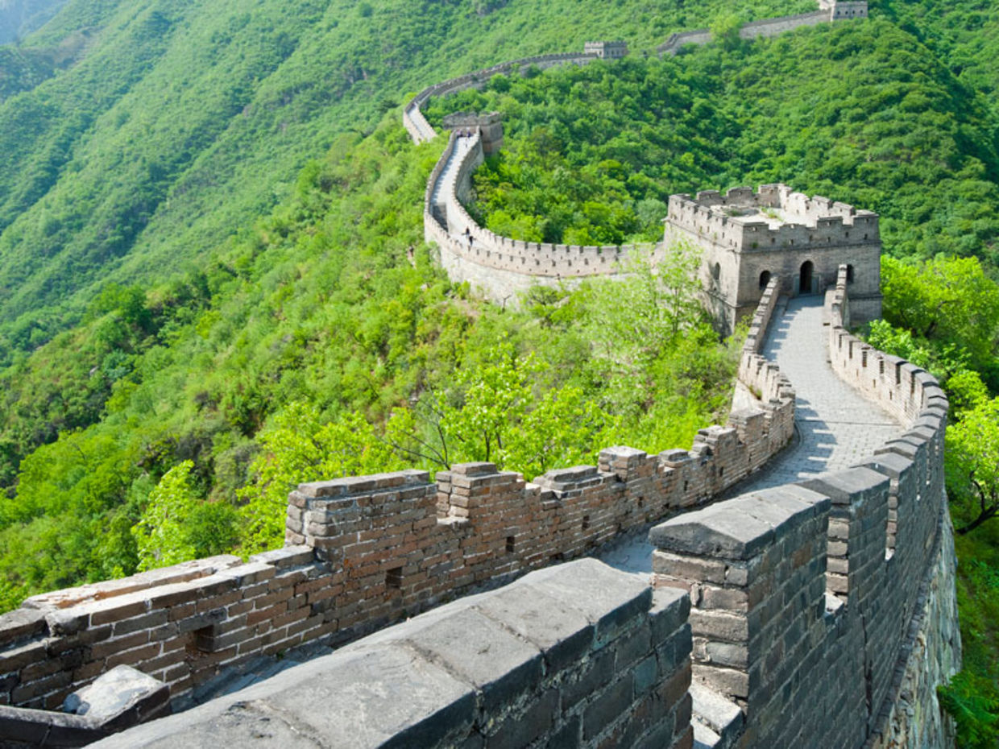
The Great Wall Of China

Slide 6
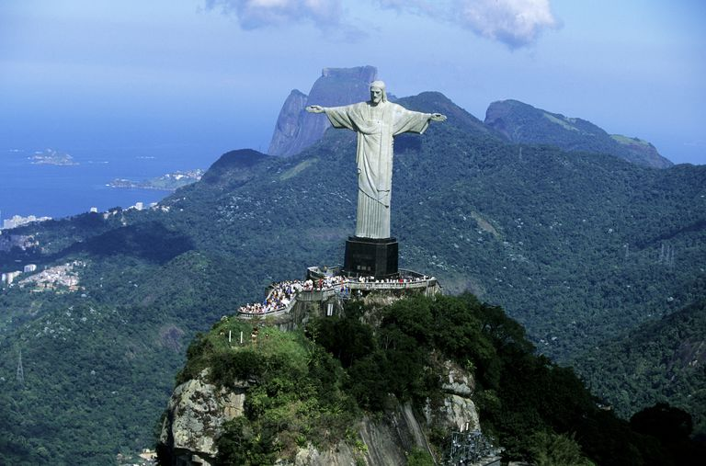
Christ The Redeemer, Brazil

Slide 7
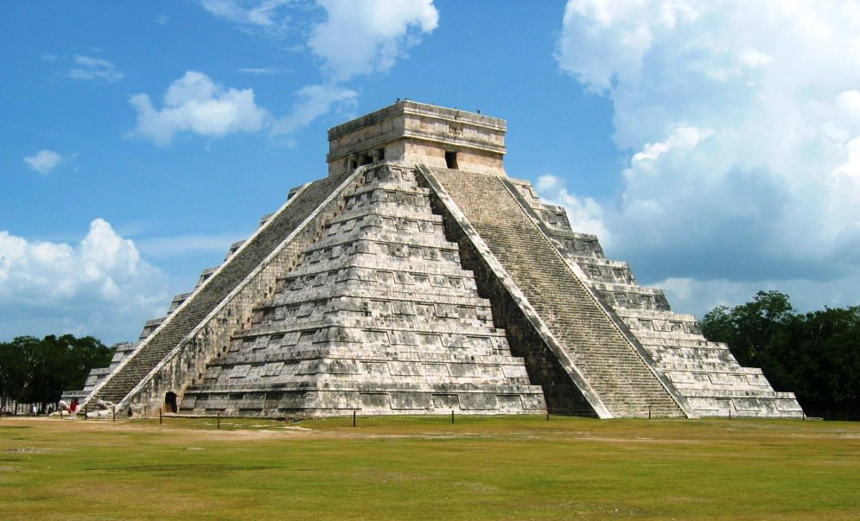
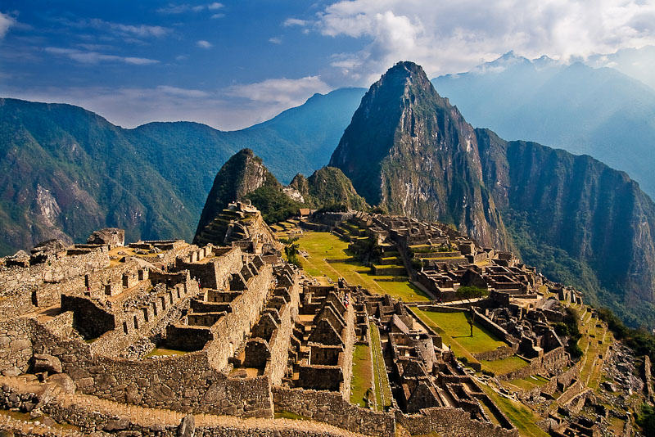
Chicen Itza, Mexico.
Machhu-Pichhu, Peru.

Slide 8
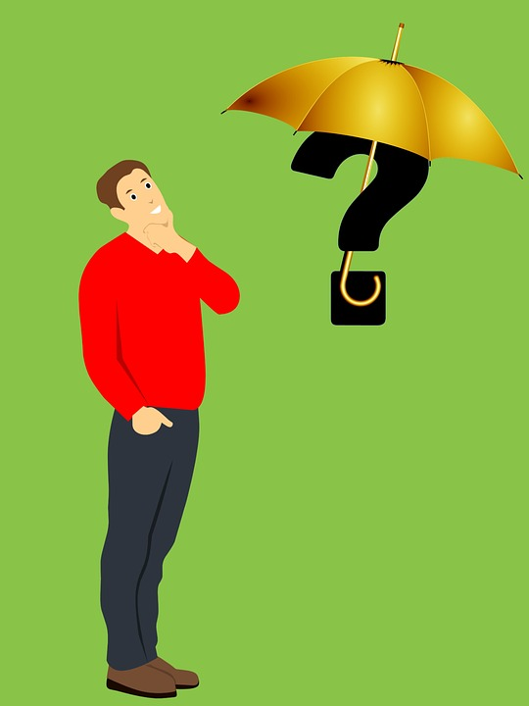
Which wonder is missing here??????

Slide 9
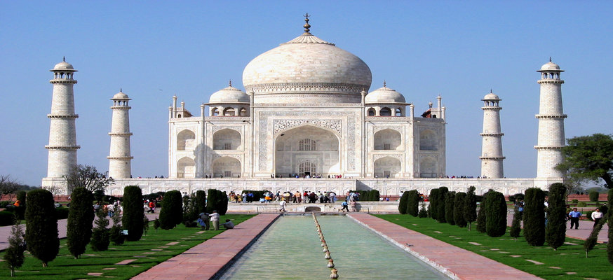
The Taj Mahal

Slide 10
So today’s topic is “The Taj Mahal”
Let’s enjoy a video.

Slide 11
Learning Outcomes-
After we have studied this unit, we will be able to
Talk about the pictures .
Learn about some information about Tajmahal.
New words and pronunciation
Information gap filling activities

Slide 12
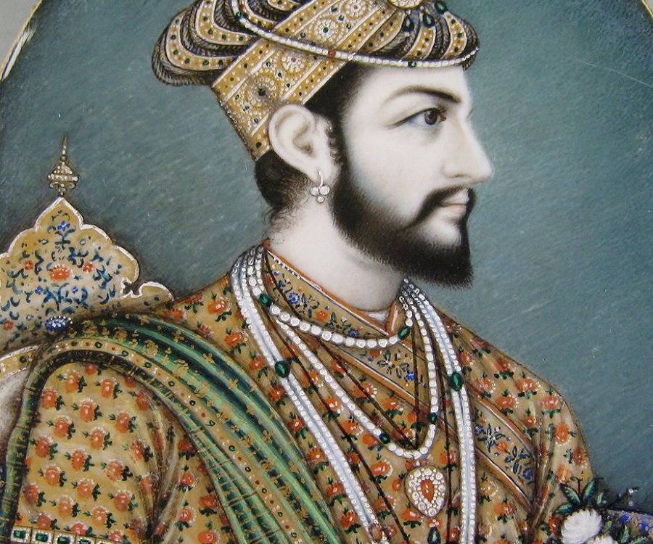
Look at the picture
Who is the man in the picture?
Emperor Shahjahan

Slide 13
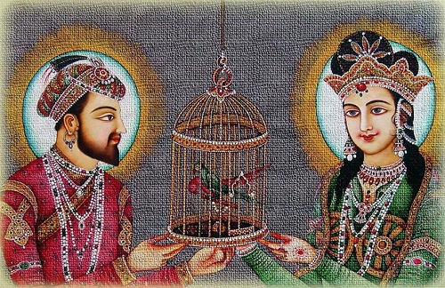
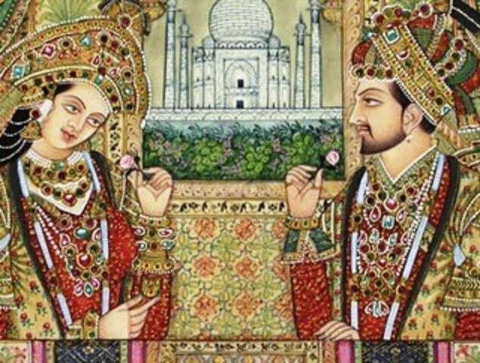
Do you know who is the woman in the pictures?
Her name is Momtaj and she is the beloved queen of Emperor Shajahan

Slide 14
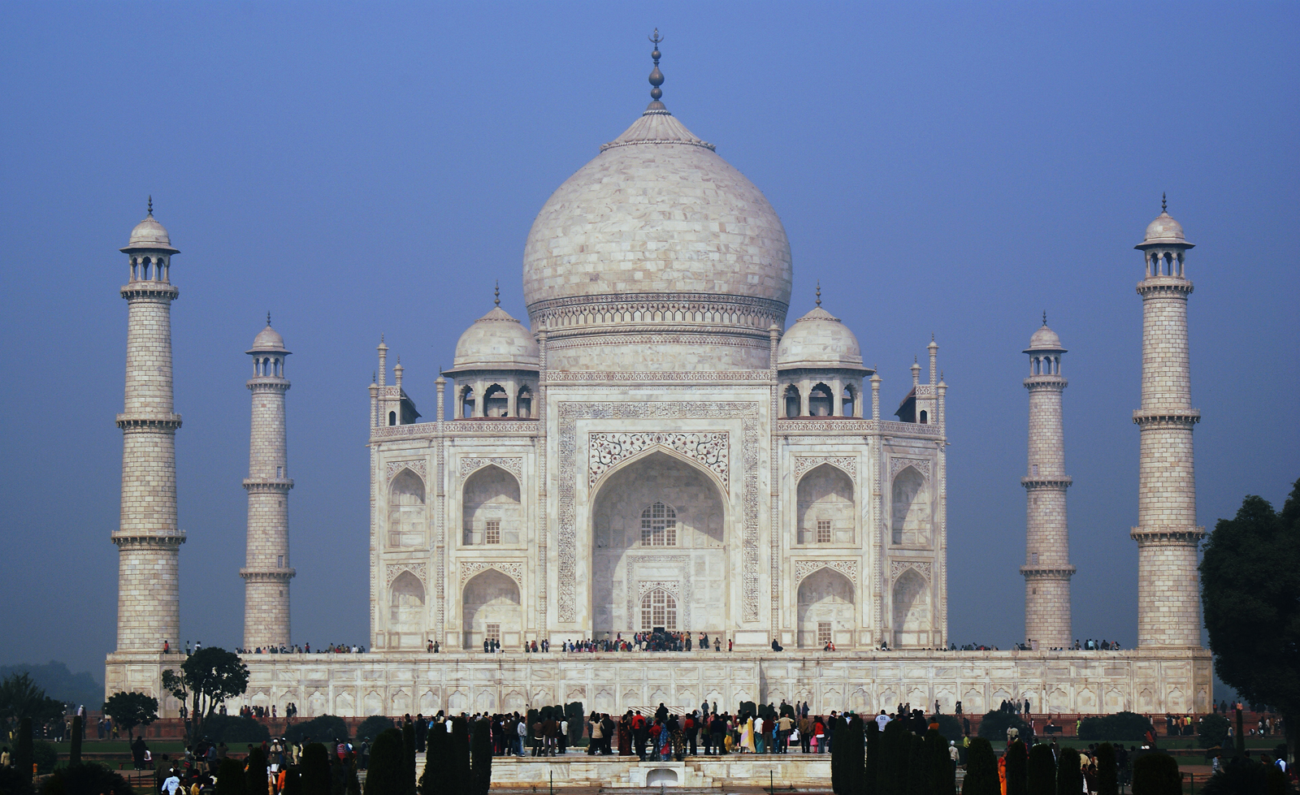
Do you know why Tajmahal was built?
The Tajmahal was built in the memory of Momtaj, the beloved queen
of Shajahan

Slide 15
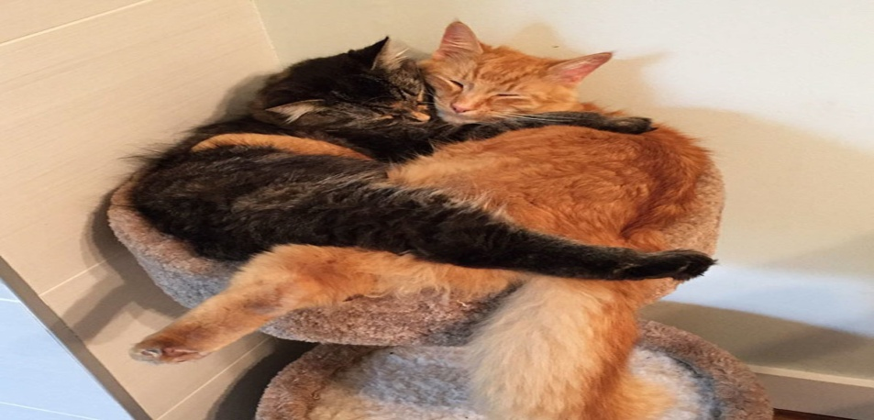
Beloved
Someone special
Wonder
Being surprised
Inseparable
Attached

Slide 16
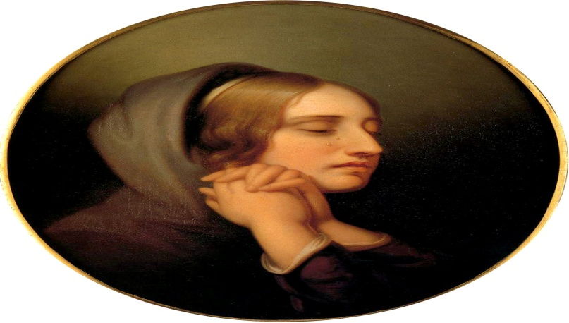
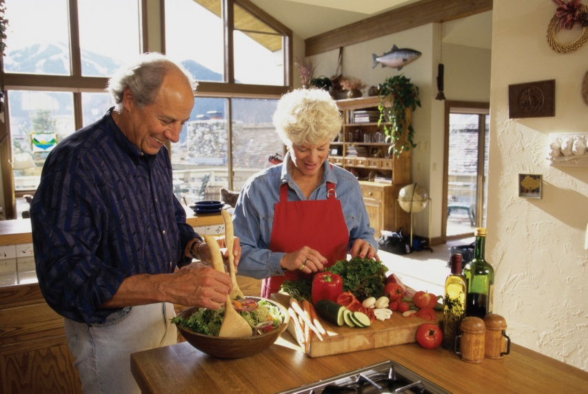
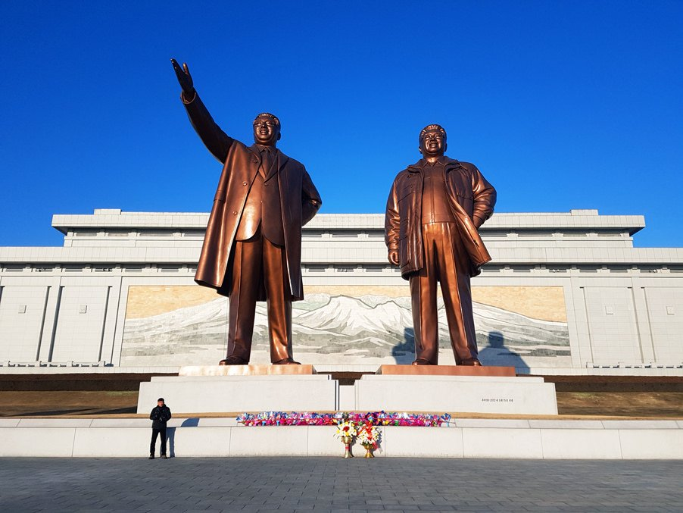
Grief
To be disappointed
Companion
Fellow
Monument
A statue

Slide 17
Text Analysis
Taj Mahal is one of the wonders of the world. It was built by Emperor shah Jahan .Shah Jahan and his wife Momtaj Mahal married in 1612 and she was his inseparable companion until her death in child birth in 1631. His grief led him to design and construction this magnificent building for her final resting place. Later, Shah Jahan also buried there. The monument is set within a large complex of gardens and other buildings on the south bank of the river Jamuna out side the city of Agra. The whole complex is a rectangle measuring 1,900 feet by 1,ooo feet .There is a garden area of 1,000 feet. The total height of the monument is 108 feet. At the top of the entire building there is a large onion shaped dome. The construction of the Taj Mahal took 22 years, from 1632 to 1654. More than 20,000 workers worked daily to complete the work. The cost of the construction was about 40 million rupees.

Slide 18
Dear students now complete the following chart with the information giving in the passage.
What/Which/When | How/Where
(a) | is one of the greatest wonders of the world.
It was built by Emperor Sahjahan | (b)
(c) | Sahjahan and Momtaj were married off
Emperor Sahjahan was burried | (d)
(e) | 20,000 workers worked daily
a) The Tajmahal
b) In India
c) In 1612
b) beside Momtaj
e) to build Tajmahal

Slide 19
Dear students now read the passage and write true or false beside the following statements. If false give the correct statement.
(a) Momtaj died in 1620.
False.
Correct Ans. Momtaj died in 1631.
(b) The Tajmahal was built for final resting place of Momtaj.
True.
(c) The Tajmahal was built on the river Jamuna.
True.
(d) The total height of the monument is 108 feet.
True
(e) The construction work of Tajmahal took 15 years.
False.
Correct Ans. The construction work of Tajmahal took 22 years.

Slide 20
Evaluation
a) Who built the Tajmahal?
b) Why it was built?
c) How many workers did work for Tajmahal?
d) How many years did it take to build the Tajmahal?
e) Who were burried in the Tajmahal?

Slide 21
Write a summary on “Tajmahal” not more than 70-80 words.

