Slide 1

Welcome

Slide 2
Introduction
Shahrina Bin Sweety
Assistant Teacher of
39 No. Chormonai Madrasha GPS
Barishal Shadar
Barishal
Class 4
Subject English
Unit 34
Lesson 1-2 [ SM Sultan…….of Bangladesh]
Page No 68

Slide 3
Learning Outcomes
Listening : 4.2.1. enjoy and understand simple stories.
Speaking : 1.1.1 repeat after the teacher and say words, phrases and sentences with proper sounds, stress and intonation.
Reading : 1.4.1 read words, phrases and sentences in the text with proper pronunciation, stress and intonation.
1.7.1 read short paragraphs, dialogues and simple letters.

Slide 4

Creating safety learning Environment

Slide 5
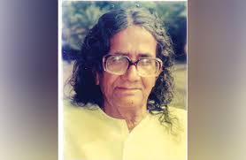
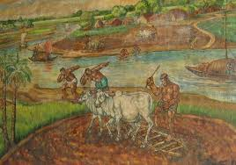
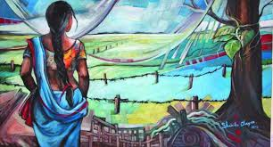
Showing Picture
Asking Questions :
What do you see in the picture ?
What’s the name of the person ?
What did he like ?

Slide 6

Let’s listen an audio
Again

Slide 7
Sound Practice
Famous
Painter
A lot of
College
Farmer
Fisherman

Slide 8
Group Work
Make 5 groups. Each group practices to read the text with proper pronounciation, stress and intonation.

Slide 9
Evaluation
Who is SM Sultan ?
Where was he born ?
When was he born ?

Slide 10


THANKS

