Slide 1


Slide 2
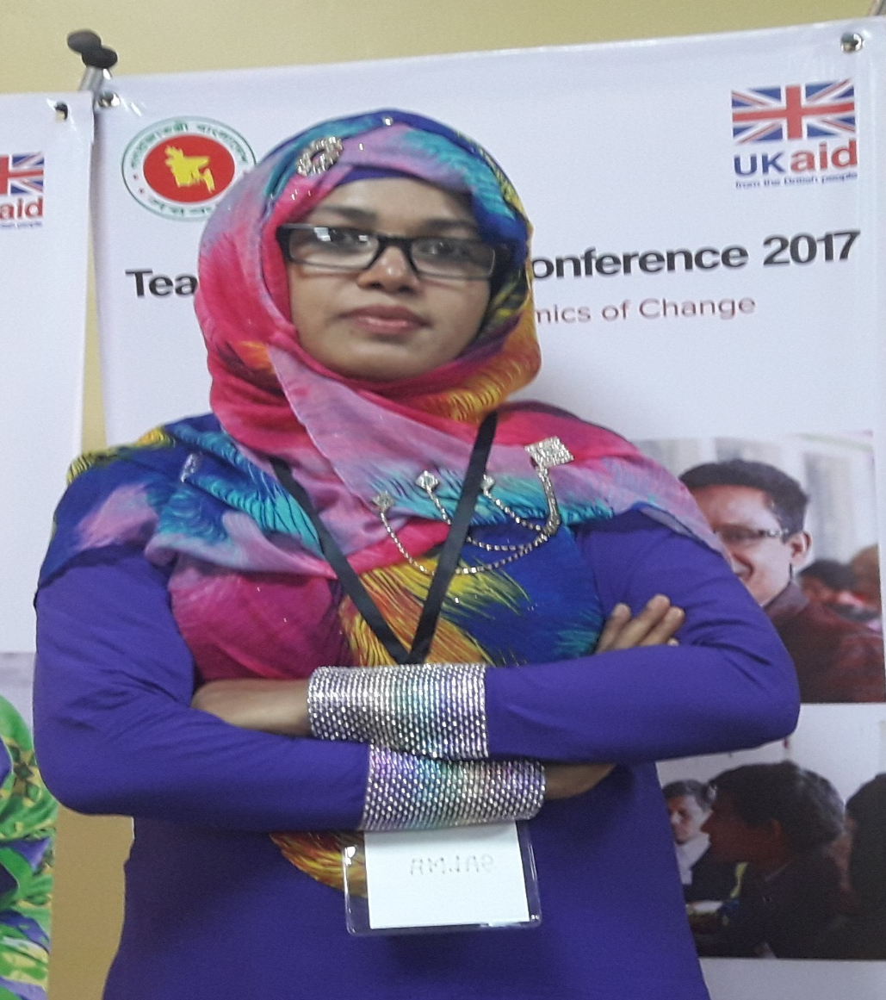
INTRODUCING MYSELF
*SALMA BEGUM (Diba)
*Assistant Teacher
*Purbo Charpata Government Primary School
* Raipur, Lakshmipur.

Slide 3
Identity of the content
Class : Two
Subject : English
Unit : 24
Lessons : 4 – 6
Forest, Shed, Tree

Slide 4
By the end of the lesson, students will be able to __
* LISTENING: 1.1.1 become familiar with English sounds by listening to common English words.
* SPEAKING: 1.1.1 repeat after the teacher simple words and phrases with proper sounds and stress. {3 words}
1.1.2 say simple words and phrases with proper sounds and stress.
3.1.2 ask and answer questions about the familiar objects.
* READING: 1.4.1 read words and phrases with the help of visual clues (about 30 new words) and simple sentences.
* WRITING: 3.1.2 write words and phrases using non-cursive small letters.

Slide 5
Let’s sing the “Animal’s home” song together

Slide 6


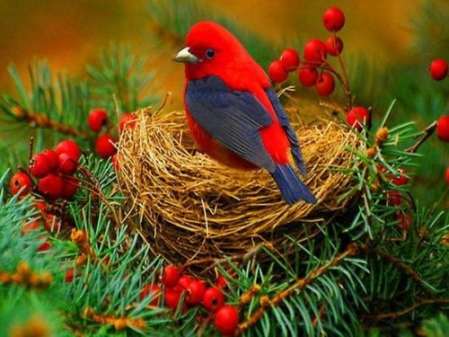
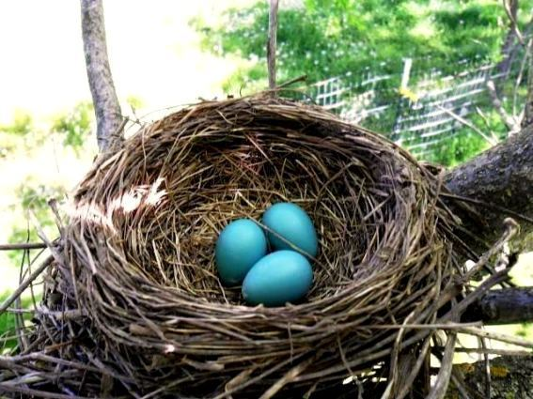
Look at the picture Then, think alone and one after another. discuss in pairs.

Slide 7
Title of the lesson
Animals and where they live

Slide 8
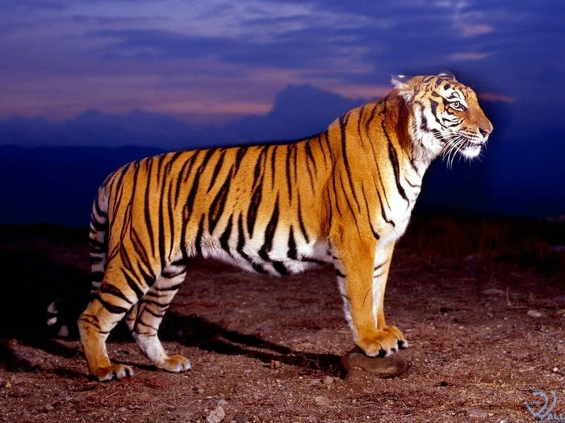
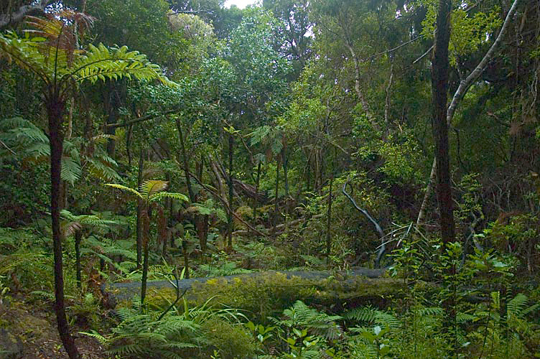
forest
Where does a tiger live?

Slide 9
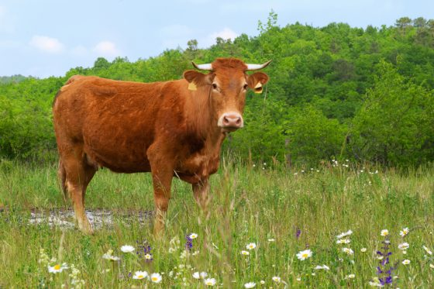
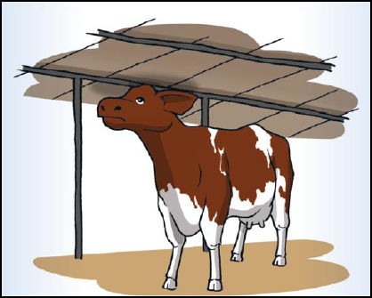
shed
Where does a cow live?

Slide 10
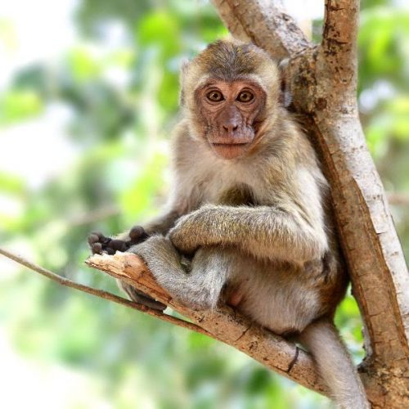
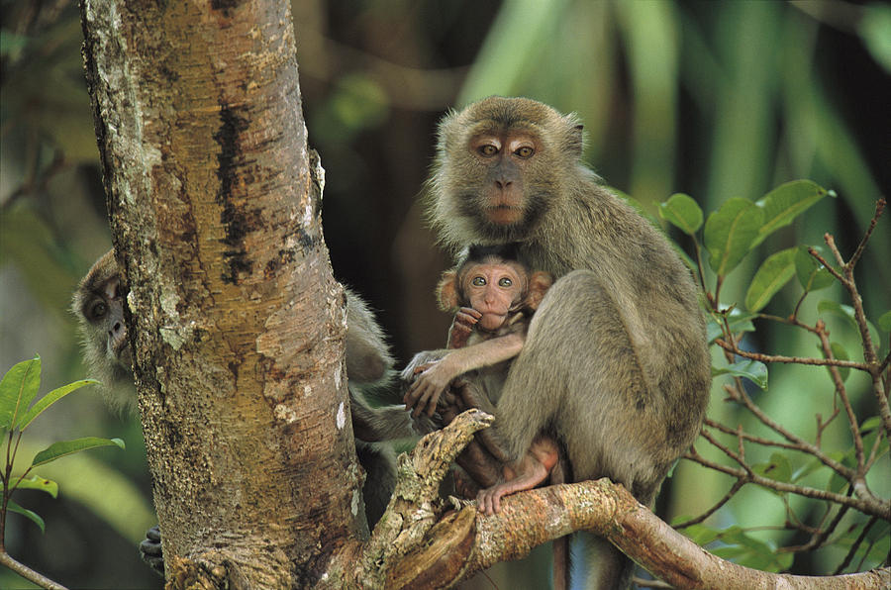
tree
Where does a monkey live?

Slide 11
Let’s listen the new words attentively

Slide 12
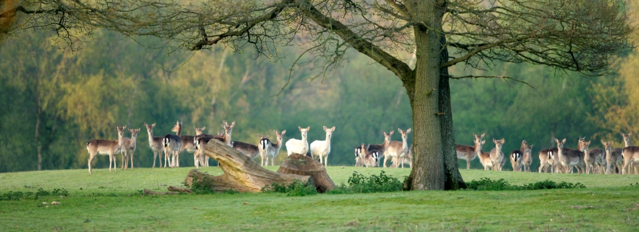
Repeat after me
forest

Slide 13
Spell and pronounce the words
FOREST
forest
A tiger lives in a forest.

Slide 14
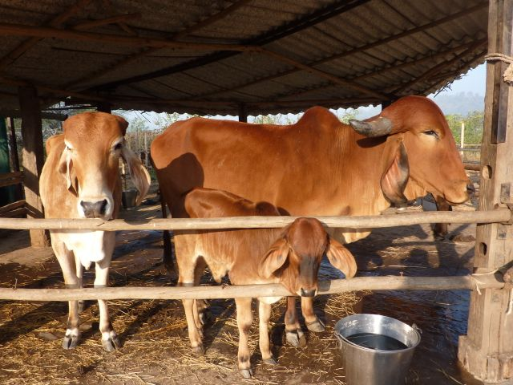
Repeat after me
shed

Slide 15
Spell and pronounce the words
SHED
shed
A cow lives in a shed.

Slide 16

Repeat after me
tree

Slide 17
Spell and pronounce the words
TREE
tree
A monkey lives in a tree.

Slide 18
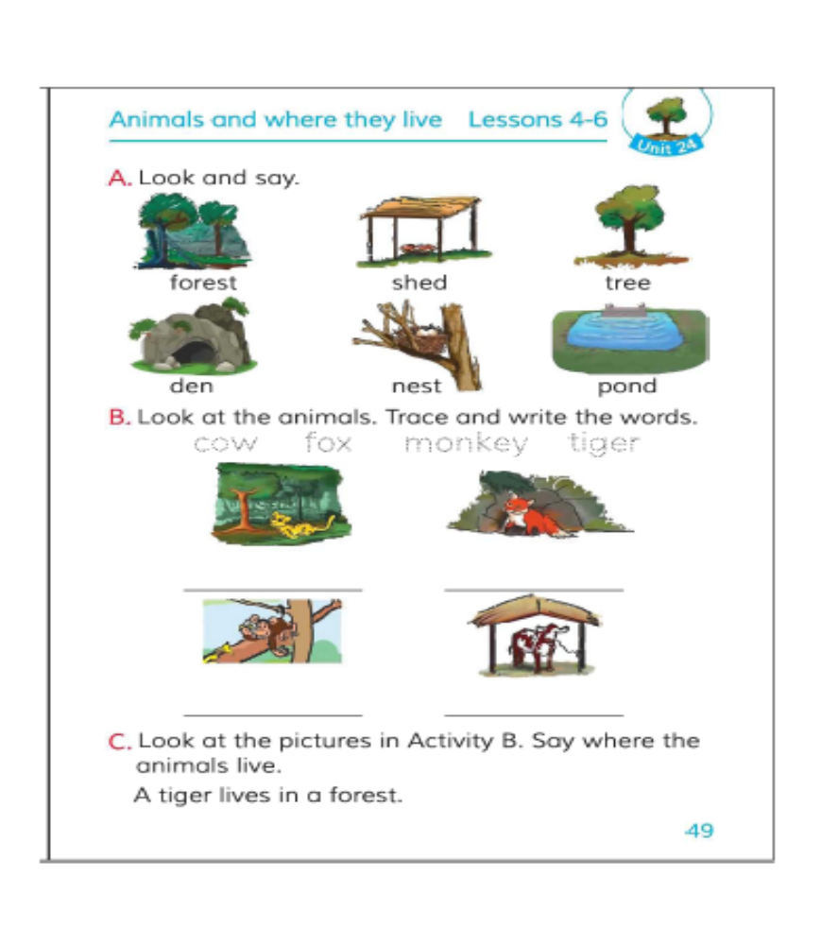
Open your book at page 49

Slide 19
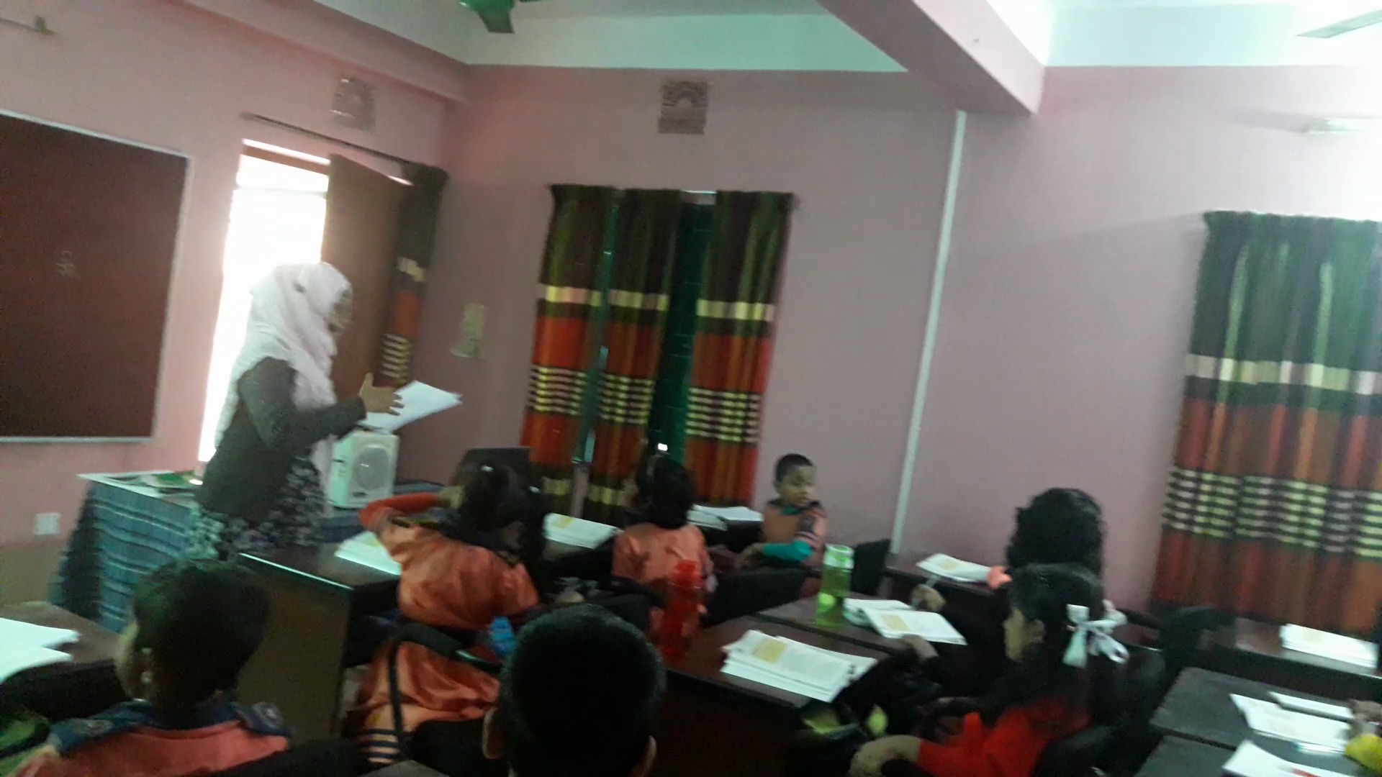
Teacher’s loud reading
Students, listen to me attentively

Slide 20
Kim’s game
Which word is missing?
forest
tree
shed
monkey
cow
tiger

Slide 21
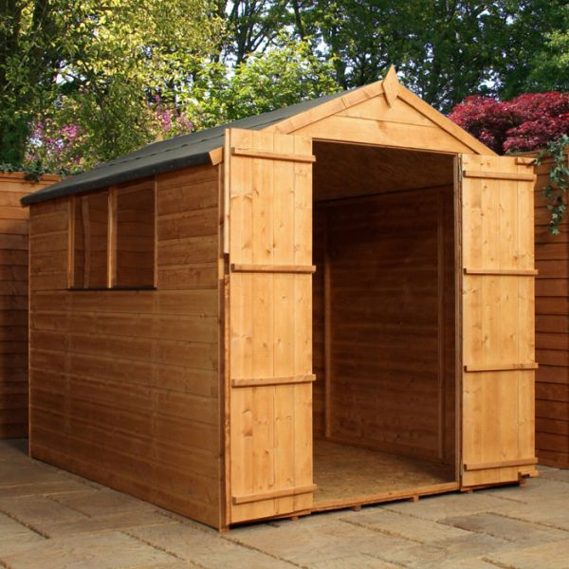


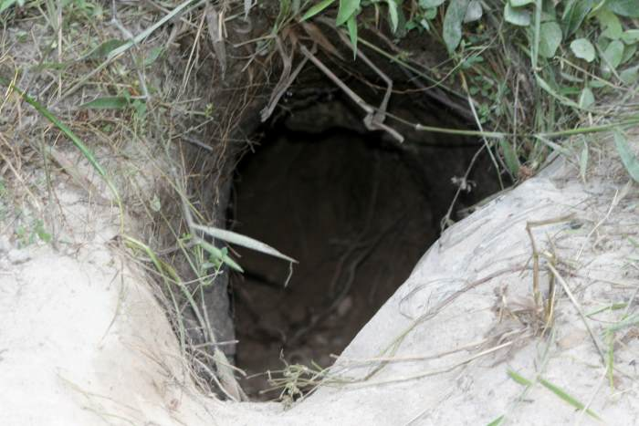
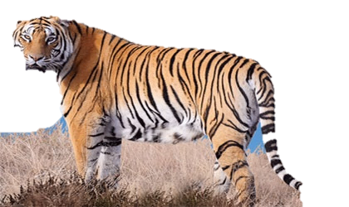
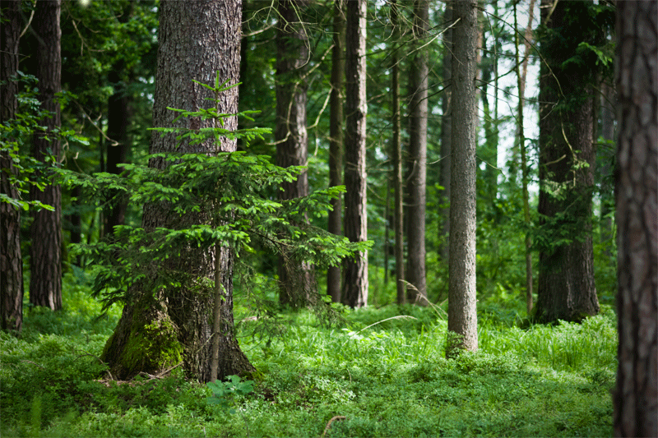
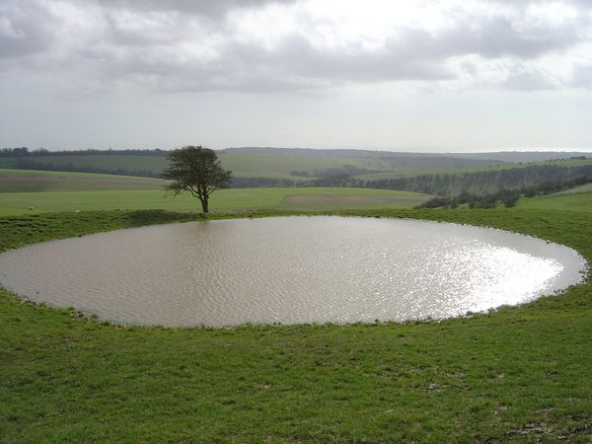
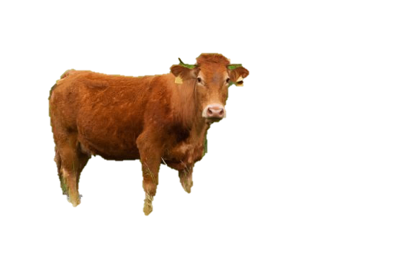
Where do they live?

Slide 22
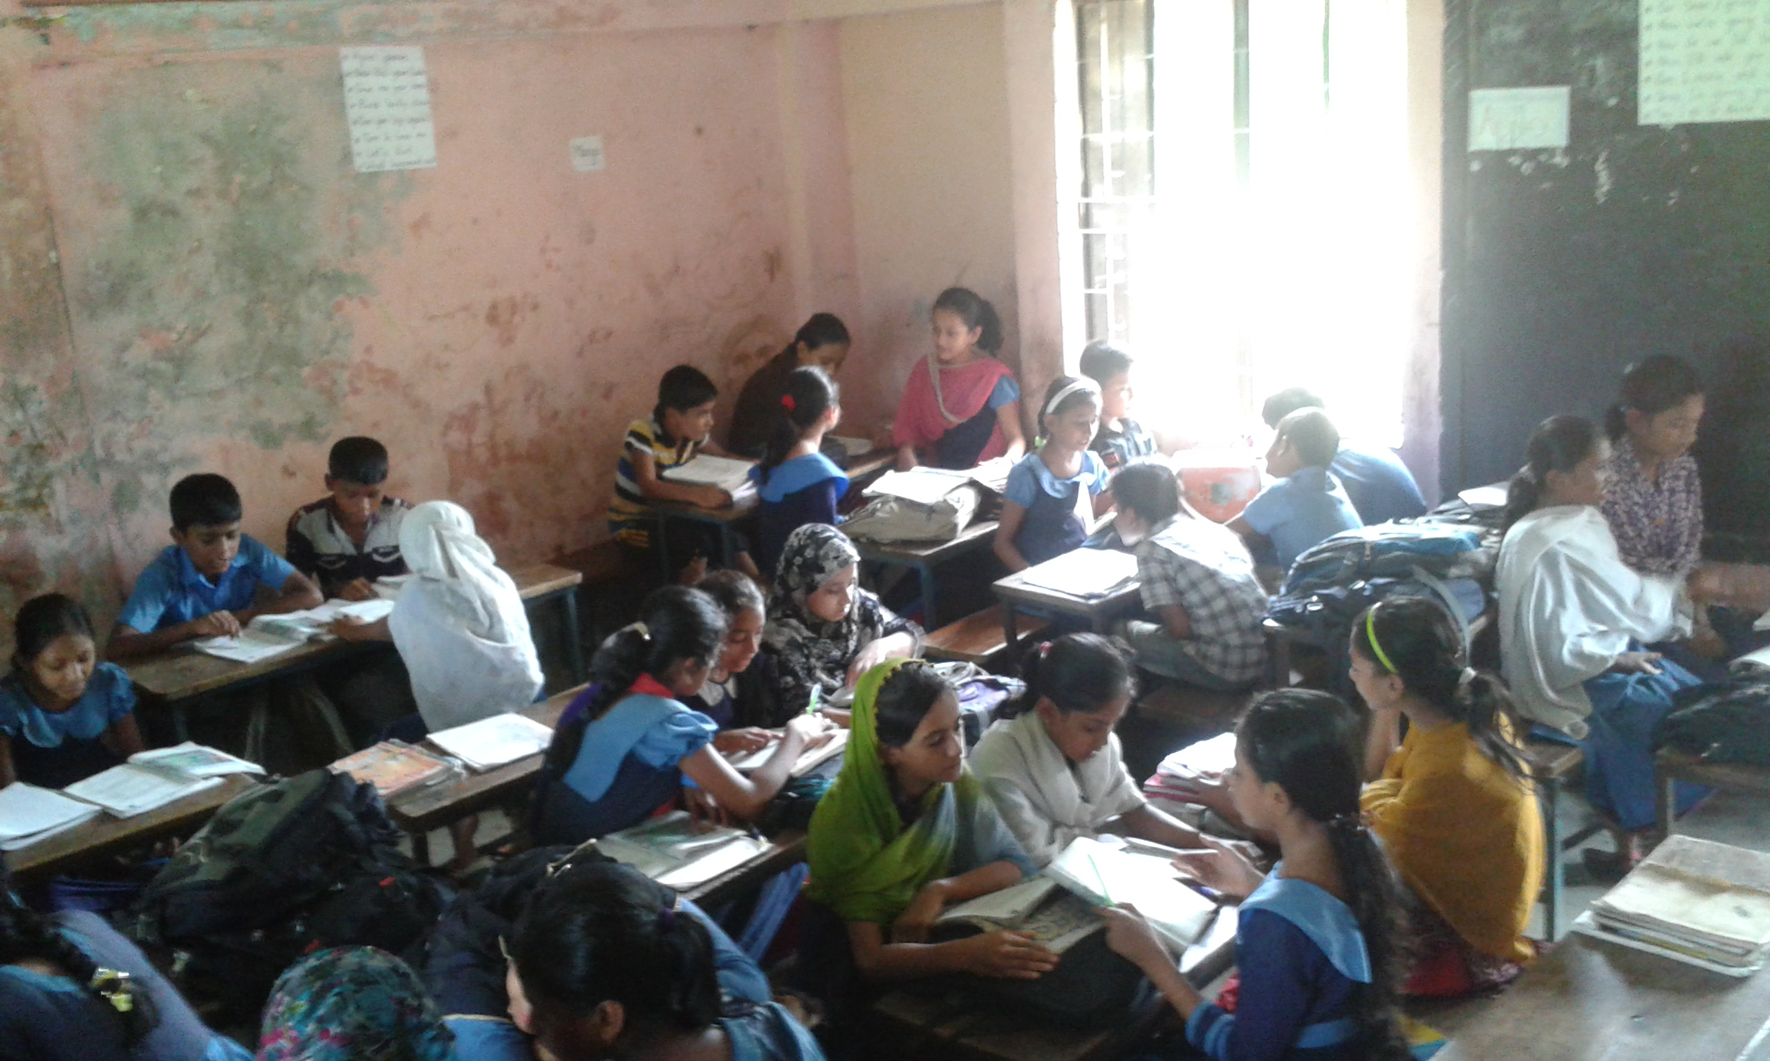
Group
answer
*
Where does a
1.tiger
2.cow
3.monkey
live?
and
ask
Work
1. A tiger lives in a forest.
2. A cow lives in a shed.
3. A monkey lives in a tree.

Slide 23
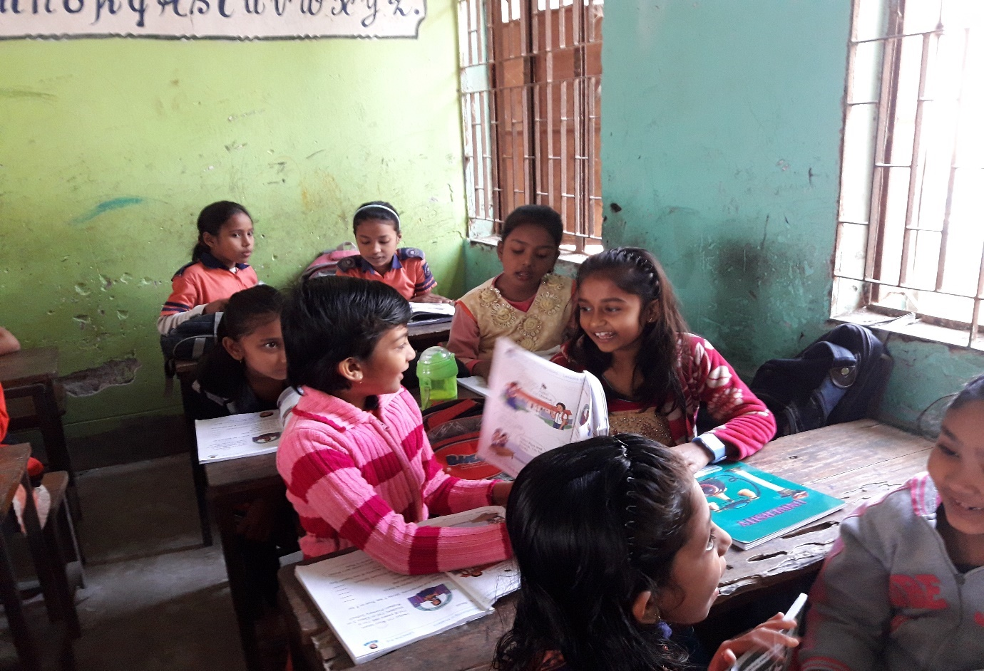
Pair
Work
Let’s match
Matching
Cow | forest
Tiger | tree
Monkey | shed
Cow | shed
Tiger | forest
Monkey | tree

Slide 24
Feedback
Let’s repeat all together after him/ her
c
o
w
s
h
e
d
m
o
n
k
e
y
t
i
g
e
r
f
o
r
e
s
t
t
r
e
e

Slide 25
Trace and write
forest
tree
shed

Slide 26
Checking learning
Write down in your note book
tesrof
fosret
forest
tree
reet
tere
edsh
shed
ehds
restfo
eret
desh

Slide 27


