Slide 1
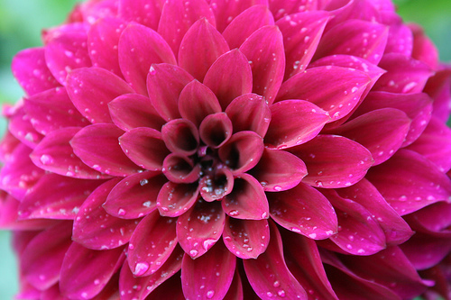
welcome

Slide 2
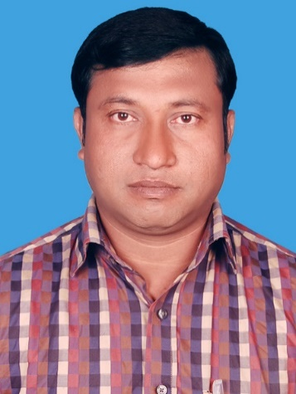
Introduction
Abul kalam rubel
Assistant Teacher (commerce)
Shaheed alauddin High School
Mirzapur, Pakundia, Kishoreganj
Class: Six Time: 40 Minutes
Contact # 01712276872

Slide 3
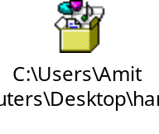
Let’s WATCH a video

Slide 4
The International Mother Language Day-1

Slide 5
Learning outcomes
After you have studied this lesson, you will be able to-
1. ask and answer some questions.
2. complete a chart.
3. match some words with their meaning.
4. write answer to some questions.

Slide 6
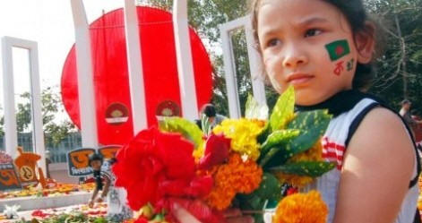
New words
Tribute=
Tri + bute= tribute
An act of showing respect
We pay tribute to the language martyrs.

Slide 7
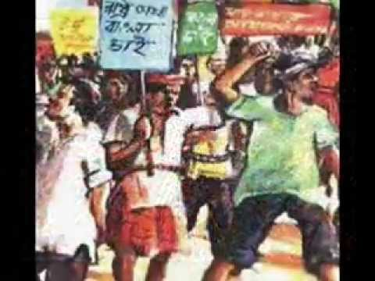
Movement=
Move + ment= movement
revolution
Our language movement took place in 1952.

Slide 8
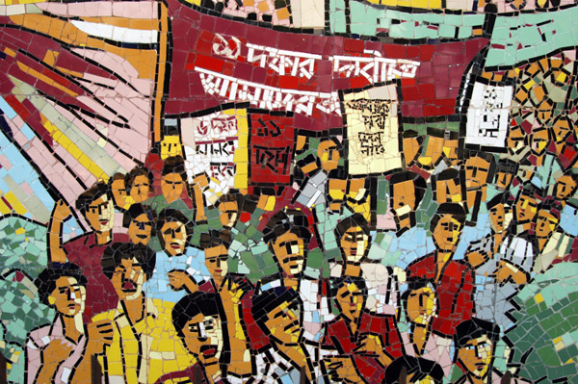
Procession=
Pro + ce + ssion = procession
a number of people moving in an orderly way
The students brought out a procession.

Slide 9
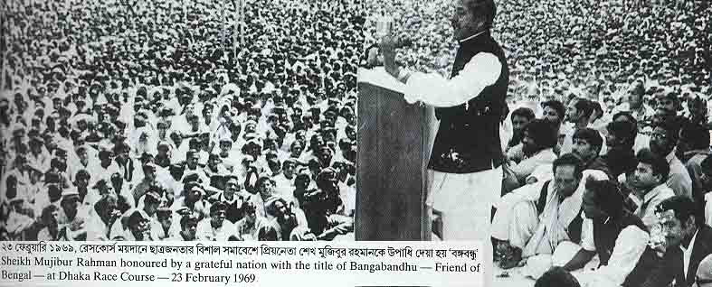
declaration=
Dec + la + ra + tion=declaration
announcement
Sheikh Mujib made the declaration of our independence.

Slide 10
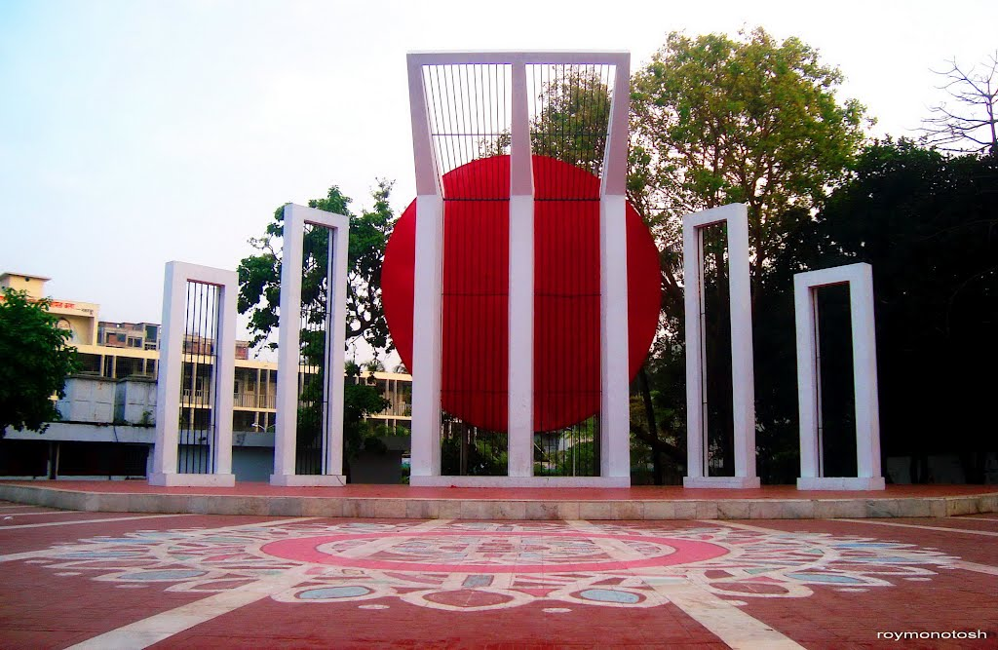
Talk about the picture.
What is the picture about?
Where do you think it is?
Why was it built?

Slide 11
Read the text in your book and complete the following chart.
Time | What happened
1947
1948
1952

Slide 12
Group work
Match the following words with their meaning
Words | Meaning
Tribute | A number of people moving in an orderly way
Climax | To refuse to obey
Outlaw | To ban
defy | An act of showing respect
procession | The most exciting point of time

Slide 13
Evaluation
Why do we observe 21 February as the International Mother Language Day?
What happened when Urdu was declared as the only official language of Pakistan?
What happened on 21 February 1952?

Slide 14
Home work
Write a paragraph on how you observed the International Mother Language Day in your school this year.

Slide 15

Thanks

