Slide 1

welcome

Slide 2
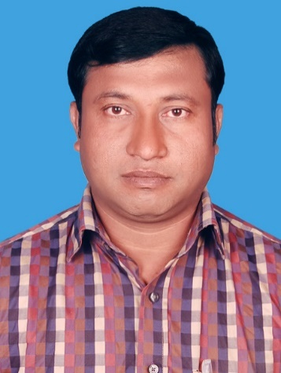
Introduction
Abul kalam rubel
Assistant Teacher (commerce)
Shaheed alauddin High School
Mirzapur, Pakundia, Kishoreganj
Class: Six Time: 40 Minutes
Contact # 01712276872

Slide 3
Lesson Introduction
English Text EFT
Unit-17
Class-Ten
Duration-50 minutes

Slide 4
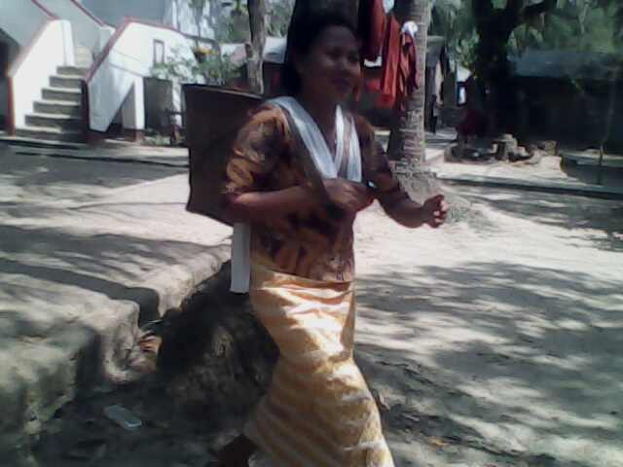
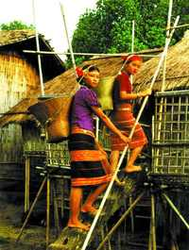
What kind of people they are?

Slide 5
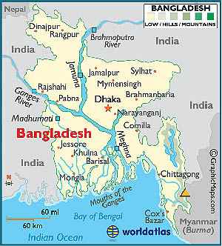
Look at the map
a. General people.
b. English people.
c. Tribal people.
d. Arabian people.
Hilly area
hilly area
What kind of people live in hilly area ?__

Slide 6
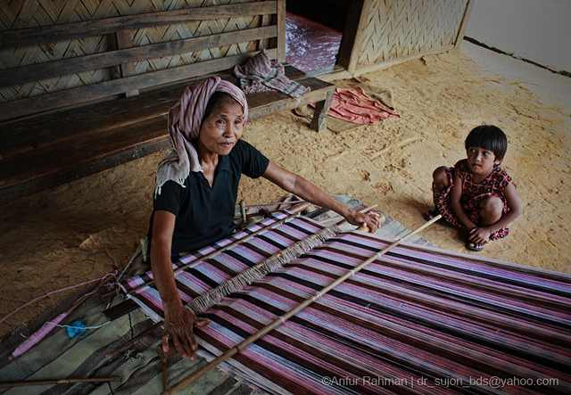
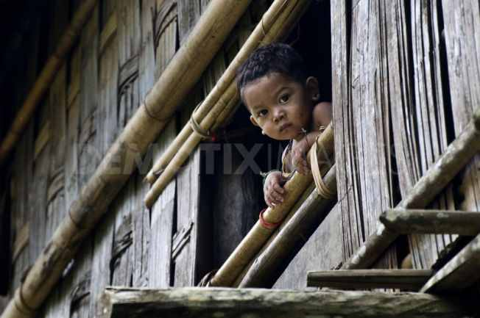
What kind of men do you see in the pictures?

Slide 7
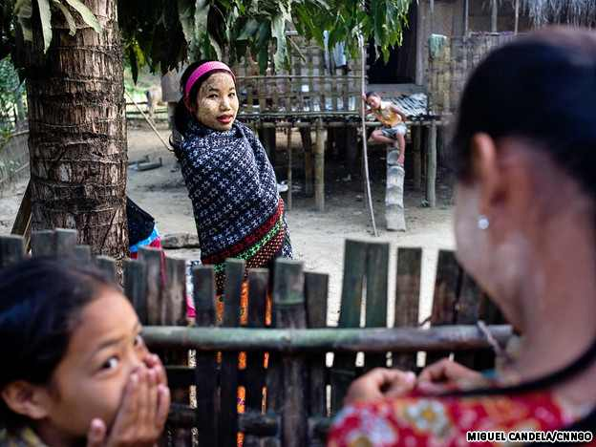
Our Today’s Topic is
THE MAGHS. Lesson-1,Page No 172

Slide 8
Learning out come
After studying the lesson, students will be able to-
Look at the picture and talk about them.
Identify true/ false statements and given correct information, If false
Read a text and answer questions based on it
Fill in gaps
Write a description of a process.

Slide 9

Open your text book and read more about the Maghs silently.

Slide 10


Slide 11
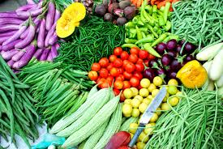
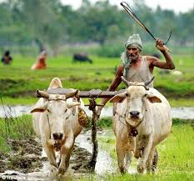
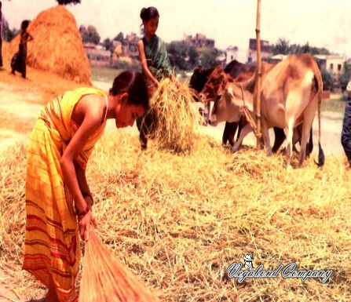
Some clues for word meaning
Vegetables (We eat )
Agricultural tools (Farmers use)
platforms
Thatched
(farmers gather )

Slide 12
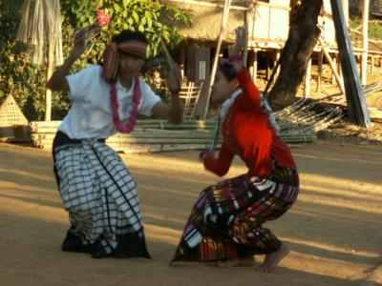
Follow the picture
Look at the picture
a. Muslims.
b. Arabians .
c. Tribal .
d. Italian .
Who are doing these perform? ?
Who are doing these perform? ?
Who are doing these perform?

Slide 13
Look at the picture
a. running.
b. Making fence.
c. Entering the house.
d. Weaving the loom.
Look at the picture and say what the people are doing.

Slide 14
Look at the picture
a. Playing piano.
b. Making fence.
c. Weaving cloth.
d. Gossiping with child.
Look at the picture and say what the woman is doing?

Slide 15


Slide 16
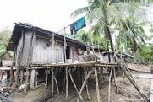
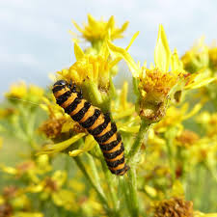
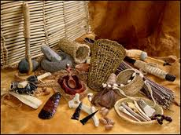
The Maghs build their houses on high platform for three reasons
?
Protect from insect
Keeping tools

Slide 17
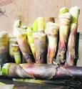
Maghs favourite food is

Slide 18
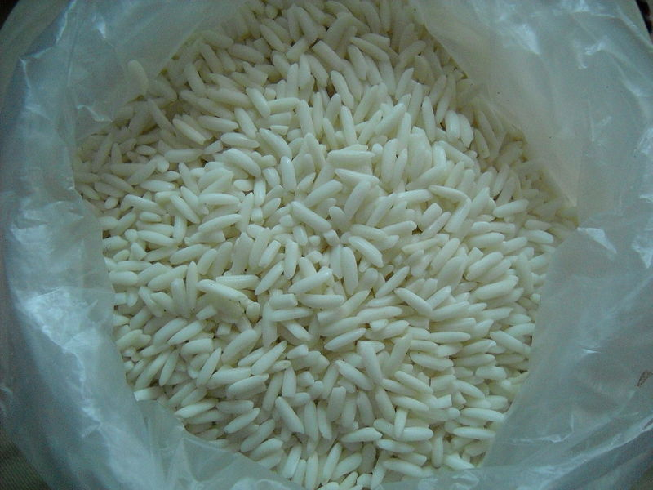
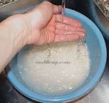
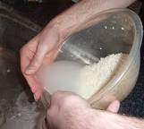
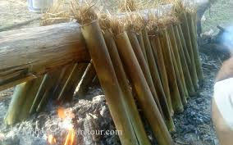
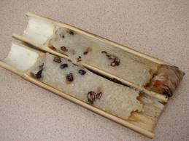
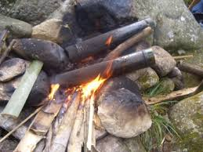
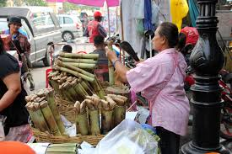
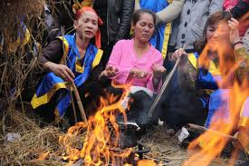
Process of making sticky rice

Slide 19
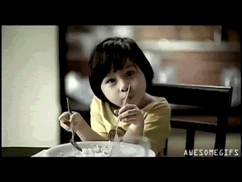

Slide 20
The diagram below shows the process of making sticky rice.
First:
Sticky rice
washed
Then pour in to bamboo tube with water
Next:
Tie Mouth of
The tube
Banana
leaves
After that
/fire/heated
After some time/rice/boiled
sufficiently/cooled
Tube/broken/sticky
rice/eaten

Slide 21
Speaking skill
Answer the following questions
a. What types of houses do the Maghs live in ?
b.When do the Maghs take their major meals ?
c. What is their main food?

Slide 22
      Activity sheet-02
Pairs work
Time-5 minutes
First Make questions and then answers from the following table
What | is | Maghs maim food?
Where | do | We see them in the country?
How they | Build | Their houses?

Slide 23
Write true or false , supply the right information
The Maghs live in town.
They take their meal twice daily
Mahgs can make cakes
Their houses become damp

Slide 24
Grammar/structure
Timber or bamboo posts support the platforms. The walls are made of bamboo, slates and the roof is thatched.
What is the function of the bold words?
These are Linking words and phrase

Slide 25
First
then
next
Finally
after
Linking words

Slide 26
group work (Activity sheet-3)
Complete the passage with accurate words& their right forms
The reason to ……... houses on high platforms is also to protect them from the different types of ……… and animals. Moreover they can use the empty space below their houses to ……… things such as agricultural tools and-……… . Timber or bamboo posts support the platforms. The walls are ……… of bamboo, slates and the roof is thatched.
build
insects
keep
looms
made

Slide 27
Home task
Write a short description on
“How make Morog Polao”

Slide 28
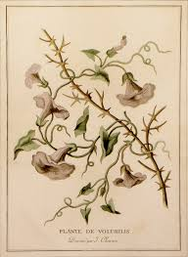
Thanks all

