Slide 1


HOW ARE YOU ?

Slide 2
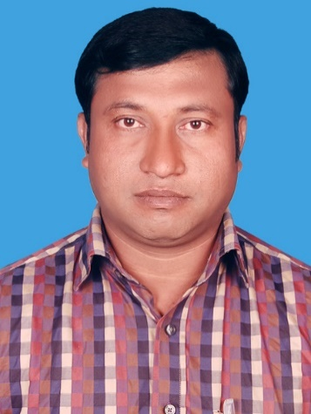
Introduction
Abul kalam rubel
Assistant Teacher (commerce)
Shaheed alauddin High School
Mirzapur, Pakundia, Kishoreganj
Class: Six Time: 40 Minutes
Contact # 01712276872

Slide 3
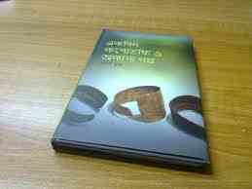
Identity
English For Today
Class : 9+10
Unit : Six.

Slide 4






Look at the Flags
Maldives
Sri Lanka
India
Nepal
Pakistan
Bhutan
Do you know which countries belongs to these flags ?
These are our neighbour countries.

Slide 5


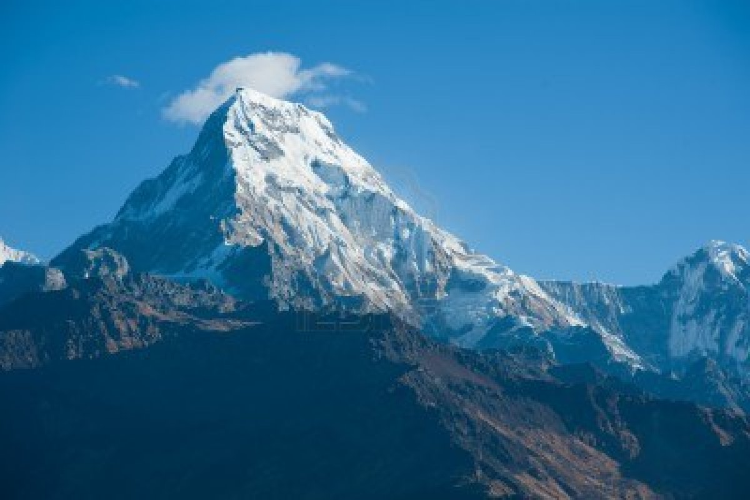


What is the name of this peak ?
Mount Everest

Slide 6
Learning Outcomes
After we have studied this unit, we will be able to
Read, comprehend and summerise texts.
Ask and answer questions.
Read travel ads and talk about them.
Write letters to friends describing places of interest.

Slide 7
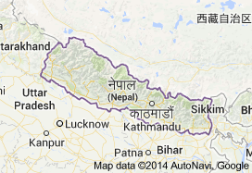
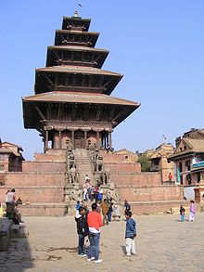
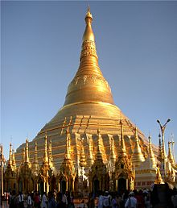


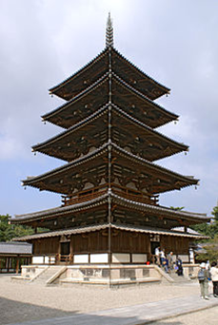
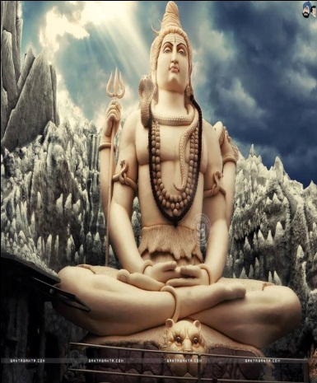
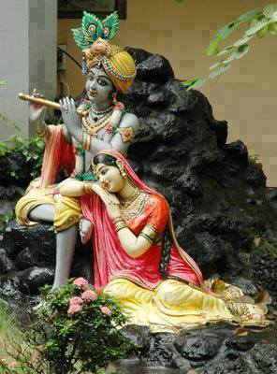
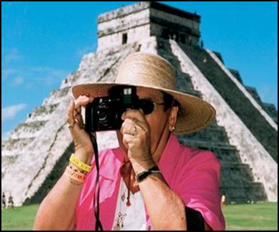
Presentation ( Model reading by the teacher )
a. Known as the Land of Everest. Nepal is one of the most charming countries in Asia. It Is also known as the only Hindu Kingdom in the world………………………New year.

Slide 8
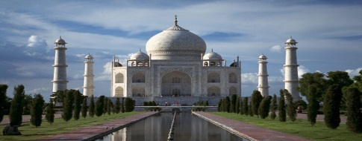


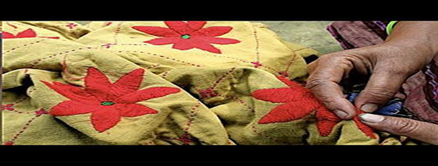


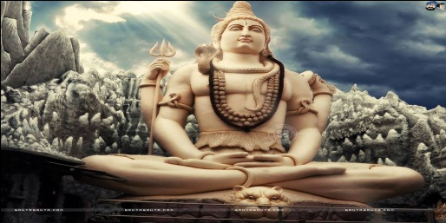
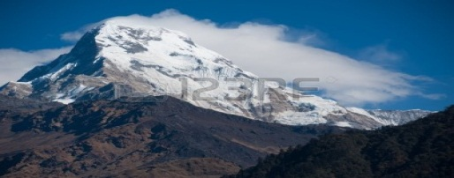
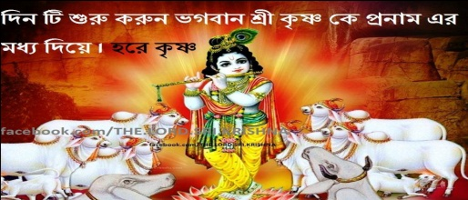
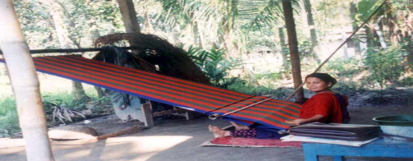
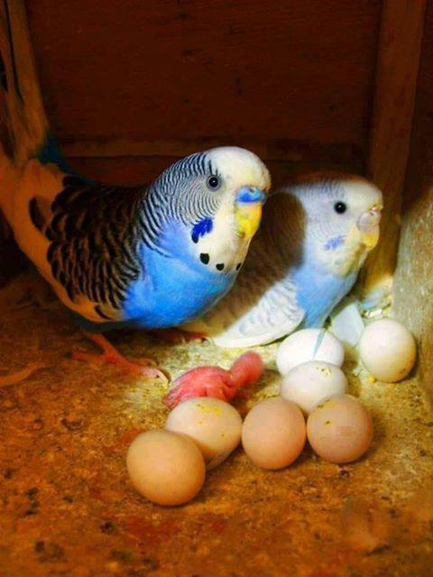
Presentation ( Word Meaning )
Sublime |  | Vibrant
Charming |  | Heritage
Peak |  | Worshipper
Temple |  | Shrine
Valley |  | Deities
Ethnic |  | Dazzling
execllent
striking
Very beautiful
Works of arts
A person who worships or pray
mountain
A building for worship
Holy place
Land between hills
Gods or goddesses
Of a nation
Very beautiful

Slide 9
Presentation ( Synonym and Antonym )
Main word | Synonym | Antonym
Charming | Delightful | Repulsive
Sublime | Attractive | Usual
Luxury | Daintiness | Hardship
Tropical | Summer | Winter
Peak | High point | Bottom
Rural | Rustic | Urban
Combine | Unite | Separate
Elegant | Graceful | Ungraceful
Religious | Pious | Irreligious
Drench | Wet | dry

Slide 10
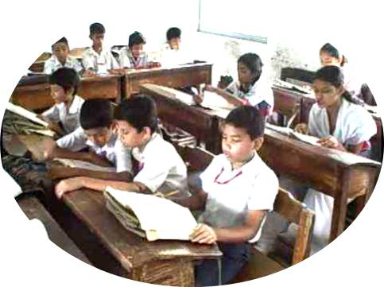
Silent reading by the students
Teacher will monitor and help the learners .

Slide 11
Group works ( Group – A )
Write the meaning of the following Phrase:
1. Tropical lowland.
Ans: a land that lies at the foot of a hill.
2. Temperate climate.
Ans: a moderate climate.
3. Ethnic groups.
Ans: groups having distinct racial and cultural features.
4. Pilgrimage destination.
Ans: a sacred place where people travel to perform religious acts.
5. Elegant architecture.
Ans: graceful work of building crafts.

Slide 12
Group Works ( Group – B )
Write down the answer of the following questions :
How many ethnic groups are there in Nepal ?
Ans: In Nepal there are 103 ethnic groups.
2. What do you know about the weather of Nepal ?
Ans: The weather in Nepal varies from place to place. Southern part has hot summers and warm winters and monsoon rains occur from June to September. Again, the central hill-lands have a temperate climate.
3. ``Many Nepalese combine Hindu and Buddhist practices.’’ – explain this statement with example.
Ans: This statement implies that many Nepalese either Hindu or Buddhist perform the religious activities of the two religions at the same time. For example, many temples and shrines are shared between the people of the two faiths and some deities are worshipped by both of them.

Slide 13
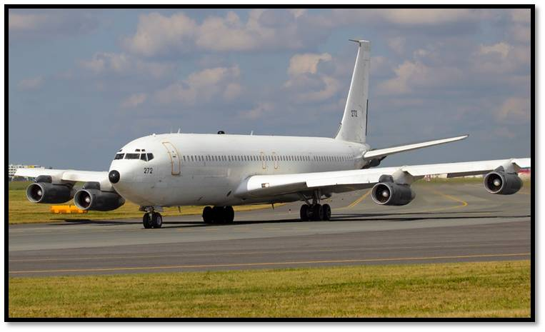
Pair Work
Look at the advertisement of a package tour to Nepal.
Dhaka – Kathmandu – Pokhara Package Tour.
Price : BDT- 39,999/-
Duration : 4 nights and 5 days.
Package Includes :
Return Air Ticket with Bangladesh Airport taxes and Kathmandu departure taxes.
2 nights accommodation in Kathmandu.
2 nights accommodation in Pokhara.
Buffet: Daily breakfast and lunch.
Both way Airport transfers in Kathmandu.
Kathmandu – Pokhara – Kathmandu by A/C bus.
Half day sightseeing in Kathmandu Valley.

Slide 14

Now discuss the advertisement with your partner and answer the following questions if they are true or false:
a. The package includes the cost of travelling from Kathmandu airport to the hotel in Kathmandu.
Ans: True.
b. The tourists will be provided with breakfast, lunch and dinner.
Ans: False, Corr:Ans: The tourists will be provided with breakfast and lunch.
c. The tourists do not have to pay extra for a half-day sightseeing in Pokhara.
Ans: True.
d. The tour operators will bear all visa related costs.
Ans: False, Corr: Ans: The operators will bear return air ticket with Bangladesh Airport taxes and Khatmandu departure taxes.
e. The tourists will go to Pokhara from Kathmandu by domestic flights.
Ans: False, Corr: Ans: The tourists will go to Pokhara from Kathmandu by
AC bus.

Slide 15
Individual work
Make a list of the festivals that are celebrated in Nepal.
Answer:
A list of the festivals that are celebrated in Nepal is as follows:
1. Dasain of dusherra.
ii. Tihar
iii. The Holi and Chaitra Daisan
iv. Haribodhini Ekadashi.
v. Maha Sivaratri.
vi. The Krishna Jayanti.
vii. Mani Rimd.
viii. Buddha Jayanti.
ix. Losar.

Slide 16
Home Work
Imagine that you have chosen the package tour to visit Kathmandu and Pokhara. Now write a letter to your friend highlighting the main attractions of the tour.

Slide 17
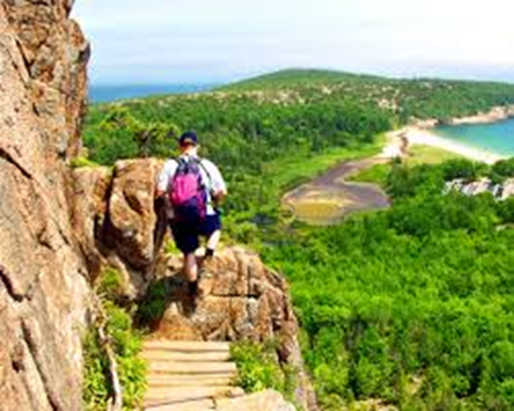
Good-bye

