Slide 1
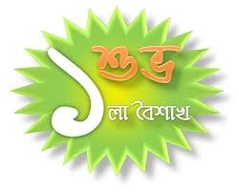
১৪২১

Slide 2
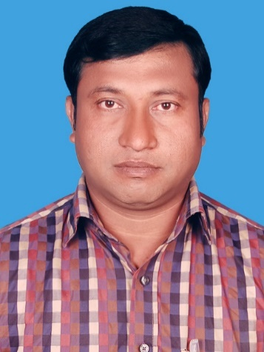
Introduction
Abul kalam rubel
Assistant Teacher (commerce)
Shaheed alauddin High School
Mirzapur, Pakundia, Kishoreganj
Class: Six Time: 40 Minutes
Contact # 01712276872

Slide 3
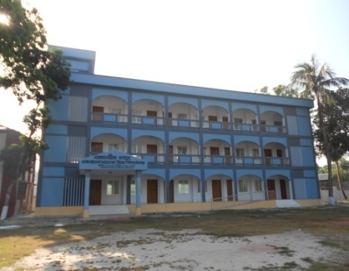
IDENTITY
SUBJECT.
English For Today
Class : 9 & 10

Slide 4
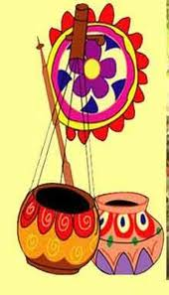
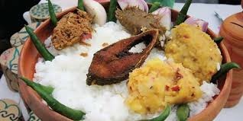
Look at the picture
When do we enjoy this kinds of food ?

Slide 5
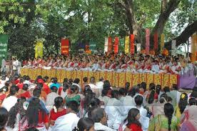
Look at the picture
When do we celebrate this festival ?
In pahela baishakh.

Slide 6
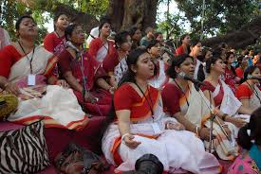

Creating Emotion
Let`s enjoy a video clip

Slide 7
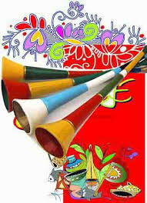
Lesson Diclaration
PAHELA BOISHAKH
Unite Three, Lesson : 6

Slide 8
LESSON OUTCOMES
After completing this lesson students will be able to
talk about events and festivals.
ask and answer questions and give opinions in a logical sequence.
write and compare among different festivals.
infer meanings from the context.

Slide 9
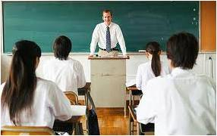

Presentation : Loud reading Slide 8 – 12.
( Click every audio icon for listening the following text )
‘Pahela Boishakh’ is the first day of bangla new year. The day is a public holiday. This day has a special significance for us as it forms a part of Bangalee culture and tradition. People from all walks of life, irrespective of their ethnic identity or religious beliefs, celebrate the day with traditional festivities, On this day, the whole of Bangladesh is in a festive mood. The day inspires people to start life with renewed hopes and inspirations.

Slide 10
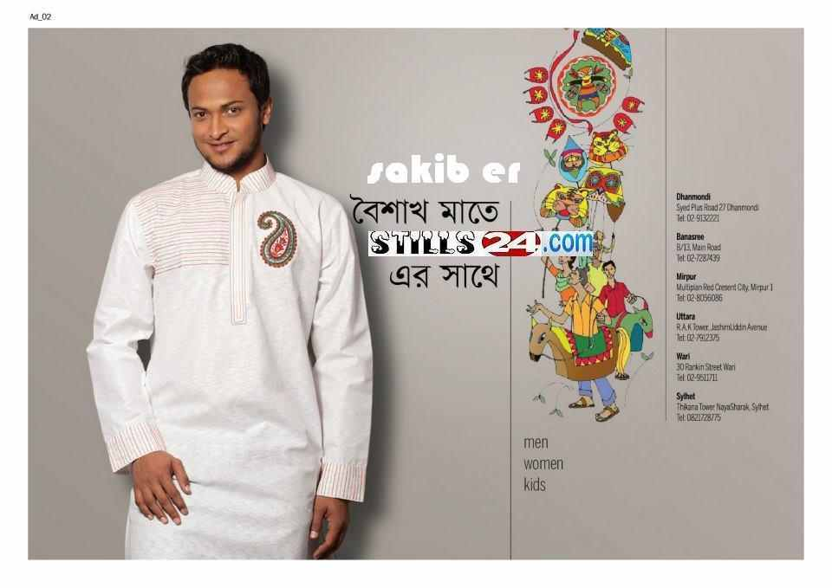
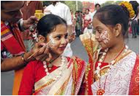
Presentation : Loud reading Slide 8 – 12.
Every year the day is celebrated traditionally. People wake up early in the morning, have a bath and wear their traditional clothes. Women wear white saris with red borders and adorn themselves with colourful churis and flowers, while men dress themselves with pajamas and punjabis. It is a day when people love eating traditional food.

Slide 11
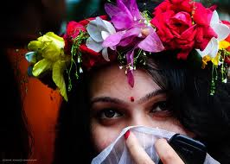
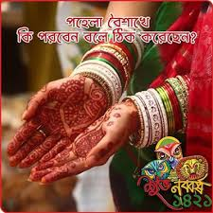
Presentation : Loud reading Slide 8 – 12.
The most colourful event of the day is held in Dhaka. Early in the morning, people in hundreds and thousands pour in from all directions to attend the cultural function at Ramna Batamul organised by Chhyanate. The cultural programme begins just with sunrise and and the renowned artists of the country take part in the programme that starts with the famous Tagore-song Esho-he-Boishakh, Esho Esho. Artists also sing traditional folk songs, and display classical dances with the rhythm of musical instruments.

Slide 12
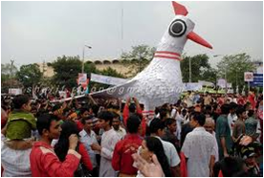
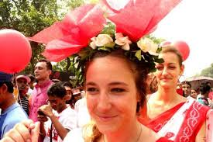
Presentation : Loud reading Slide 8 – 12.
People also come to join the colourful processions, the biggest carnival of the country, organised by the Fine Arts strdents of Dhaka University.
The procession usually displays the traditional practices of Bangalee Culture. The masks and wreaths worn by the people are so fascinating ! Often they symbolise contemporary worries or happiness in the national life. It attracts an increasing number of foreign tourists every year. The day is also observed all over the country. Different social and cultural organisations and educational institutions celebrate the day with their own cultural programmes.

Slide 13
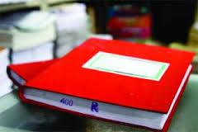
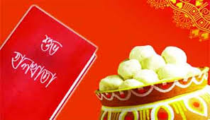
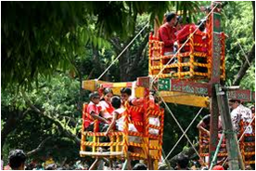
Presentation : Loud reading Slide 8 – 12.
On this day , newspapers bring out special supplements. There are also special programmes on the radio and television.
The celebration of Pahela Borshakh marks a day of cultural unity for the whole nation irrespective of caste and creed.

Slide 14
Vocabulary
Word | Meaning
Significance | The importance of something
Irrespective | Without considering
Inspiration | The process of being mentally stimulated to do or feel something
Renowned | Famous and respected
Adorn | To make more beautiful of attractive
Carnival | A public festival
Creed | A set of principles of religious beliefs.
Caste | Divisions of Hindu Society.

Slide 15
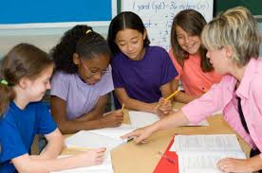
Silent reading
Teacher will monitor and help the learners.

Slide 16
Evaluation : Individual work
Choose the best answer from the alternatives.
People celebrate Pahela Boishakh ----- their ethnic identity.
i) regarding ii) according to iii) considering iv) regardless of
b. People throughout the country celebrate the day by
A) attending traditional cultural programmes
B) eating traditional food.
C) dressing themselves with modern clothes.
Which of the above answer/s is/are correct ?
i) A & B ii) B & C iii) A & C iv) B
c) In the passage, the word `dress’ is a/an --- .
i) noun ii) adverb iii) verb iv) noun & verb
d) Choose the pair that does not show `verb : noun’ -----
i) inspire : inspiration ii) festive : festival
iii) believe : belief iv) celebrate : celebration
e) The programme at Ramna Batamul is organised by -----.
i) Bulbul Lalitakala Academy ii) Shilpakala Academy
iii) Bangla Academy iv) Chhayanat

Slide 17
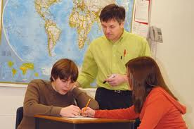
Pair Works
Evaluation :
Answer the following questions.
  What do you mean by pahela Boishakh ?
  How do the women adorn themselves ?
  How is the day observed in Dhaka ?
  How does Pahela Boishakh inspire people ?
  e. What do the mass media do ? Why ?

Slide 18
Evaluation :
Group Works
Complete the passage with suitable words.
The word Pahela means the first and Boishakh is (a)--- month of Bangla calendar. The day is observed not (b)------in Bangladesh but (c)------ in some other parts of the world. In England, the Bangalees also (d) ------the day with a street (e) ------ in London.
Ans: a) first b) only c) also d) celebrate e) procession

Slide 19

Home Work
Write with in ten sentences about how did you celebrate Pahela Boishakh -1421.

Slide 20


THE END.

