Slide 1

WELCOME

Slide 2
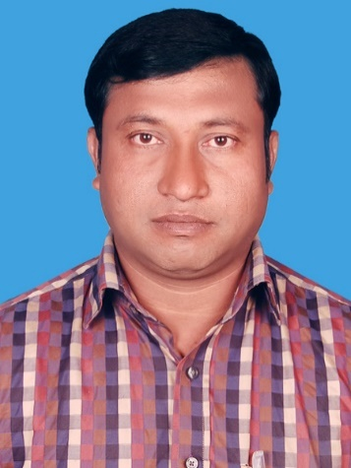
Introduction
Abul kalam rubel
Assistant Teacher (commerce)
Shaheed alauddin High School
Mirzapur, Pakundia, Kishoreganj
Class: Six Time: 40 Minutes
Contact # 01712276872

Slide 3
PRESENTED BY
ABUL KALAM RUBEL
ASSISTANT TEACHER
SHAHEED ALAUDDIN HIGH SCHOOL

Slide 4
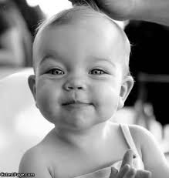
A child

Slide 5

A student

Slide 6


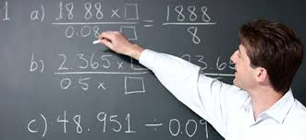
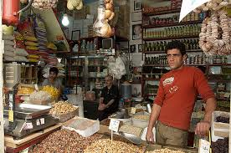
A doctor
An engineer
A teacher
A business man

Slide 7
TENSE
AND IT’S CLASSIFICATION

Slide 8
OBJECTIVES
By the end of the lesson students will have…..
1. learnt about tense and it’s classification.
2.learnt about tenses and their uses.
3. learnt to buildup sentences.
4.learnt to say the structure of tenses.

Slide 9
TENSE
PRESENT
PAST
FUTURE

Slide 10
Tense and it’s structure & example
NAME OF TENSE | STRUCTURE | EXAMPLE
PRESENT | Sub.+Verb(Present)+Obj. | I am a student
PAST | Sub.+Verb(Past)+Obj. | I was a child
FUTURE | Sub.+Shall/will+Verb(Present)+Obj | I shall be a doctor

Slide 11
PRESENT TENSE
INDEFINITE
CONTINUOUS
PERFECT
PERFECT CONTINUOUS

Slide 12
PAST TENSE
INDEFINITE
CONTINUOUS
PERFECT
PERFECT CONTINUOUS

Slide 13
FUTURE
TENSE
INDEFINITE
CONTINUOUS
PERFECT
PERFECT CONTINUOUS

Slide 14
Tense
NAME OF TENSE | NAME OF THE PARTS | STRUCTURE | EXAMPLE
PRESENT | INDEFINITE | Sub.+Verb(Present)+Obj. | I am a student
 | CONTINUOUS | Sub.+(am/is/are)+verb (Present)+ing+Obj. | I am reading a book.
 | PERFECT | Sub+ have/has+verb (past par.form)+obj | I have read a book.
 | PERFECT CONTI. | Sub+ have/has been+verb (pre.form)+ing+obj | l have been reading a book for three hours.
PAST | INDEFINITE | Sub.+Verb(Past)+Obj. | I was a child
 | CONTINUOUS | Sub.+(was/were)+verb (Present)+ing+Obj. | I was reading a book.
 | PERFECT | Sub+ had+verb (past par.form)+obj | I had read a book.
 | PERFECT CONTI. | Sub+ had been+verb (pre.form)+ing+obj | I had been reading a book for three hours.
FUTURE | INDEFINITE | Sub.+shall/will Verb (Pre.)+Obj. | I shall be a doctor
 | CONTINUOUS | Sub.+(shall be/will be)+verb (Present)+ing+Obj. | I shall be reading a book.
 | PERFECT | Sub+ shall have/has+verb (past par.form)+obj | I shall have read a book.
 | PERFECT CONTI. | Sub+ shall/will have/has been+verb (pre.form)+obj | I shall have been reading a book for three hours.

Slide 15
Individual Work
Change the following sentences as directed.
She is singing a song.(Past con.)
They make a garden.(Present per.)
I have been doing the work since morning.(Future per.con)

Slide 16
Individual Work
Anawer sheet.
She was singing a song.
They have made a garden.
I shall have been doing the work since morning.

Slide 17
EVALUATION
1. How many kinds of tense?
2.What is the difference between past perfect and future perfect?
3. What is the structure of past continuous tense?

Slide 18
Home Work
Draw the structure of all kinds of tenses as my drawn structure in this class.

Slide 19


Thanks a lot

