Slide 1

WEL COME

Slide 2
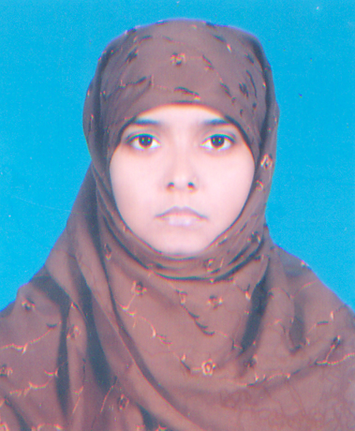
Presentation By -
Farhana Akter
Assistant Teacher
Jaria Islamia siddiquia Dakhil Madrasah
Fakirhat,Bagerhat.

Slide 3
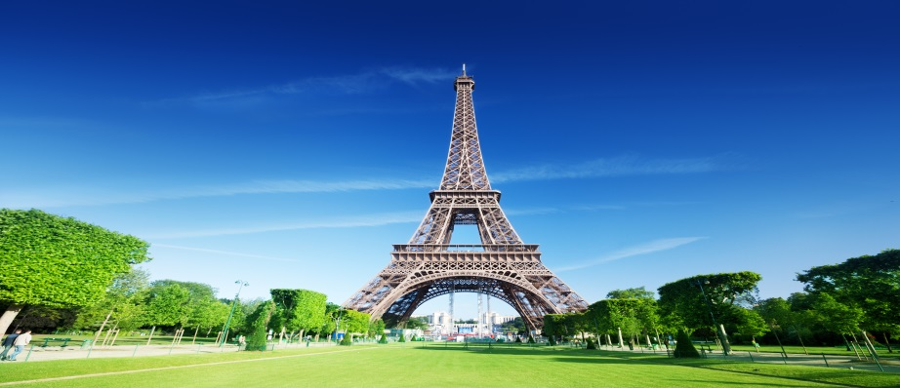
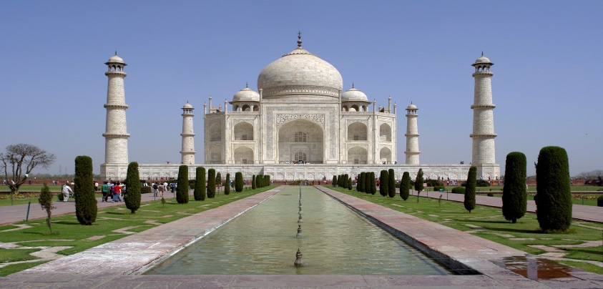
Look at the pictures and discuss

Slide 4
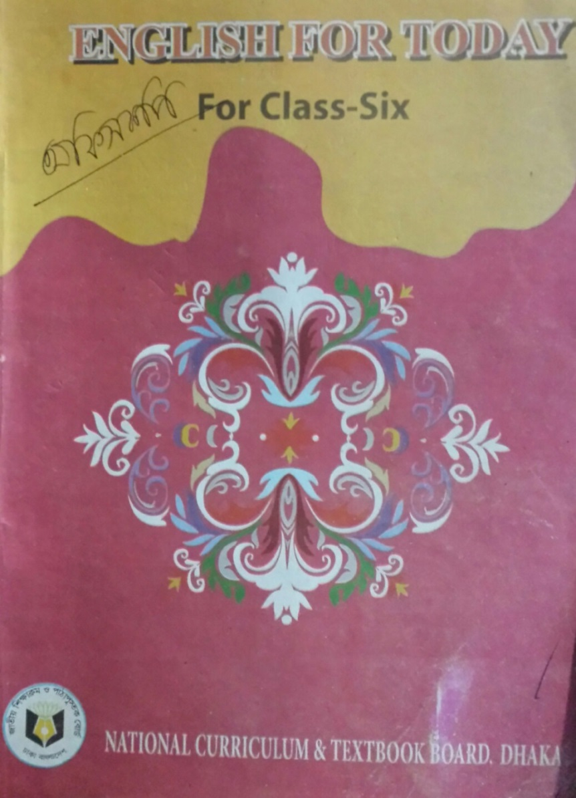
Lesson Plan
Class-vi
Subject:English 1st paper
Lesson 22:wonders of the world- 1
Todays Subject

Slide 5
Learning out comes-
After completing the lesson students will be able to-
1.read and understand text.
2.ask and answer questions.
3.vocabulary.
4.Fill in the gaps.
5.write short paragraph.

Slide 6
Vocabulary : admire(verb), Amazing(adjective), Architecture(noun), craftsmen(noun), Emperor(noun),

Slide 7
Now make questions using the cues given below-
1. What is the Taj Mahal ?
2.Where is it Located ?
3. How much does Shsh Jahan love Mumtaz ?

Slide 8
Assessment :
Sound
Picture Identification
Pronunciation

Slide 9
Home Work:
Write a paragraph about the Taj Mahal.

Slide 10
Good Bye

