Slide 1
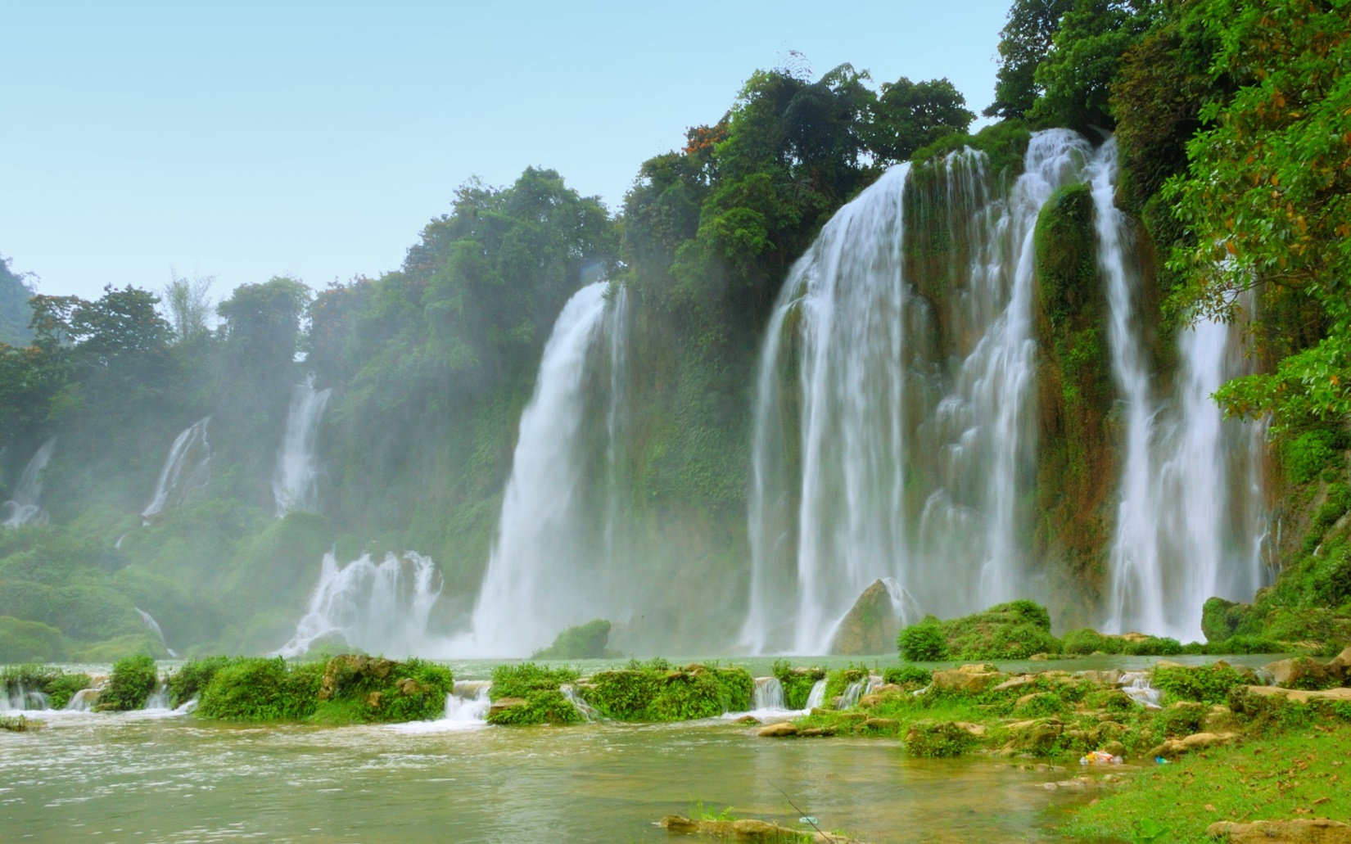
Dear students, welcome to my class

Slide 2
Teacher’s identity
Md. Imran Kabir
Assistant teacher
Pabna Collectorate Public School And College, Pabna
Email-i.kabir01111@gmail.com
Mobile- 01756005577
Class- Nine
Subject- English 1st paper
Unit-8, Lesson-2
Time- 50 minutes

Slide 3
What do you see in the video?
Paharpur Sompur Bihar

Slide 4
Our today’s lesson is-
The Sompura Mahavihara

Slide 5
Learning outcomes
After we have studied this lesson, we will be able to-
Listen for specific information
Read and understand text
Ask and answer questions
Describe a place.

Slide 6
Keywords

Slide 7
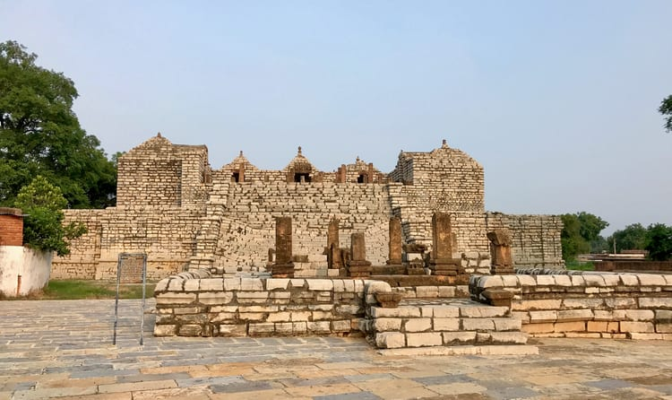
Excavation, antiquarianism, prehistory
Archaeological

Slide 8
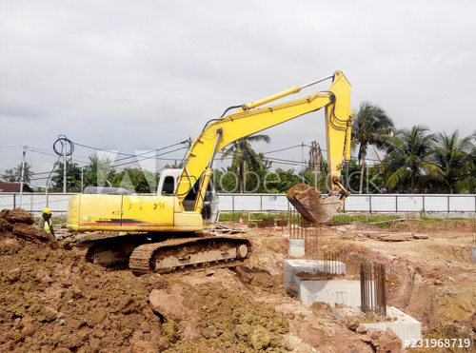
Excavate
Dig, bore, tunnel

Slide 9
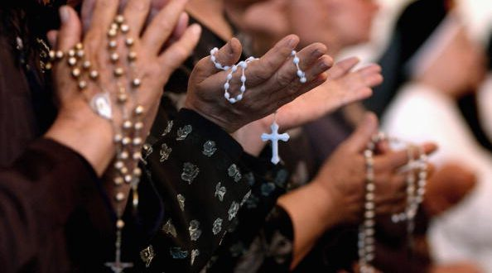
Devout
Pious, religious, saintly

Slide 10
Tall, high, giant
Lofty

Slide 11
Survey
Study, review, scrutiny

Slide 12
Research
Investigation, experiment, testing, analysis

Slide 13
Prevent
Halt, hamper, obstruct

Slide 14
Read the text- A and answer the following questions-
Paharpur is an important archaeological site situated in a village named Paharpur in Naogaon district of northern Bangladesh. Naogaon is mainly plain land but in the middle of it stood a hill covered with jungle. When the jungle was cleared and the hill excavated, there emerged a lofty ruin of an ancient temple. The temple is about 24 metre high from the surrounding level. Pahar means hill. Hence is the name Paharpur. The Paharpur site has been excavated and re-excavated a number of times by archaeologists. Sir Alexander visited the place in 1879. Cunningham intended to carry out an extensive excavation but was prevented by the land owner. Nevertheless, he was satisfied with whatever excavation he was permitted to carry out. The site was declared to be protected by the Archaeological Survey of India in 1919 under the Ancient Monuments Preservation Act of 1904.
Systematic and regular excavation started jointly by Archaeological Survey of India, and Varendra Research Society of Rajshahi and Kolkata (at that time known as Calcutta) University in 1923. They excavated the south west corner of the monastery. Next in 1925-26 RD Banerjee excavated the northern part of the central mound. From 1926-27 onward, excavation was carried out under the supervision of KN Dikshit.

Slide 15
The Department of Archaeology of Bangladesh brought the site under further excavation after independence. The operation took place in two phases. The first phase was initiated in 1981-82 and continued to 1984-1985. The second phase was started in 1988-89 and continued to 1990-91.
Pre-liberation expeditions have revealed the architecture of a vast Buddhist monastery, the Somapura Mahavihara. It is dominated by the central shrine, attracting immediate attention by its lofty height and unusual architectural design.
Somapura Mahavihara was one of the most famous Buddhist institutions for monks of ancient Bengal and in southern Asia. The excavated complex at Paharpur has been identified as Somapura Mahavihara built by the Second Pala king Dharmapala (781-821 AD). Some clay seals from the ruins bear the inscription Shri-somapure-Shri-Dharmapaladeva-Mahavihariyarya-bhiksu-sangghasya. The Pala rules were devout Buddhists and they founded a number of monasteries throughout their growing empire. Some of them became great centres of learning and their reputation quickly spread throughout Asia. Somapura Mahavihara’s close relationship with the ruling dynasty implied that it shared the political ups and downs of its benefactors.

Slide 16
Individual work
Read the text- A and fill in the blanks-
Paharpur a)_ an important archaeological site b)_ in a village named Paharpur in Naogaon district of northern Bangladesh. When the jungle c)_ and the hill d)_, there emerged a lofty ruin of an ancient temple. The temple is about 24 metre high from the e)_ level. Pahar means hill. Hence is the name Paharpur.
Answer- a) is b) situated c) was cleared d) excavated e) surrounding

Slide 17
Group work
1. What objects indicate that Sompur Mohavira was built by the second Pala king?
Answer- Some clay seals from the ruin indicates that Sompur Mohavira was built by the second Pala king.
2. What kind of village is Paharpur?
Answer- Paharpur is a typical Bangladeshi village.
3. Why is it famous for?
Answer- Paharpur is famous for it’s archaeological site Sampur Mahavira.
4. Why was the site officially stated to be preserved?
Answer- The site was officially stated to be preserved because of it’s archaeological importance.
5. How many times excavation work was taken place?
Answer- The excavation work was taken place for five times.

Slide 18
Homework
Do you have any old or ancient relic in your city/town/village? Write about it with the help of the following questions.
When it was established?
Who built it?
How does it look like?
How big is it?
What is it’s present conditions?

Slide 19
Thank you

