Slide 1

Welcome
to
Everybody

Slide 2
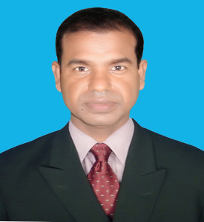


Introduction
Md. Abdul Kuddus
Assistant Teacher
Talsher Govt. Pri. School
Moheshpur, Jhenaidah.
Class: Two
Subject: English
Alphabet. Lesson:4-6,
Unite : 1. Page : 3

Slide 3
Today’s lesson
Alphabet
Unite : 1

Slide 4



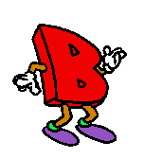
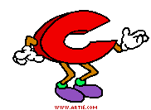
Lesson Declaration
Alphabet(Aa-Ee)

Slide 5
Learning outcomes
Students will be able-
Listening:
1.1.1 to become familiar with English sounds by listen to common English word.
Speaking:
1.1.2 to say simple words.
Reading:
1.2.1 to recognize and read the alphabet both small and capital (non-cursive) letters.
Writing:
3.1.2 write words using non-cursive small letters.

Slide 6
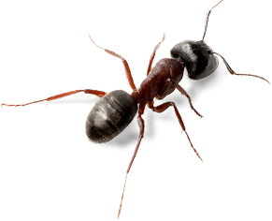
Look at the picture and say loudly
a
A
ant

Slide 7

B
b
bat

Slide 8

C
c
cup

Slide 9
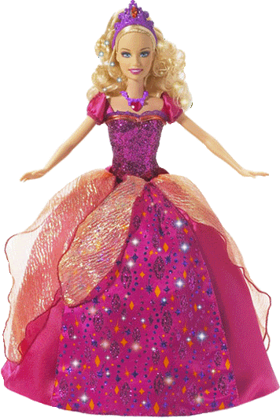
D
d
doll

Slide 10
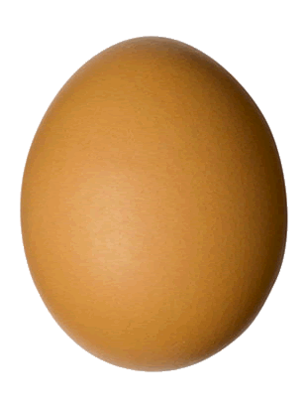
E
e
egg

Slide 11
Open at page 3 of your EFT book and look activity A
Everybody, listen to carefully
And repeat after me.

Slide 12


Loud reading by the teacher
A
ant
D
doll
B
E
egg
bat
C
cup

Slide 13

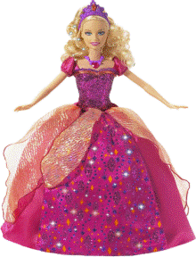

Match the pictures with the letters:
P.W
cup
A
B
doll
egg
C
D
ant
E
bat

Slide 14


Rearrange the pictures according to the letters
SGW
a
b
c
d
e

Slide 15
Read and say. Trace and write.
WCW
ant
cup
ant
bat
cup
bat
doll
egg
doll
egg

Slide 16


Evaluation
Look and say. Write.
Look at the picture and fill in the gaps:
ant
doll
bat
egg
cup

Slide 17
Evaluation
Fill in the blanks with small letter
A…., B…., C…., D…., E….

Slide 18
Thank
to
All
Goodbye

