Slide 1
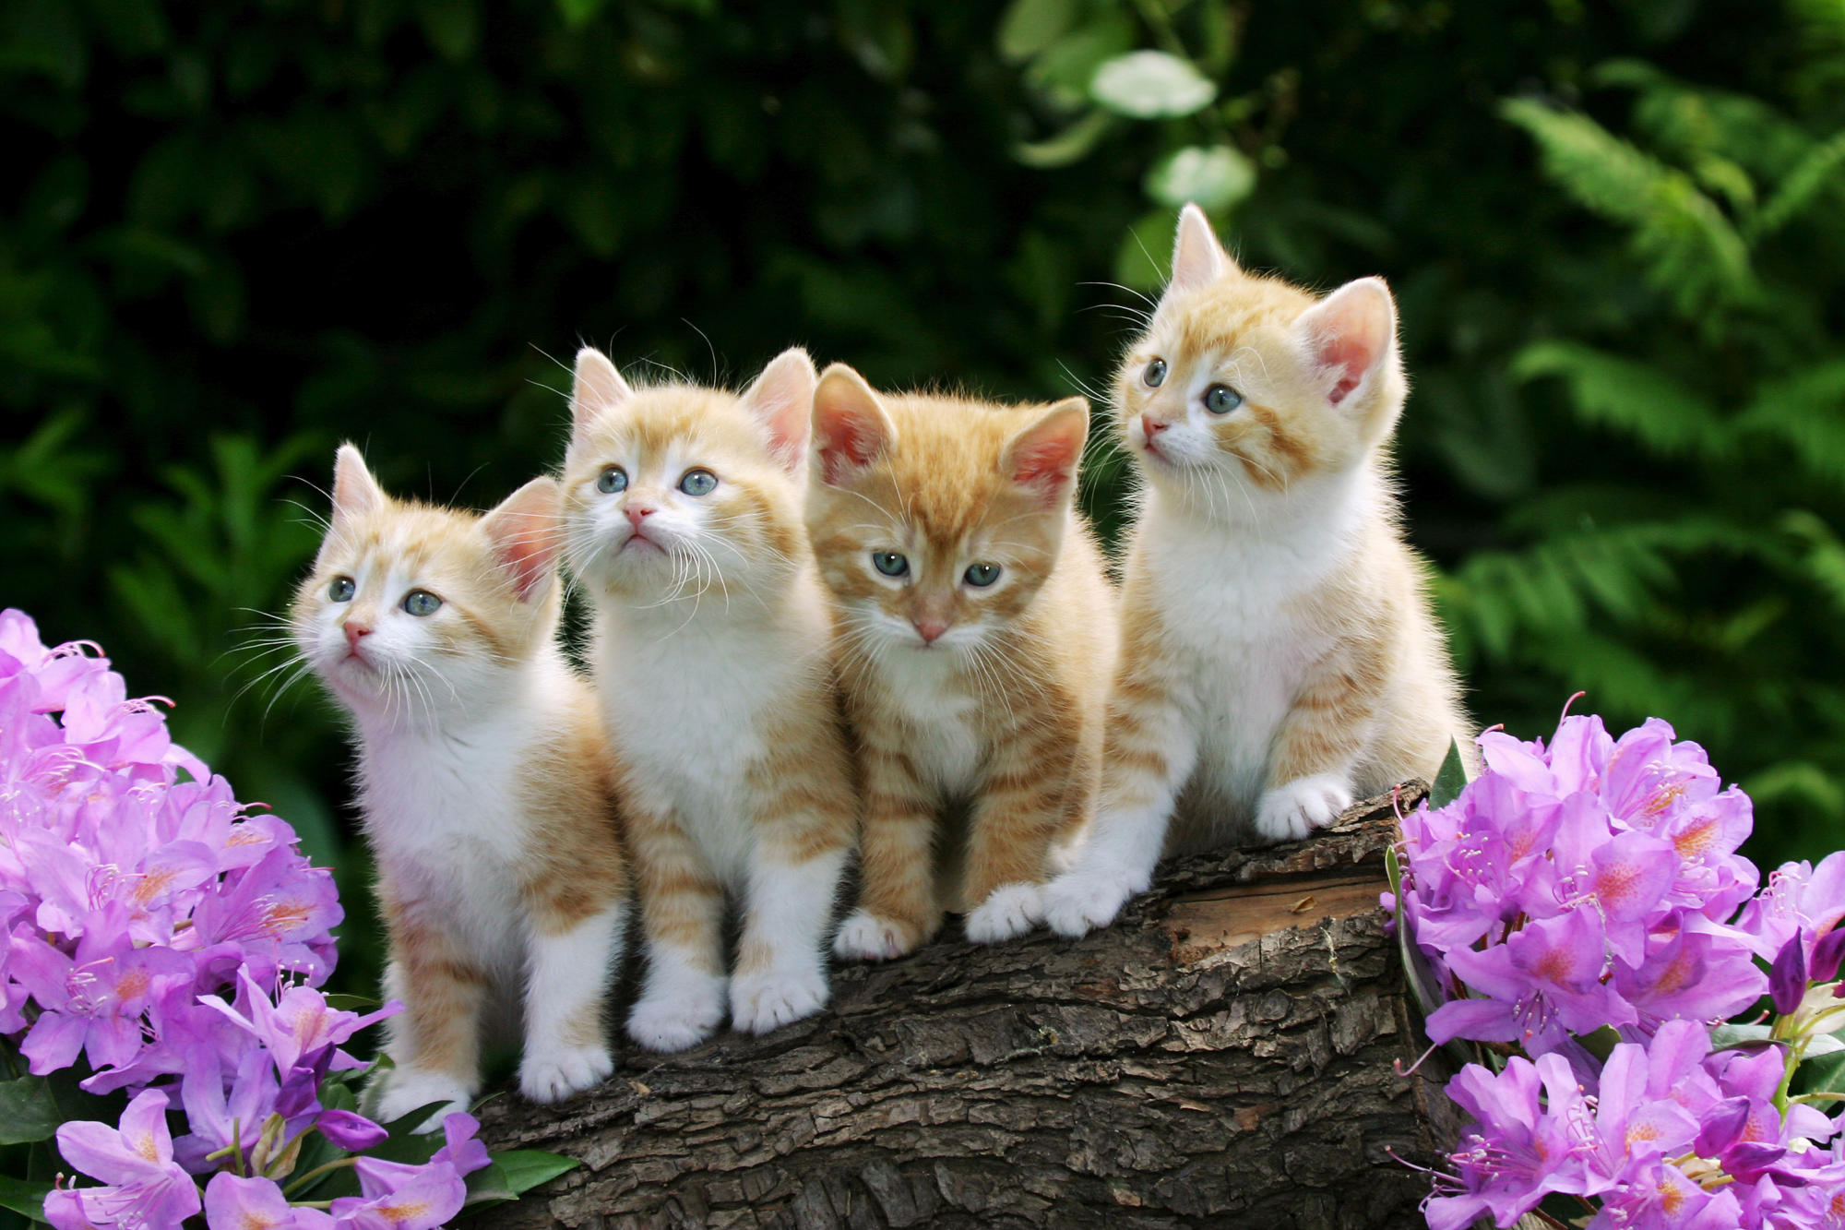


Good morning

Slide 2
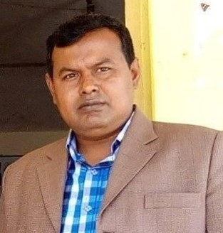

Introduction
Class: Two
Subject: English
Numbers . Lesson:1-3,
Unite : 8. Page : 16
Md.Ali Hosen
Assit. Teacher
Madhobpara GPS
Kaligonj, Lalmonirhat.

Slide 3

Let’s watch a video

Slide 4



Can you guess what we are going to learn today?
What can you see?

Slide 5
Today’s lesson
Numbers
Unite : 8
(11,12,13)

Slide 6


Learning outcomes
Students will be able-
2.1.1 recognize and read cardinal numbers 11 to 13.
4.1.1 copy numbers 11 to 13 in figures and in words
4.1.2 write numbers 11 to 13 in figures and in words

Slide 7

Look and say.
11
12
13

Slide 8
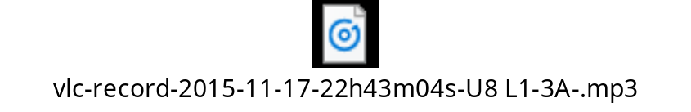

Look and say.
11

Slide 9


Look and say.
12

Slide 10
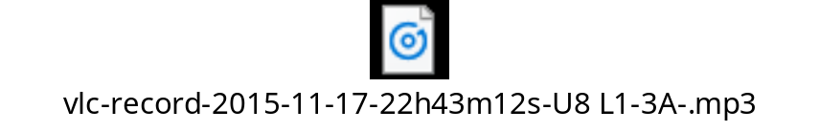
Look and say.
13

Slide 11
Let’s watch a video
11
12
13

Slide 12
Say , trace and write.
11
11
11
11
11
11
11
12
12
12
12
12
12
12
13
13
13
13
13
13
13

Slide 13


Match correctly:
P.W
11
12
13

Slide 14
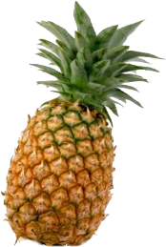
Group work
Count and write the number
Group-A
12
13
Group-B
11
Group-C

Slide 15
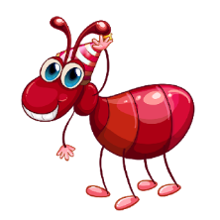
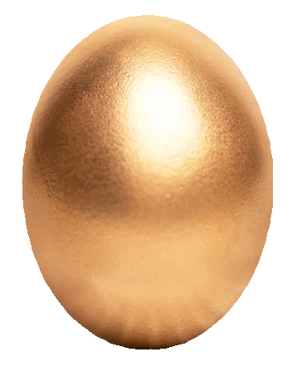


Say the number. Count and circle.
Evaluation
11
11
12
13

Slide 16

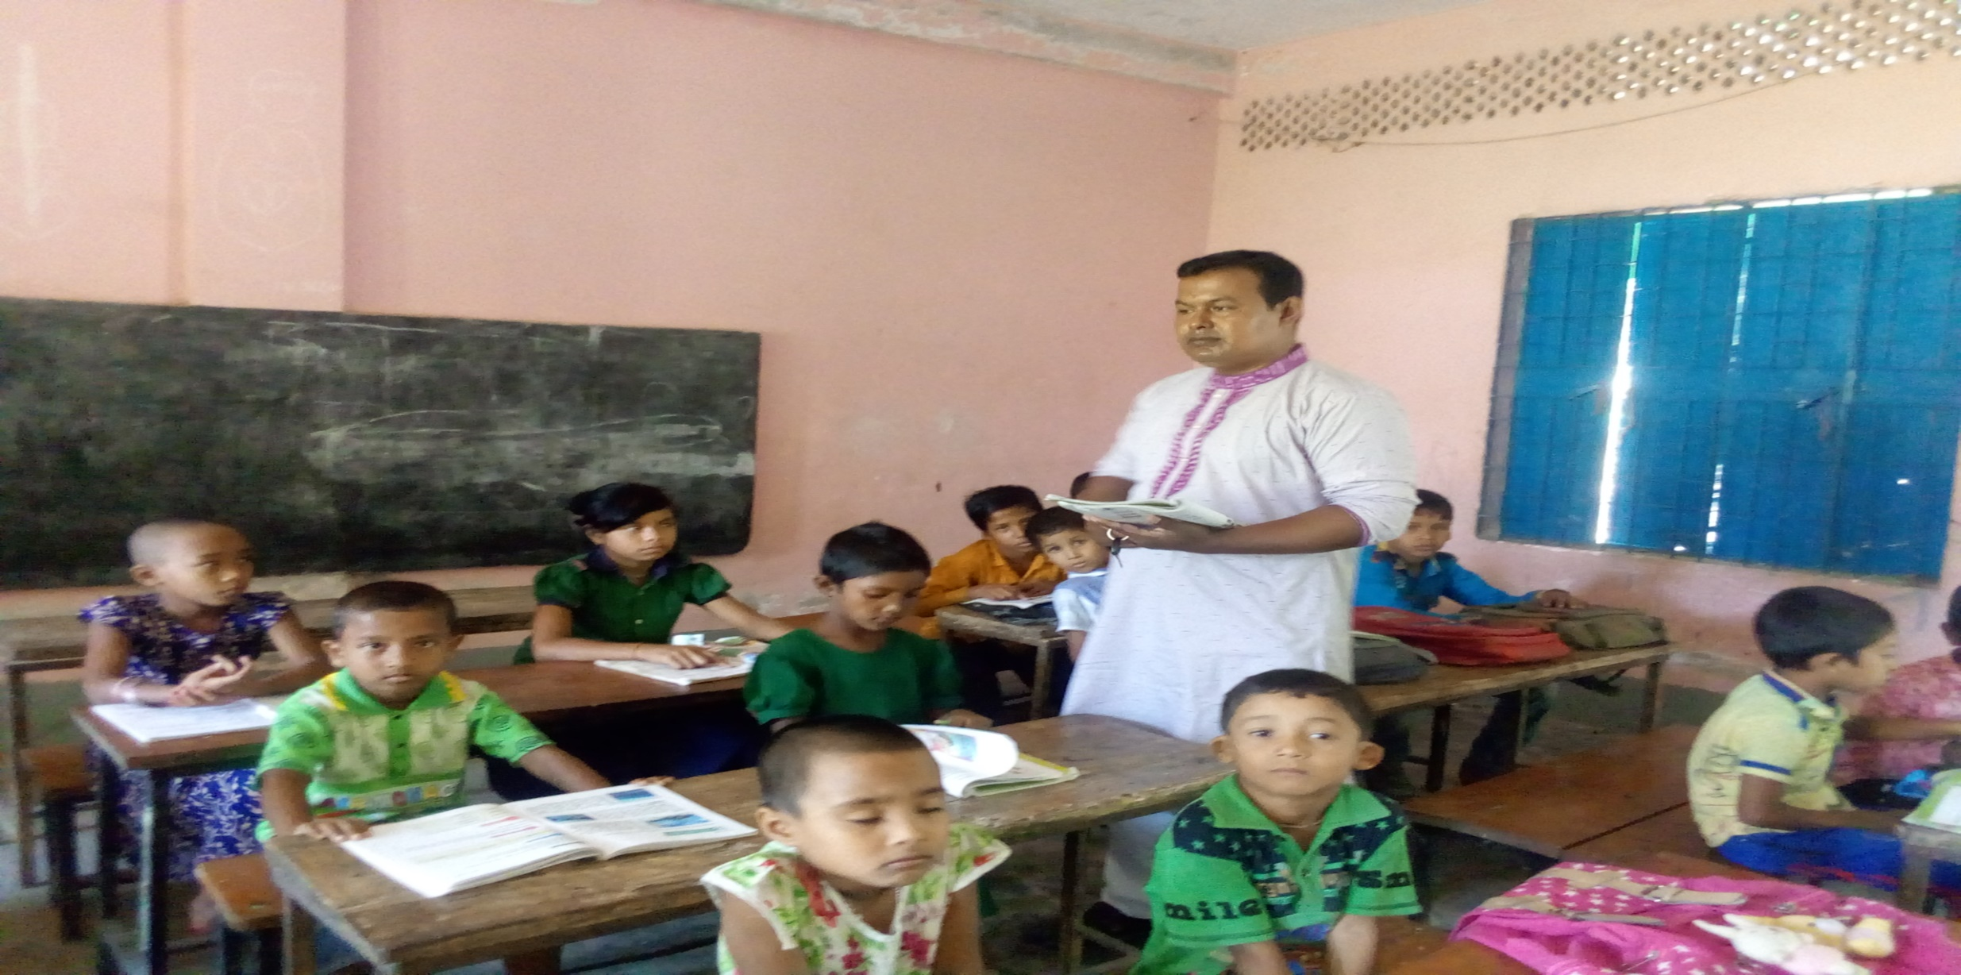
Good bye

