Slide 1

Welcome everybody to multimedia class.

Slide 2



Identity
Nurul Aziz
Assistant Teacher (English)
Krishnakumari City Corp.
Girls’ High School,
Nandankanan,Chittagong
Email : naziz13.na@gmail.com
Mobile : 01843773924
English For Today
Class : 9
Time : 45 Minutes
Date : 24/09/2019

Slide 3

Let’s watch a video

Slide 4
Our today’s lesson is….
The Statue of Liberty
Unit : 8, Lesson: 3
English For Today

Slide 5
Objectives
After the end of the lesson students will be able to
summarize the context
tell about the significance of of the Statue of Liberty
Complete a chart after listening
apply reading strategies
define and use content related vocabularies

Slide 6
Vocabulary Presentation
Centennial (Adj.)
Syn. centurial
Sculpture (Noun)
Syn. statue
Unveil (Verb)
Syn. reveal
Assemble (Verb)
Syn. join

Slide 7
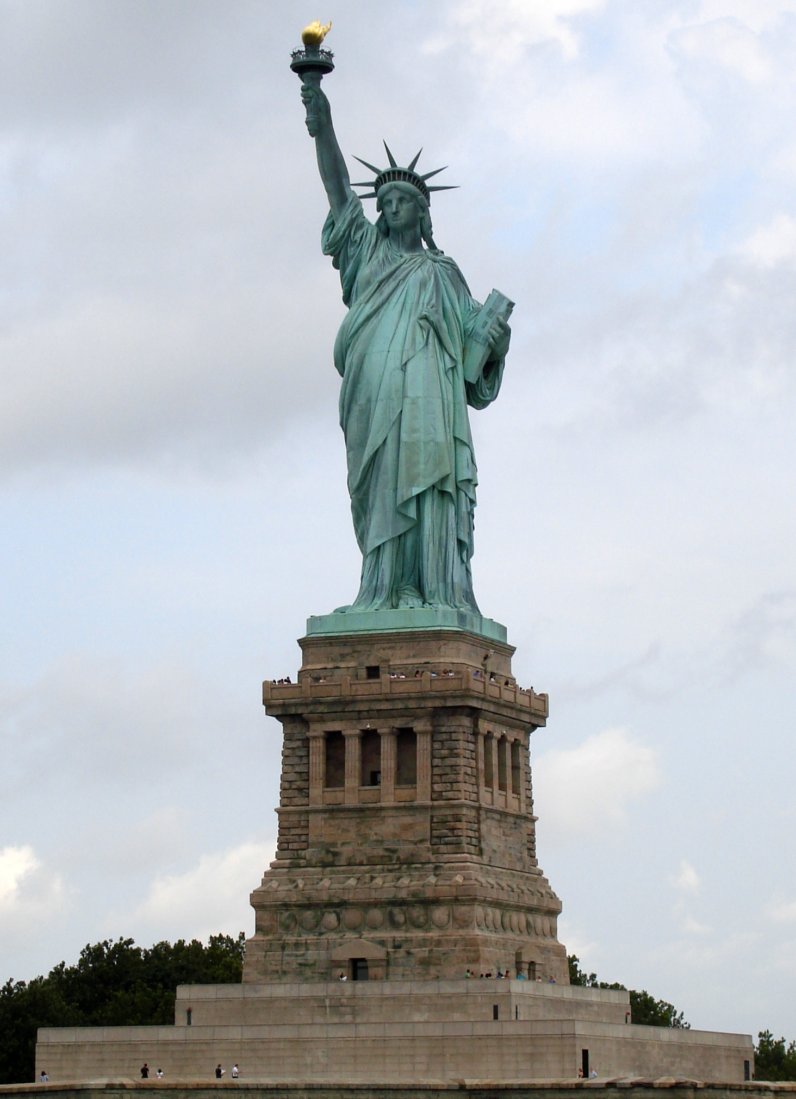
The Torch
Spiked Crown
The Tablet
Robe
Pedestal
The Statue of Liberty

Slide 8

Listen to the text and complete the chart. (Individual Work)
Statue of Liberty | Information
Situated
artist
Gift from
Reason for the gift
Presented of
Occasion
The statue symbolizes
Framework made of
Amount of copper used
weight
Year it was declared a UNESCO World Heritage Site
Notes:
The teacher use his own voice to make a listening passage.

Slide 9
Listen to the text and complete the chart. (Individual Work)
Statue of Liberty | Information
Situated | On the Harbour of New York
artist | Frederic Auguste Bartholdi
Gift from | The people of France
Reason for the gift | To commemorate the centennial of US Independence
Presented of | October 28, 1886
Occasion | The centennial of USA Independence
The statue symbolizes | Free from oppression and slavery
Framework made of | Steel and copper
Amount of copper used | 60,000 pounds
weight | 450,000 pounds
Year it was declared a UNESCO World Heritage Site | In 1984
Notes:
The teacher use his own voice to make a listening passage.

Slide 10
  1.Where is the Statue of Liberty situated?
2. Which country gave the statue as a gift?
3. When was the statue given?
4. What was the former name of the Liberty Island?
Individual Work
Answer the following questions.
Ans. The Statue of Liberty is situated On Liberty Island in the Harbour of New York.
Ans. France gave the statue to The USA.
Ans. The statue was given in 1886.
Ans. The former name of the Liberty Island was Bedloe’s Island
Notes:
Answers are given after each questions

Slide 11

‘Heritage’ is what we inherit from the past, live with them in the present and then pass on to
‘
The French Sculptor Frederic Auguste Bartholdi was assigned to design and complete a sculpture Liberty Enlightening the World within 1876, so that it could be a gift for the Americans on the occasion of the hundredth anniversary of the American Declaration of Independence. The statue was a joint venture between the U.S.A. and France.
The French people would build the statue and assemble it in the States, and the people of the USA were to build the pedestal for the statue.
Raising fund for the pedestal was completed in August 1885. The construction of the pedestal was finished in April 1886. In the meantime, France completed the Statue in July 1884. They sent it to New York on board the French war ship ‘Isere’ in 1885. While transporting the statue, it was split up into 350 pieces and packed in 214 crates.
H
Silent reading

Slide 12
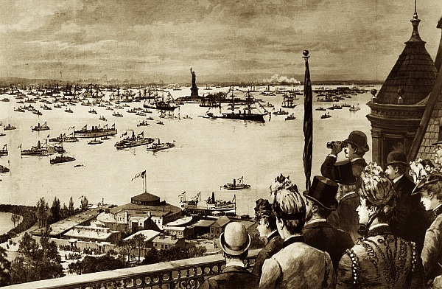
‘Heritage’ is what we inherit from the past, live with them in the present and then pass on to
It took four months to put the Statue together and place it on the pedestal. Thousands of people saw the unveiling ceremony of the Statue of Liberty on October 28th 1886. It was centennial gift ten years late.
H
Silent reading
People watching the opening ceremony of the Statue of Liberty

Slide 13
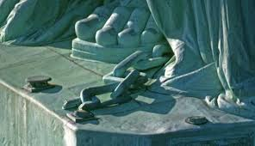
‘Heritage’ is what we inherit from the past, live with them in the present and then pass on to
The freedom that the statue stands for is not stationary. The broken chain wrapped around her feet, sticking out from the bottom of her robe, symbolizes her free forward movement, enlightening the world with her torch, free from oppression and slavery.
H
Silent reading
The broken chain wrapped around her feet

Slide 14
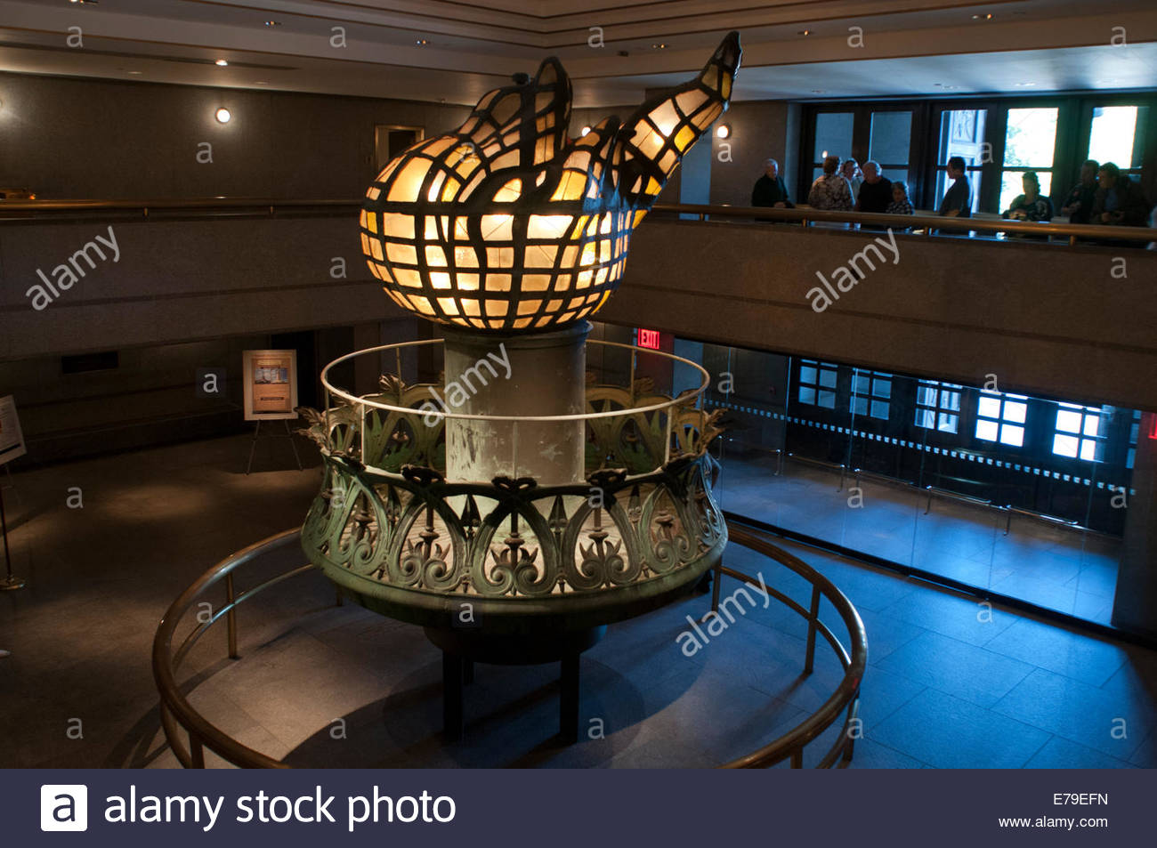
The statue’s original torch was the first part constructed in 1876. IT was replaced by a new copper torch covered in 24K gold leaf I 1984. The torch is lighted by flood light at night. The original torch is currently located in the lobby of the monument. Access to the torch has been closed since 1996.
H
Silent reading
The statue’s original torch

Slide 15
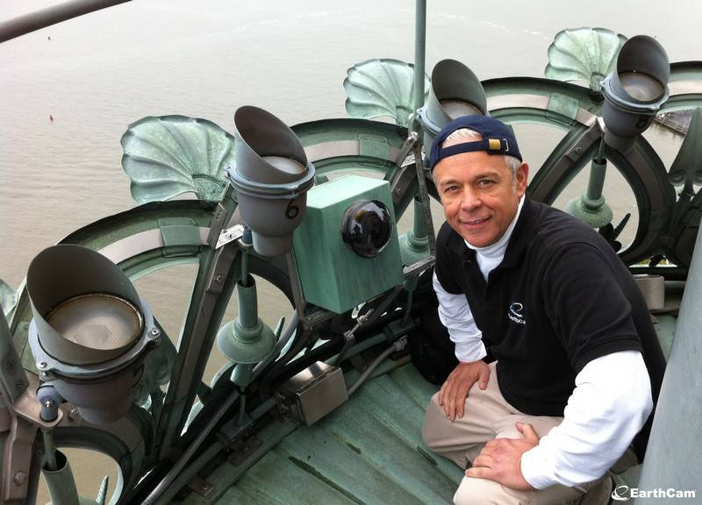
From October 28, 2011, on her 125th anniversary, the Statue of Liberty was also named “Liberty Enlightening the World Wide Web”. The credit goes to a series of new web cams placed around her torch. Several amazing views will be just a click of a mouse away.
H
Silent reading
Web cams

Slide 16
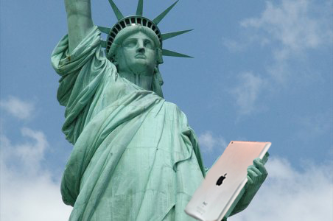
H
Silent reading
On clear days, three cameras provide unobstructed views of scenes far and near. Two cameras provide an ultra wide-angle interactive view of the famous golden torch. The remaining camera looks downwards towards the crown of The Statue of Liberty, her face and the tablet she is holding. So a person can have access to the web cam’s live feed of The Statue of Liberty from anywhere in world.

Slide 17
1.On what occasion did the French government give the Statue of Liberty to the USA?
When did she reach her destination?
How was she transported?
4.How has new technology made it possible for people to see the statue from anywhere they are?
5.What do you understand by the expression ‘enlightening the world’?
Group Work
Answer the following questions.
Notes:
Note. As the answers will vary here, teachers are requested to match the answer with peer work.

Slide 18
Prominent French artist Frederic Auguste Bartholdi was assigned---
a sculpture as a gift for the Americans. He designed a sculpture as a ---
of freedom of mankind. The copper was made in the form of the Roman
goddess Liberatas who would carry a torch and a --- of law. The
work was a joint venture. The French built the body and the USA built the --
. It is now located in the --- of New York and it is
now called ‘The Liberty Enlightening the World Wide Web’.
Evaluation
Fill in the gaps with appropriate words in the gaps.
to design
symbol
book
pedestal
harbour

Slide 19
Summarize the given text in not more than 90 words.
H
Om
e Wo
R
k

Slide 20

Thank you all for cooperation.

