Slide 1



Welcome

Slide 2
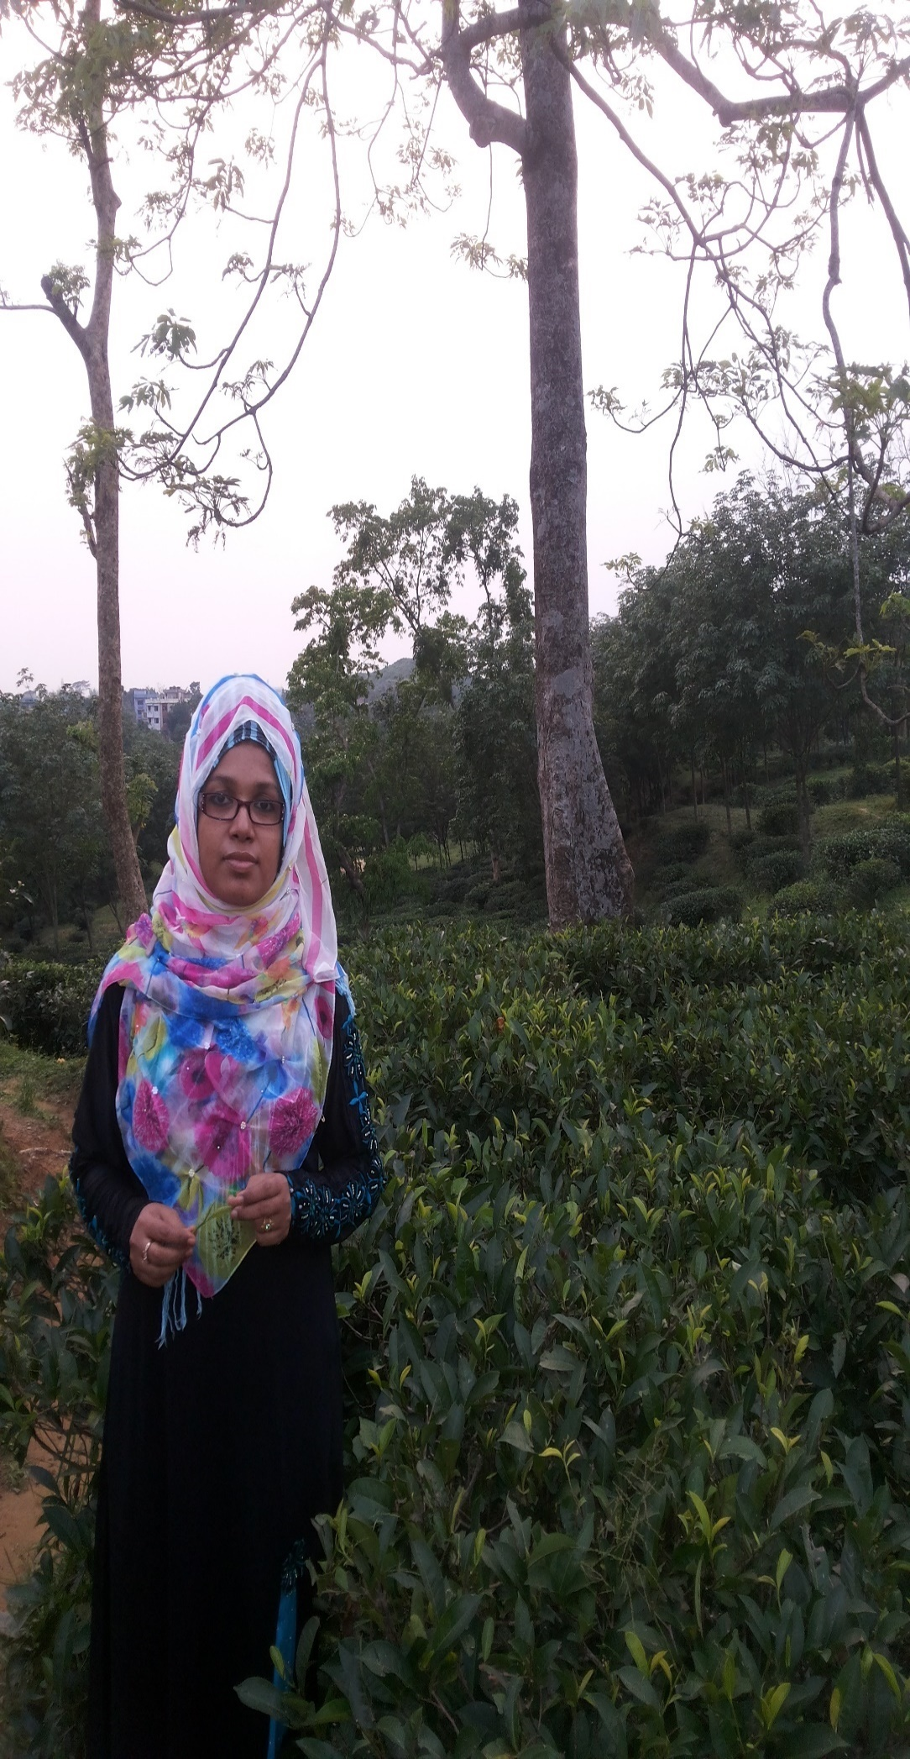
Introduction
Salma Begum Diba
Assistant Teacher
Purbo Charpata Government primary School
Raipur, Lashmipur

Slide 3
Class : Three
Subject : English
Section: B

Slide 4
Numbers
Unit: 18
Lessons:1,2

Slide 5
Learning outcomes
Speaking: 1.1.1 repeat words, phrases and sentences after the teacher with proper sounds and stress.
1.1.2 say words, phrases and sentences with proper sounds and stress.
Reading: 1.1.1 recognize and read cardinal numbers up to 100 (60-70)
Writing: 1.1.1 write cardinal numbers up to 100 in figures (60-70)

Slide 6
Warmer
Let’s learn the numbers…….
https://www.youtube.com/watch?v=ea5-SIe5l7M
https://www.youtube.com/watch?v=ea5-SIe5l7M

Slide 7
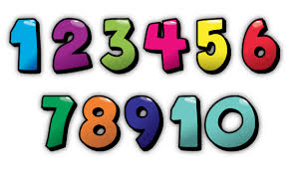
Look at the box below. What can you see? What can we call them?

Slide 8
So, today our lesson is
NUMBERS

Slide 9
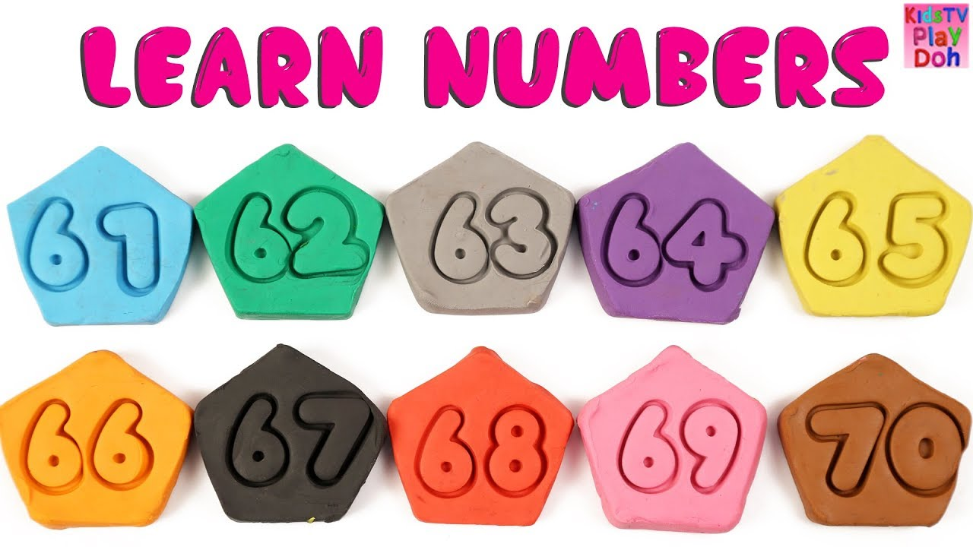

Slide 10

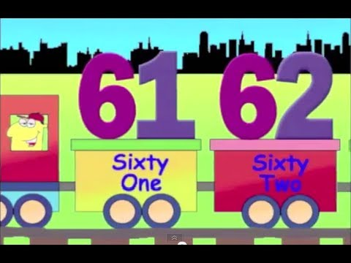

Slide 11
Open your English book

Slide 12
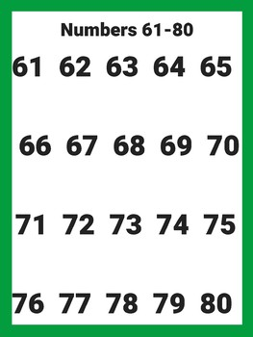

Slide 13




Slide 14
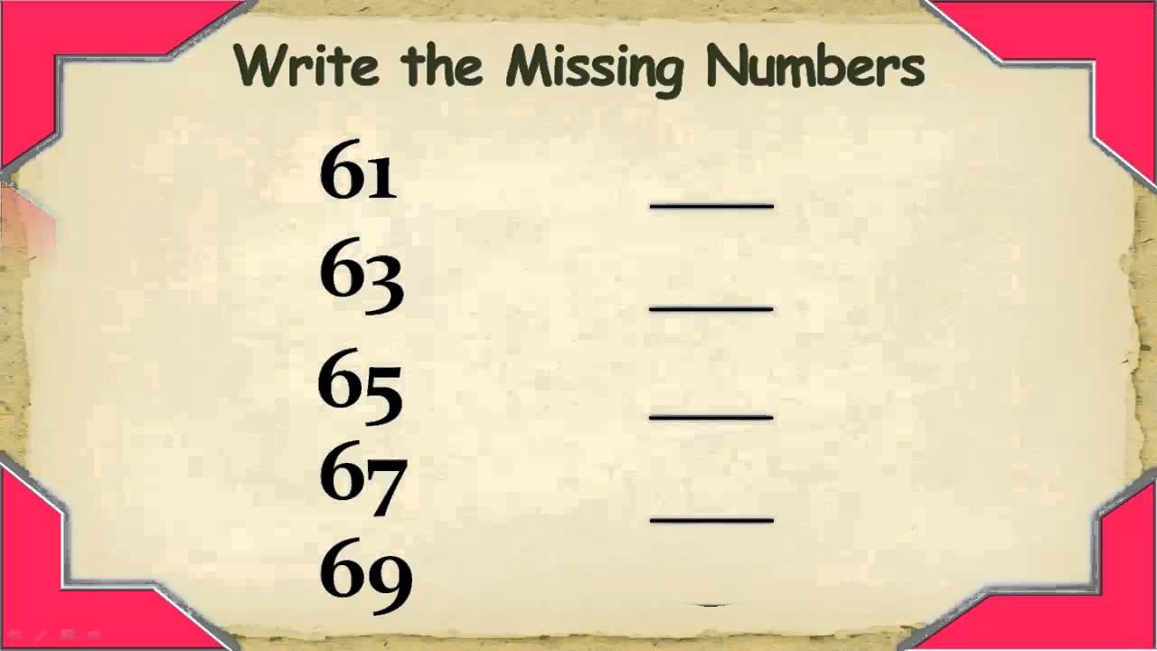

Slide 15

Goodbye

