Slide 1

ww
welcome

Slide 2
TEACHER IDENTY
Md.Rashidul Islam
Head teacher
Nalukabari Govt. primary school.
Badalgachi,Naogaon.

Slide 3
Subject : English
Class:One
Time : 40 Minitues.
Unite:22
Lesson:1-3

Slide 4
Learning outcomes
Students will be able to:
1.1.1 Listening : become familior with english sounds by listening to common english words .
1.1.1 Speaking : repeat after the teacher words and phrase.
1.1.2 say simple words and phrases .

Slide 5
Now we will singing a alphabet song a,b,c,d…..
Next time sing along with me

Slide 6
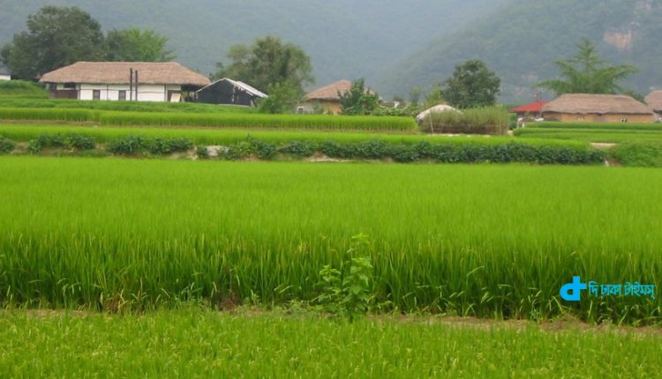
What is the name of this picture?
It’s a village

Slide 7
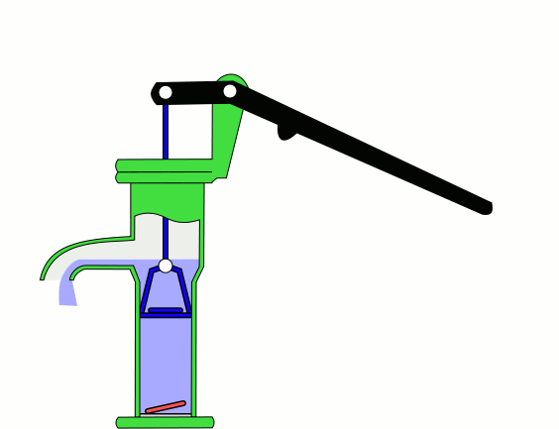
What is the name of this picture
Tubewell

Slide 8
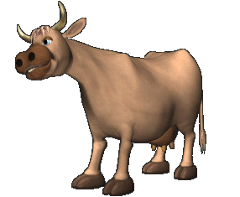
What is the name of this picture
Cow

Slide 9
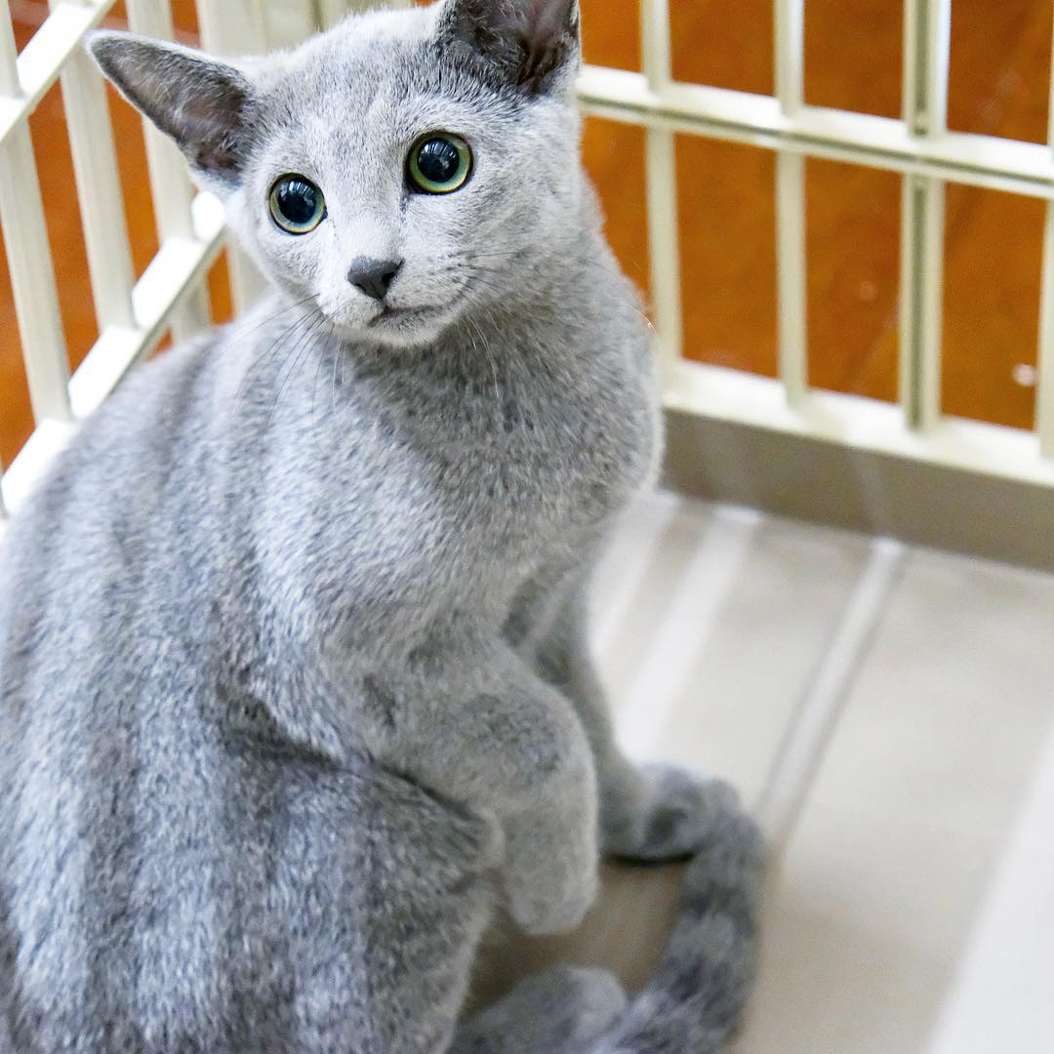
What is the name of this picture
Kitten

Slide 10
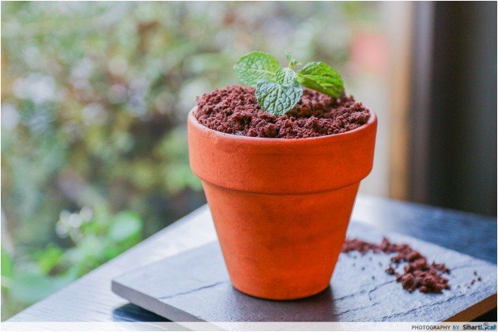
What is the name of this picture
Tub

Slide 11
Home work
Think and say the Name of things outside your house .

Slide 12

Thanks to all

